Slide 1
Strategies for the Design of Writing Assessments:
Ensuring Construct Validity and Test Integrity
Dr Rose Clesham
BILC: September 3rd 2025

Slide 2
What are the Challenges?
Access to open Access AI tools such as Chat GPT, Co-Pilot, allied to proliferation of Social media channels can pose threats to maintaining Assessment and Test Integrity
These technologies offer limitless language learning and practice opportunities for test takers
However, they may invalidate the true and accurate measurement test takers language proficiency
What are the most valuable writing skills for the 21st century?
Are there specific problems/issues in the NATO context?
Specifically for NATO?
In terms of size and scale, what are the options for Digital assessments?
How can Paper and Computer-based tests be equally comparable, valid and reliable?

Slide 3

Item types and Skill Attributions
Section | Question type | Skills scored (updated test)
 |  | Reading | Listening | Speaking | Writing
Part 1: Speaking & Writing | Read Aloud | ✔ |  | ✔
 | Repeat Sentence |  | ✔ | ✔
 | Describe Image |  |  | ✔
 | Retell Lecture |  | ✔ | ✔
 | Answer Short Question |  | ✔ | ✔
 | Summarize Group Discussion (new) |  | ✔ | ✔
 | Respond to a Situation (new) |  |  | ✔
 | Summarize Written Text | ✔ |  |  | ✔
 | Write Essay |  |  |  | ✔
Part 2: Reading | Fill in the Blanks (Dropdown) | ✔ |  |  | ✔
 | Multiple Choice, Multiple Answers | ✔
 | Reorder Paragraph | ✔
 | Fill in the Blanks (Drag and Drop) | ✔
 | Multiple Choice, Single Answer | ✔
Part 3: Listening | Summarize Spoken Text |  | ✔ |  | ✔
 | Multiple Choice, Multiple Answers |  | ✔
 | Fill in the Blanks (Type In) |  | ✔ |  | ✔
 | Highlight Correct Summary | ✔ | ✔
 | Multiple Choice, Single Answer |  | ✔
 | Select Missing Word |  | ✔
 | Highlight Incorrect Words | ✔ | ✔
 | Write from Dictation |  | ✔ |  | ✔

Slide 4
Four Writing Items:
 | Item type | Assessed Skill
1 | Write Essay | Single Skill Writing Only
2 | Summarize written text | Single Skill Writing Only
3 | Summarize spoken text | Integrated Skill Writing and Listening
4 | Write from dictation | Integrated Skill Writing and Listening

Slide 5
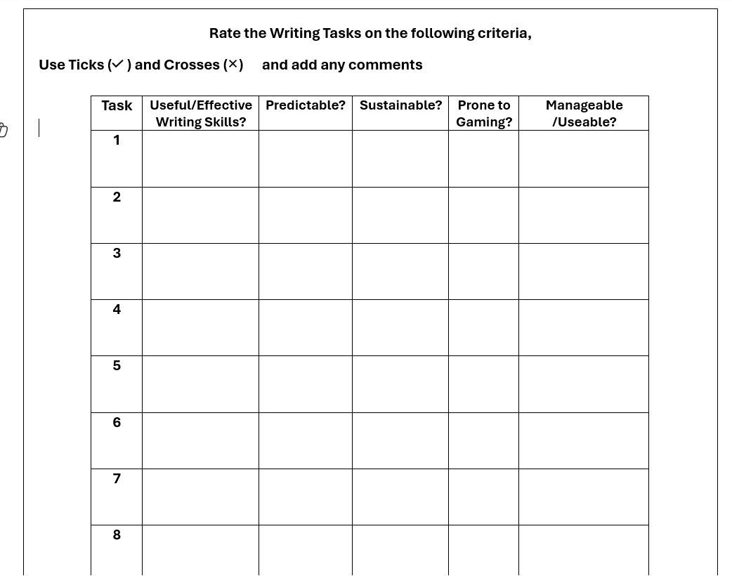

Slide 6
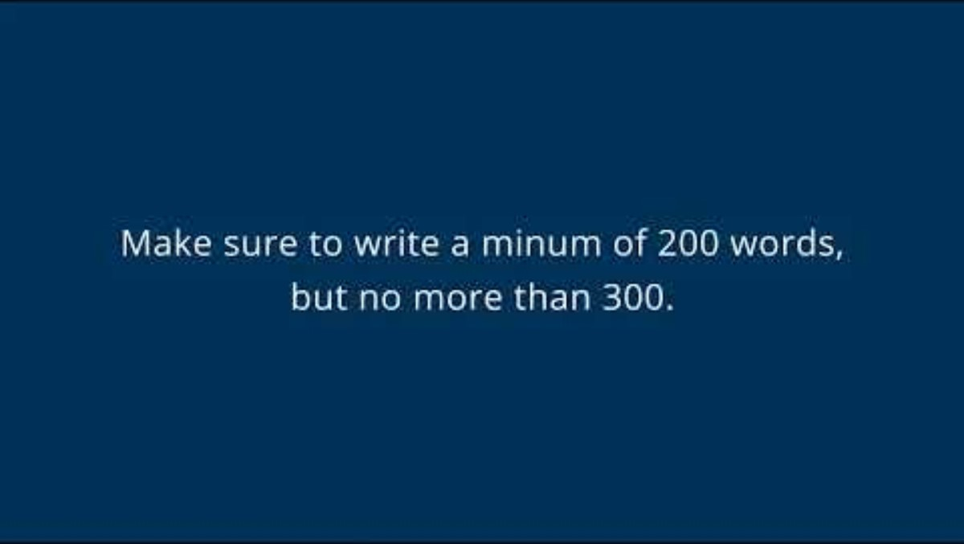
Write Essay (Writing)
TASK 1
Test takers write a 200-300 word essay in response to a prompt.
Test takers have 20 minutes to answer.
Scored on form, content, development/structure/coherence, grammar, linguistic range, vocabulary, and spelling.
This item type is designed to assess test takers' ability to:
  synthesise information from a written text
  connect their personal experiences or express their opinions in writing
  support an opinion with details, examples and explanations
  organize sentences and paragraphs in a logical way
  develop complex ideas within a complete essay
  use words and phrases appropriate to the context
  use correct grammar, spelling, mechanics
There is one of these items in the test.
Notes:
Show website video
Explain how item works
Explain what skills we are trying to assess with the item
Show all items for this type and explain range
ACTIVITY – What skills in this item are useful in your field? Write some examples on the form.
DISCUSSION – Common ground across fields, unique requirements
Play exemplars top down

Slide 7
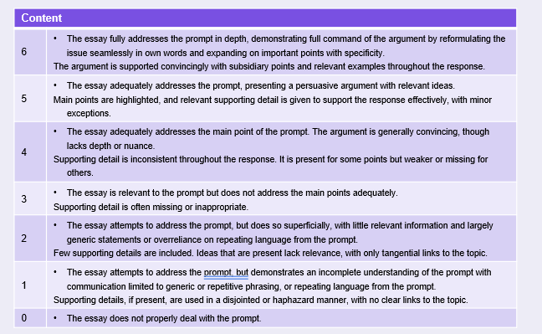

Human and AI scoring
Traits scored by Engine trained AI systems
Form
Grammar
Vocabulary
Spelling
Also

Slide 8
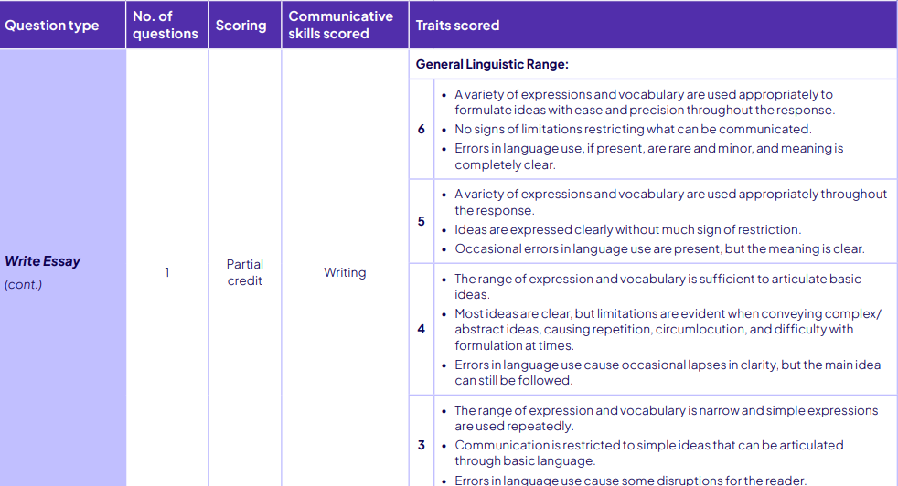
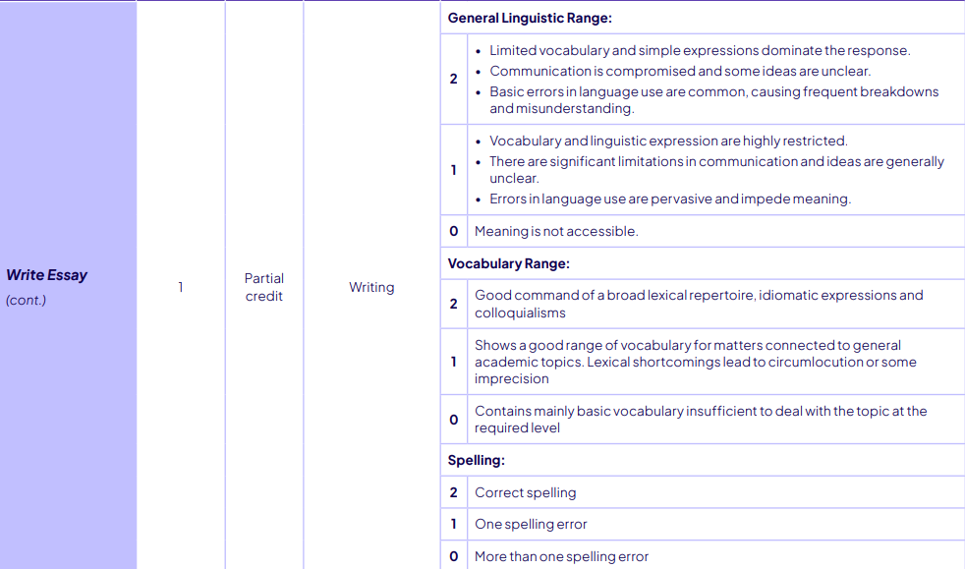

Slide 9
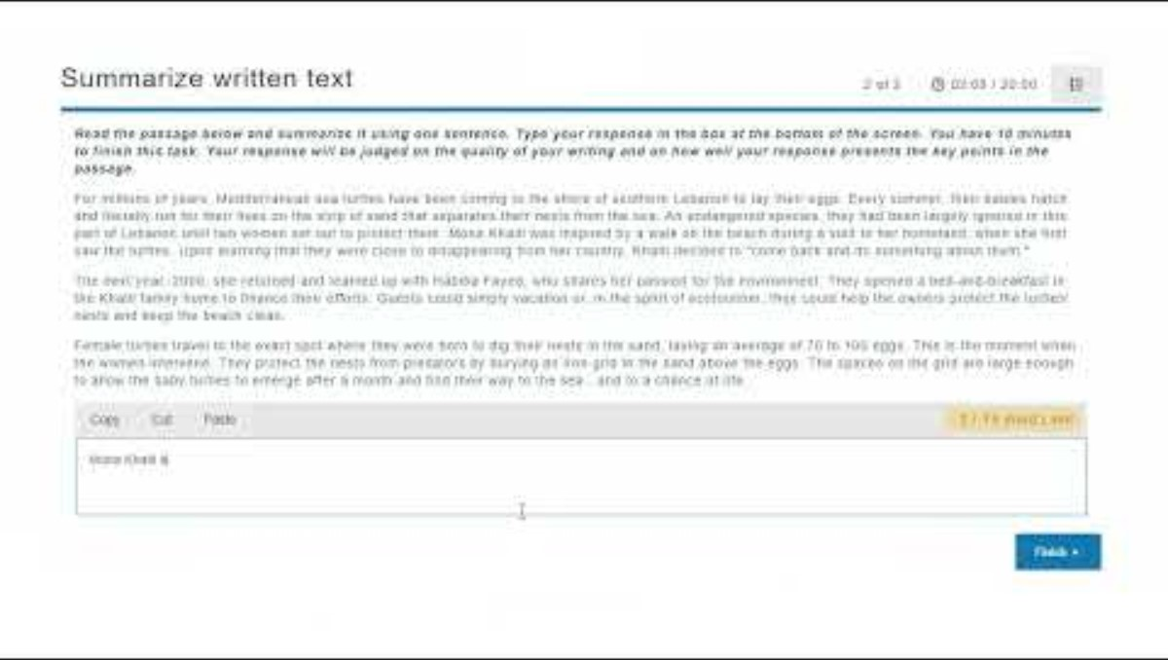
Summarize Written Text (Reading and Writing)
TASK 2
Test takers read a passage and provide a one-sentence summary of the main message.
Passages can include excerpts from news articles, journals, editorials, magazines, textbooks, essays, and other written media.
Passages are up to 300 words in length.
Test takers have up to 10 minutes to answer.
Scored on form, content, grammar, and vocabulary.
This item type is designed to assess test takers' ability to comprehend written information, identify the main points of the text, and communicate the meaning clearly and concisely in writing, using correct grammar and appropriate vocabulary.
There is one of these items in the test.
Notes:
Show website video
Explain how item works
Explain what skills we are trying to assess with the item
Show all items for this type and explain range
ACTIVITY – What skills in this item are useful in your field? Write some examples on the form.
DISCUSSION – Common ground across fields, unique requirements
Play exemplars top down

Slide 10
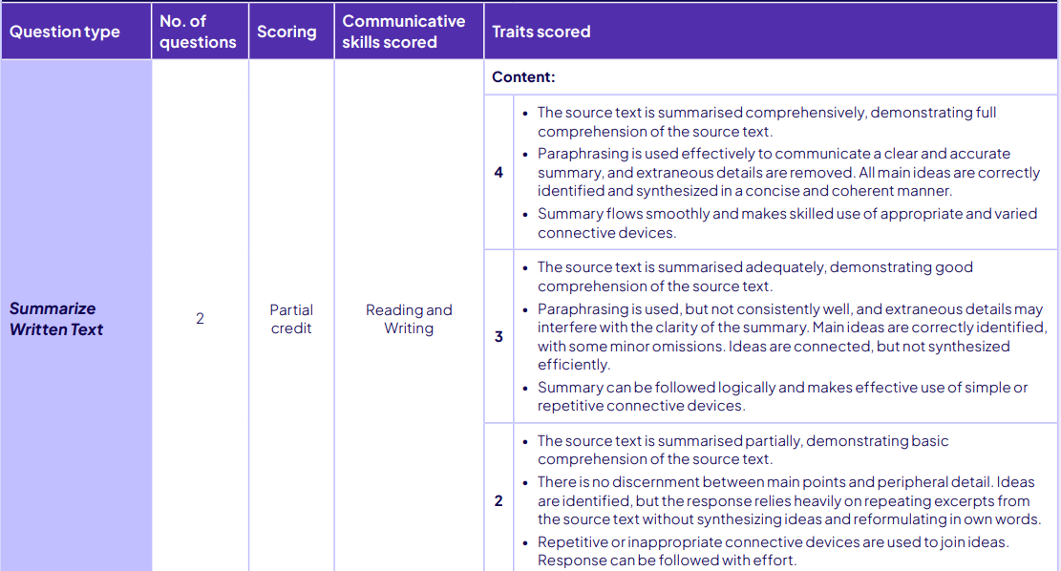
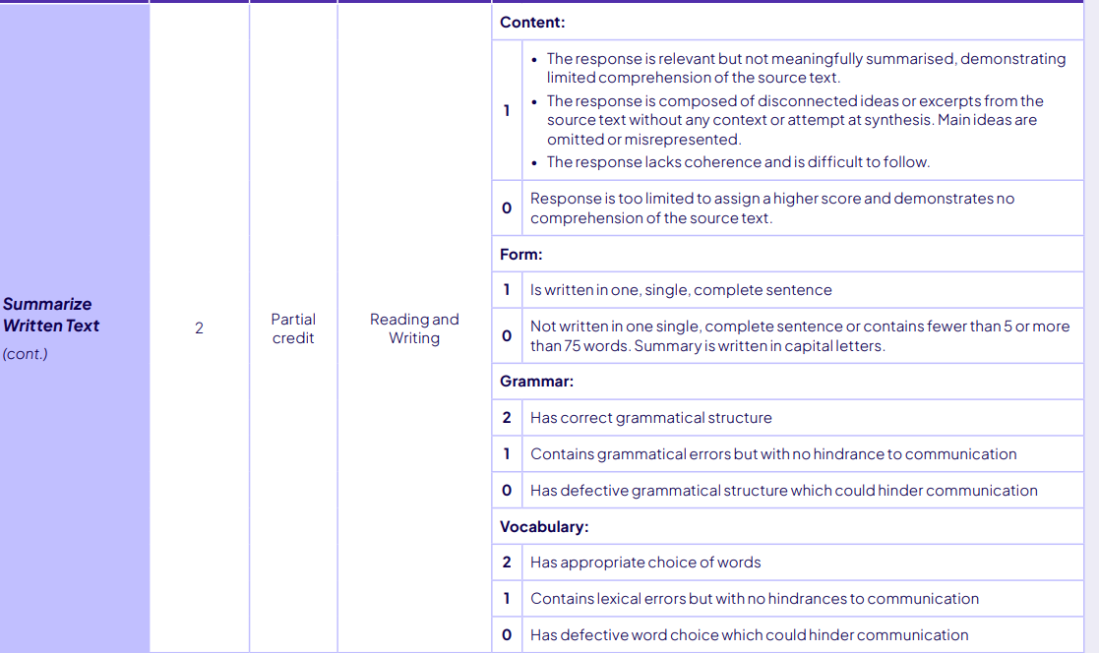

Slide 11

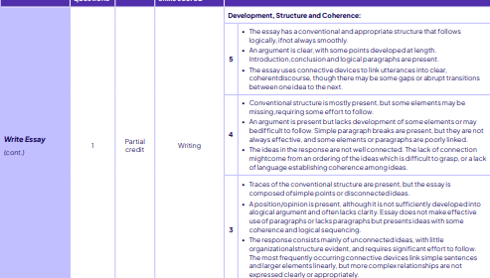

Slide 12
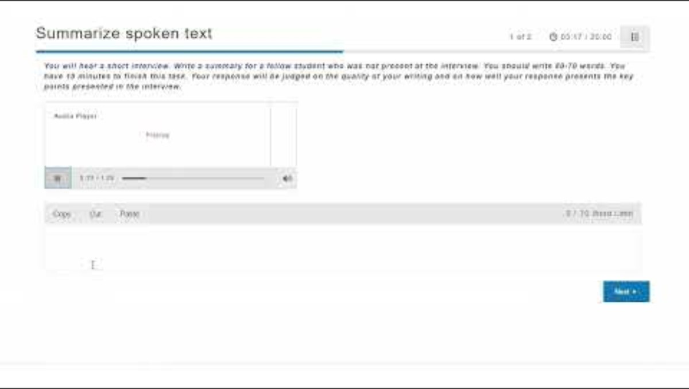
Summarize Spoken Text (Listening and Writing)
TASK 3
Test takers listen to an audio recording and write a 50-70 word summary.
Audio recordings are 60-90 seconds in duration.
Scored on form, content, grammar, and vocabulary, and spelling.
This item type is designed to assess test takers' ability to understand spoken information and communicate the gist of what was said clearly and concisely in writing, using correct grammar and appropriate vocabulary.
There is one of these items in the test.
Notes:
Show website video
Explain how item works
Explain what skills we are trying to assess with the item
Show all items for this type and explain range
ACTIVITY – What skills in this item are useful in your field? Write some examples on the form.
DISCUSSION – Common ground across fields, unique requirements
Play exemplars top down

Slide 13
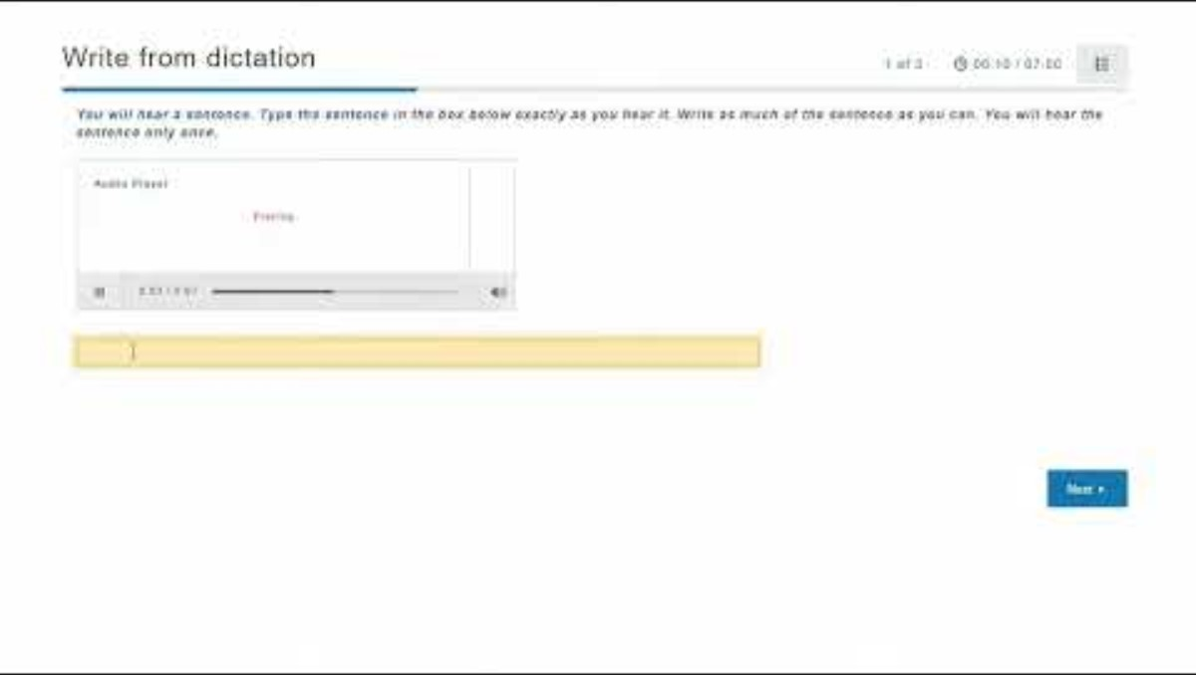
Dictation (Listening and Writing)
TASK 4
Test takers hear an audio recording of a sentence. They type the entire sentence exactly as they hear it.
The audio recording is only played once.
Audio recordings can be 3-5 seconds in duration.
This item type is designed to assess test takers' ability to understand spoken communication and reproduce the exact words in written text, with correct spelling.
There are three of these items in the test.
Notes:
Show website video
Explain how item works
Explain what skills we are trying to assess with the item
Show all items for this type and explain range
ACTIVITY – What skills in this item are useful in your field? Write some examples on the form.
DISCUSSION – Common ground across fields, unique requirements
Play exemplars top down

Slide 14
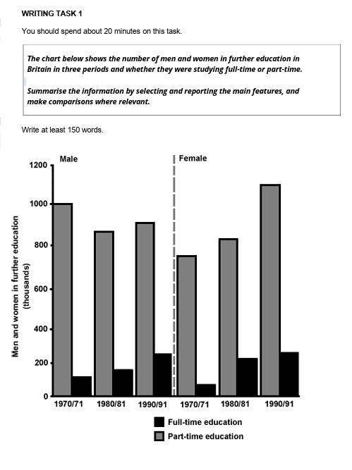
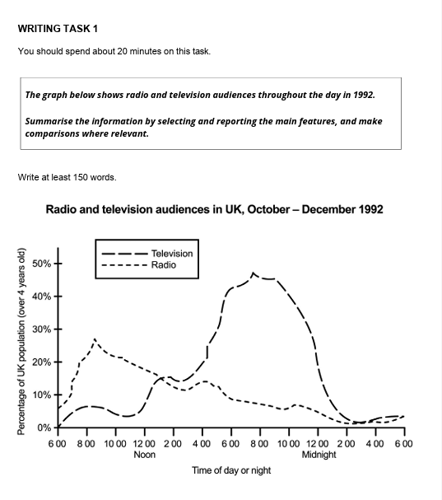
TASK 5
IELTS

Slide 15
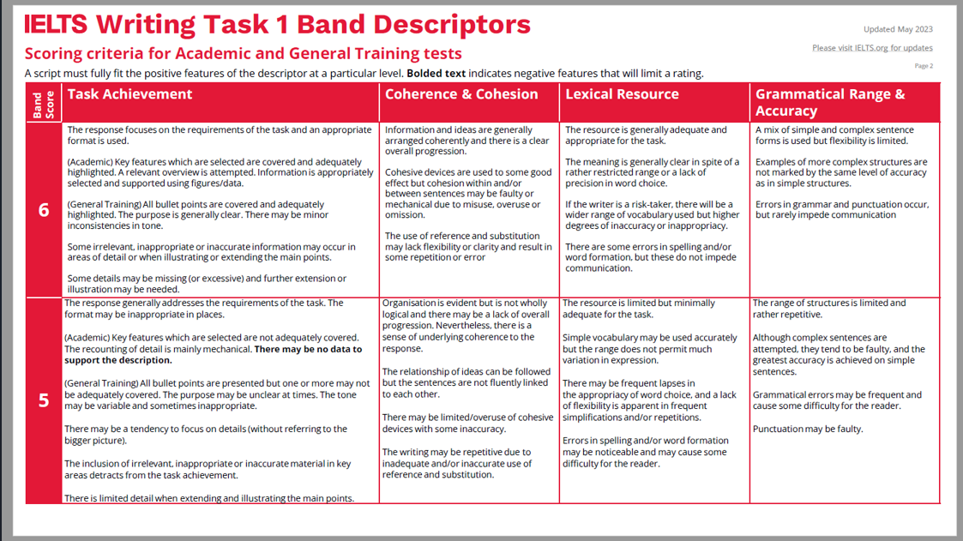

Slide 16
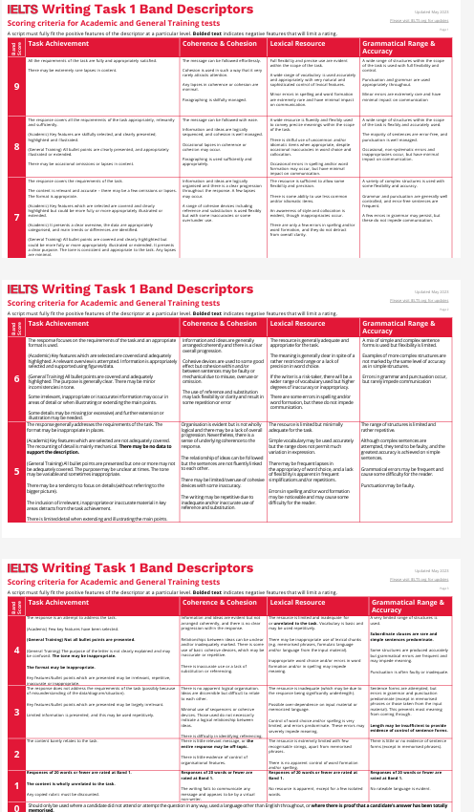

Slide 17
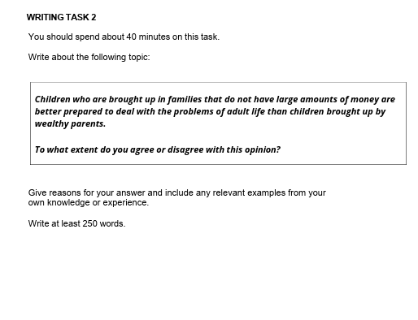
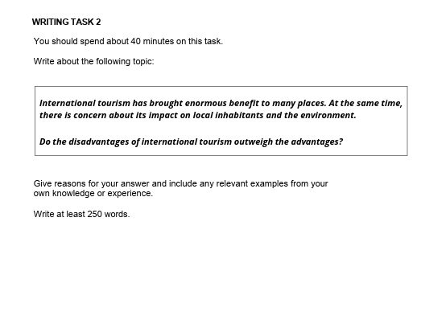
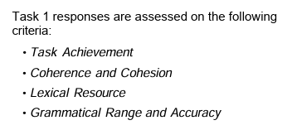
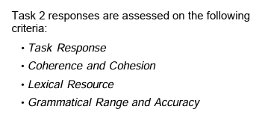
TASK 6

Slide 18
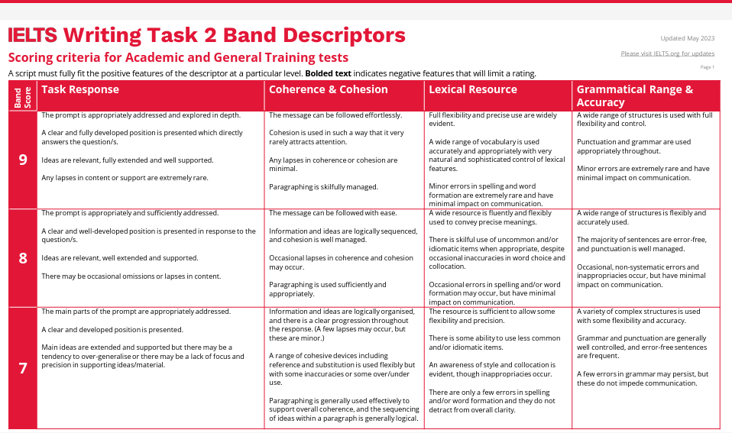

Slide 19
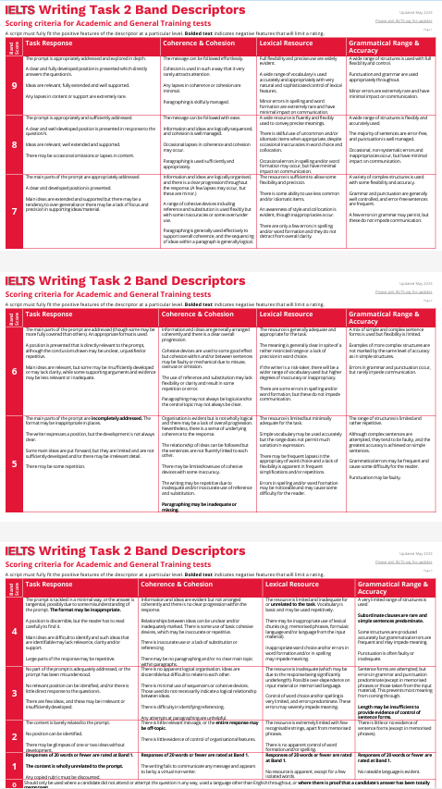

Slide 20
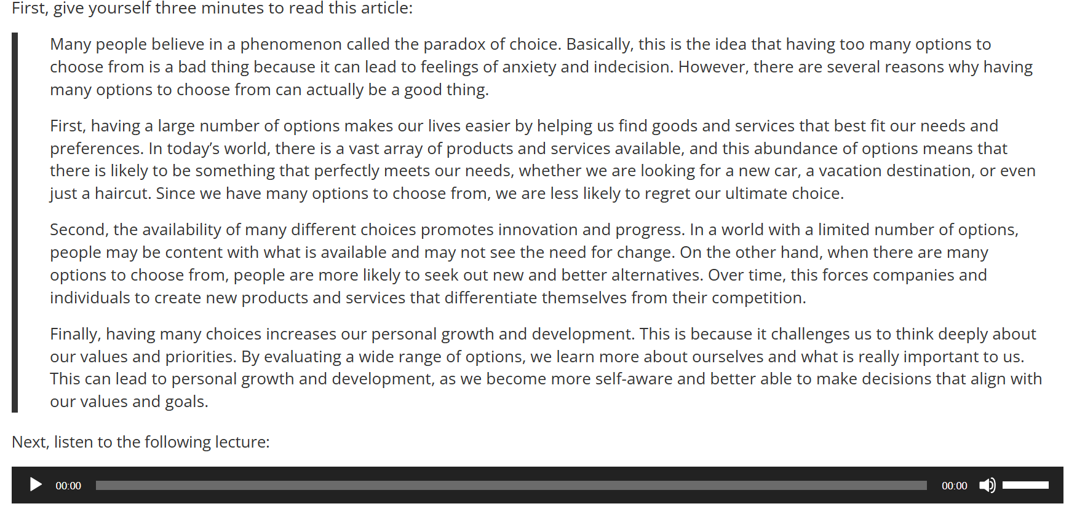
TASK 7
You have twenty minutes to answer the following question. You can refer to the article as you write your essay. You may not listen to the lecture again.
Summarize the points made in the lecture, being sure to explain how they oppose specific points made in the reading passage.

Slide 21
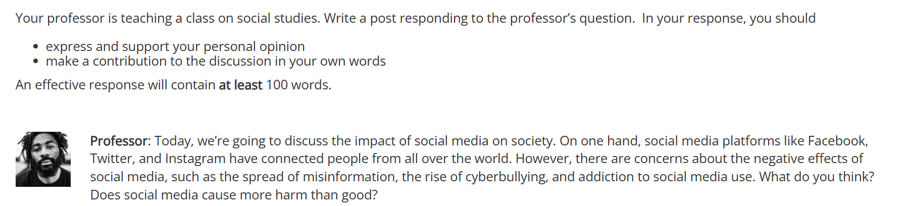
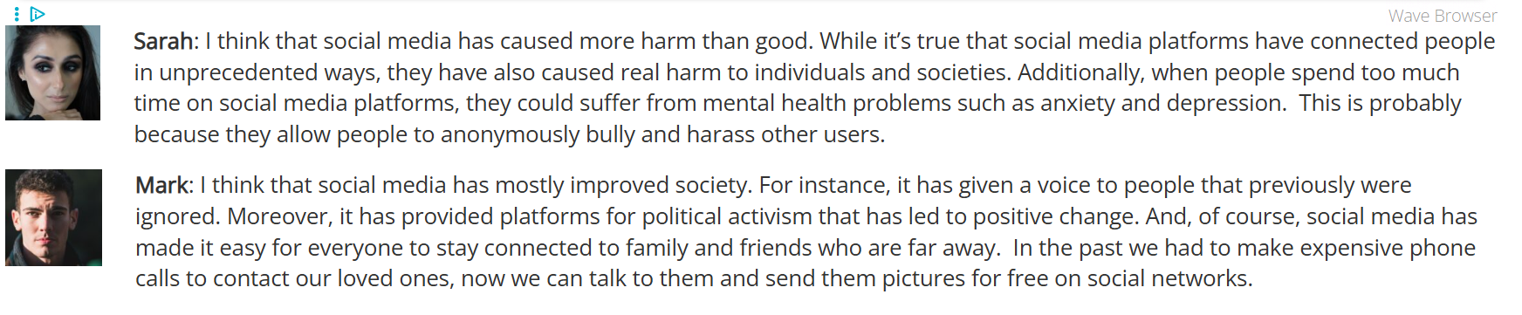
TASK 8

Slide 22
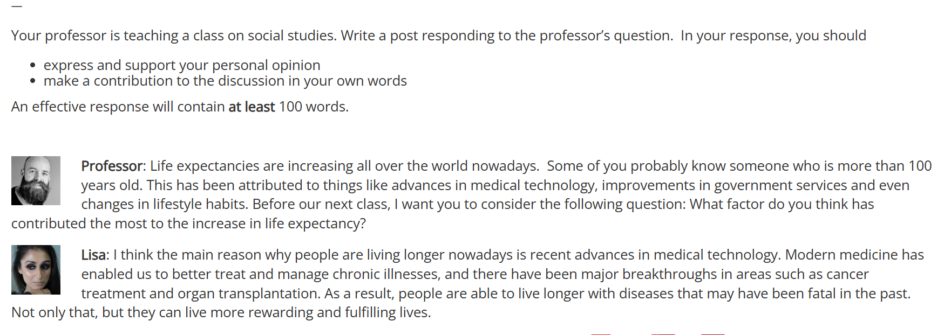
TASK 8

Slide 23
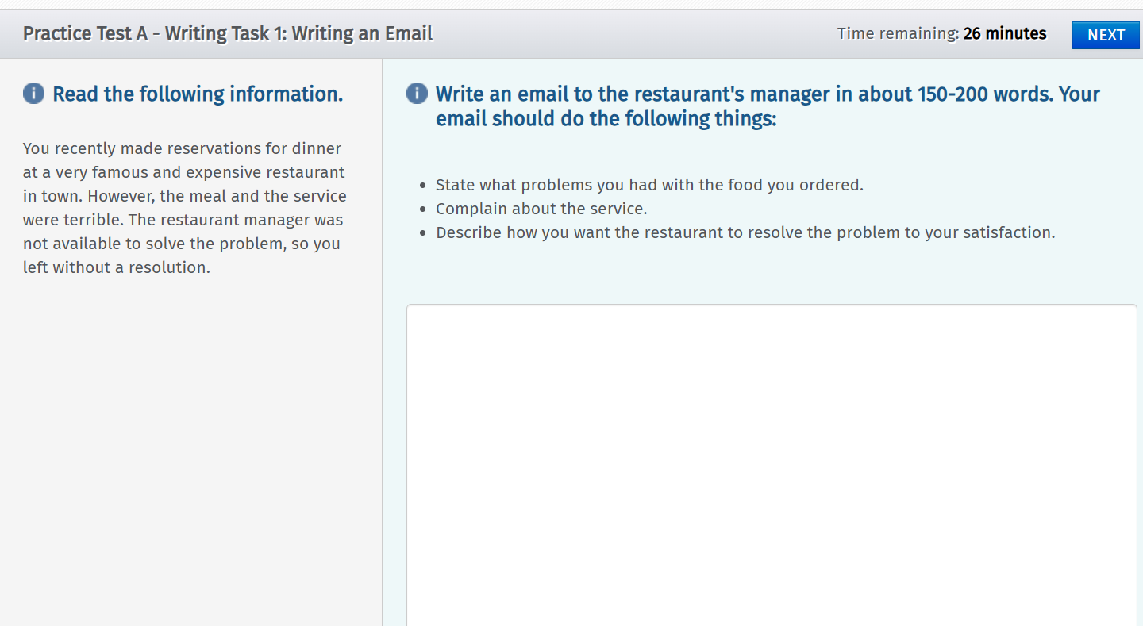
TASK 9

Slide 24
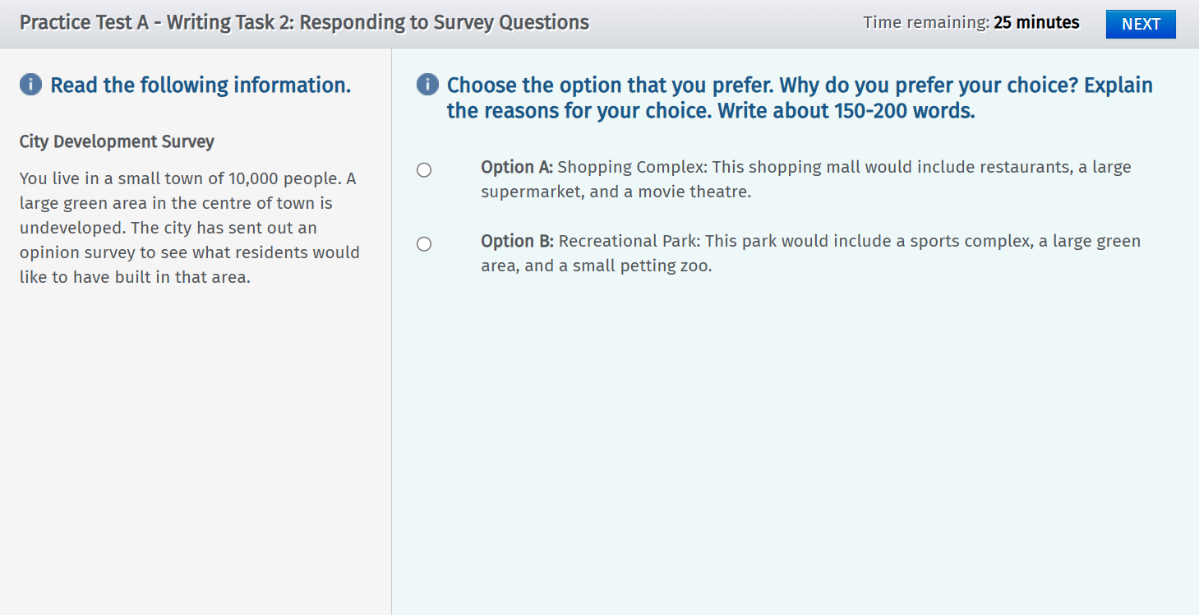
TASK 10

Slide 25
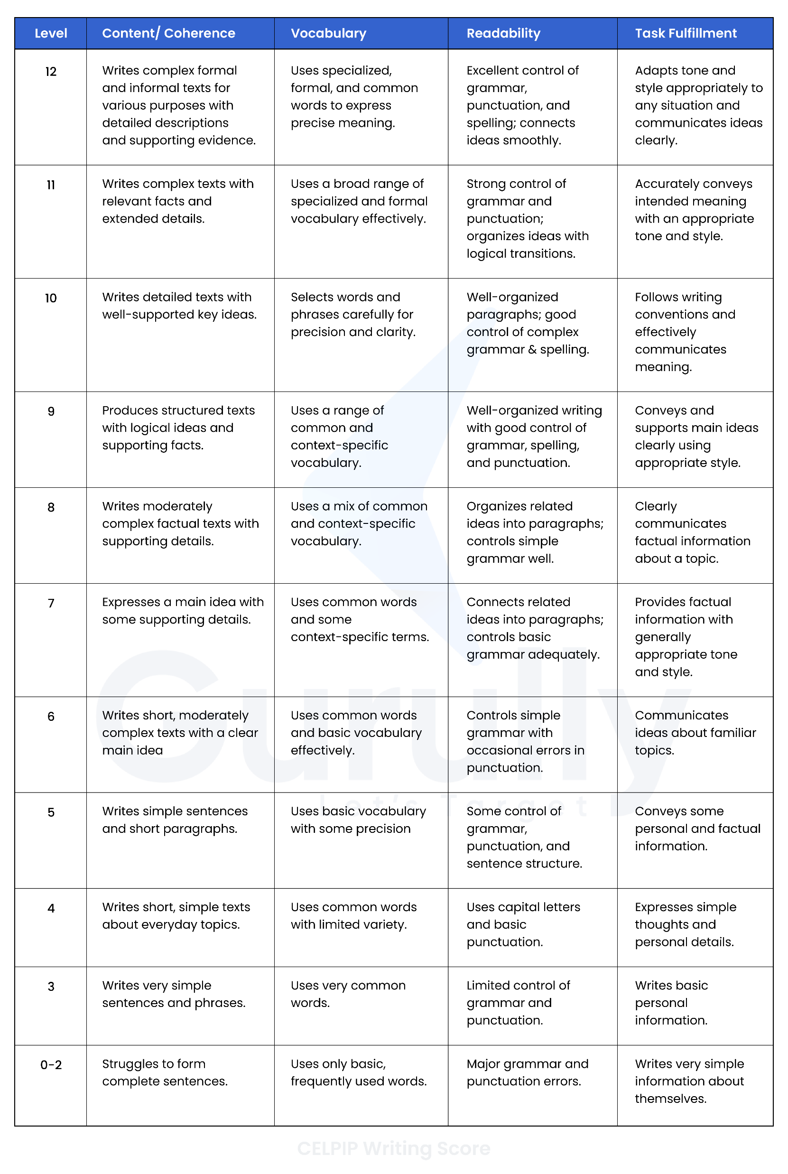

Slide 26
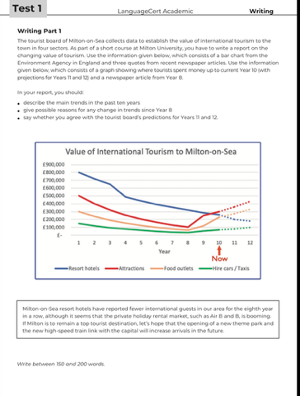
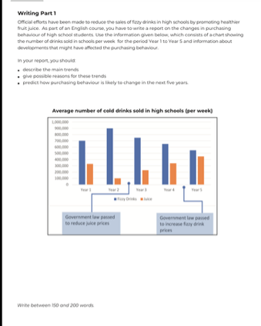
TASK 11

Slide 27
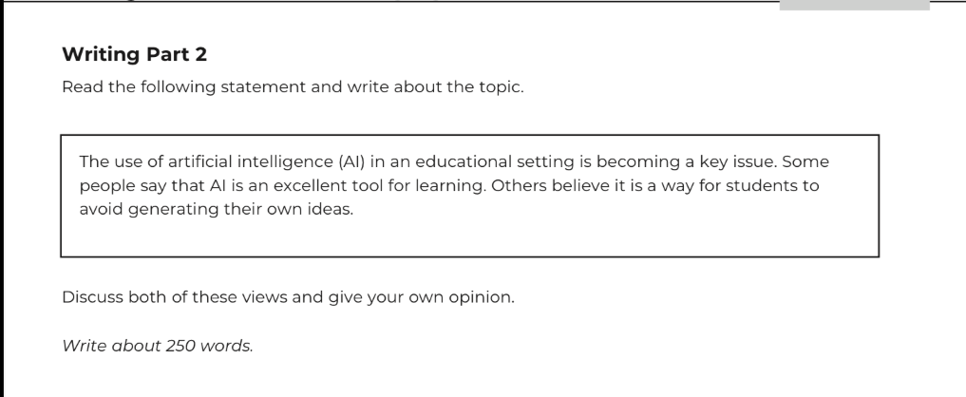
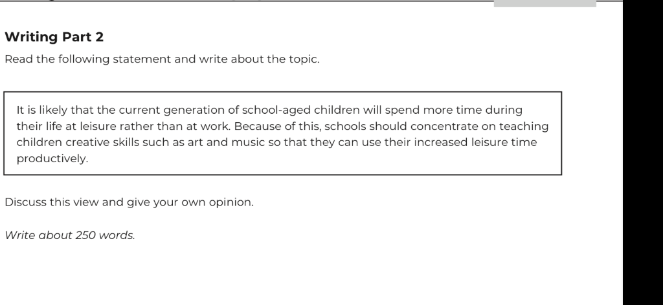
TASK 12

Slide 28
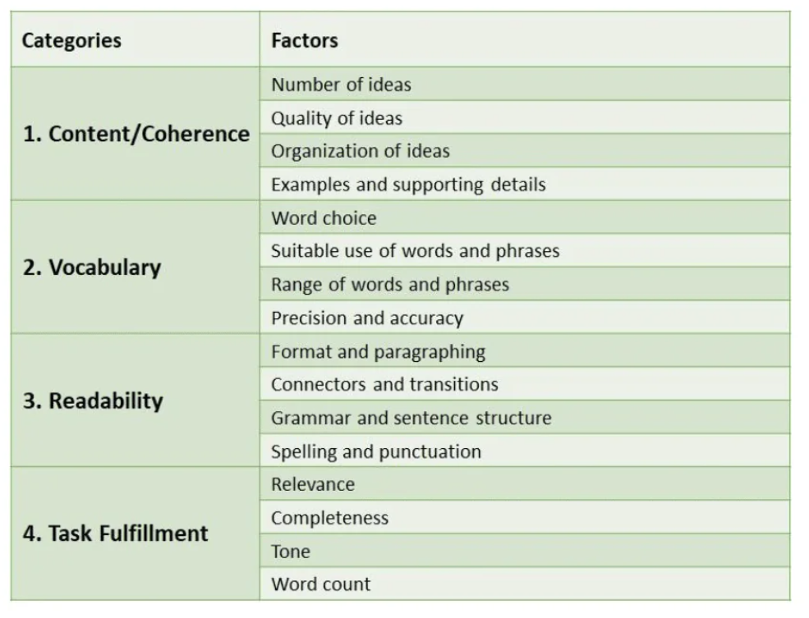
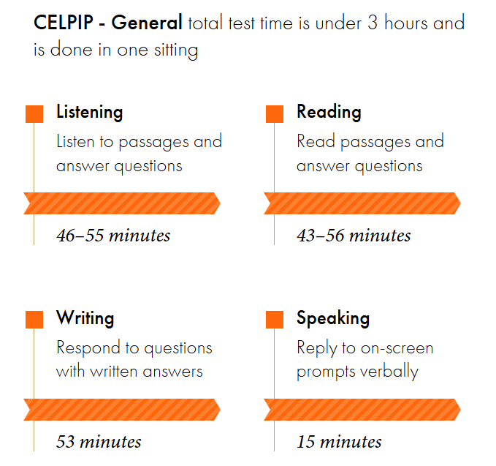
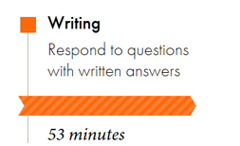

Slide 29
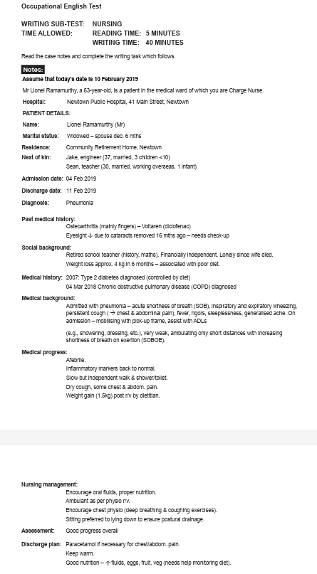
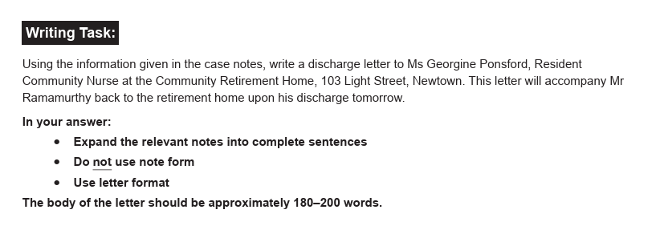
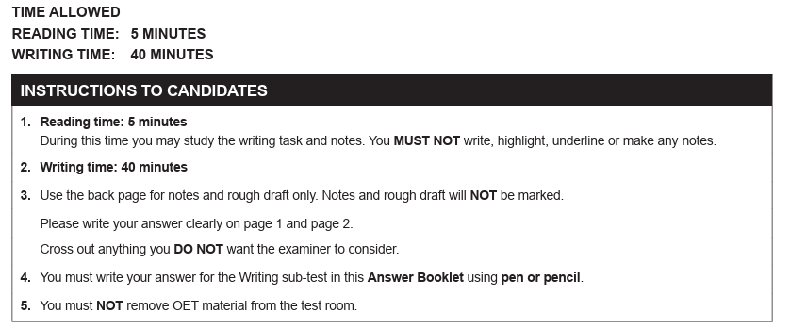
TASK 13

Slide 30
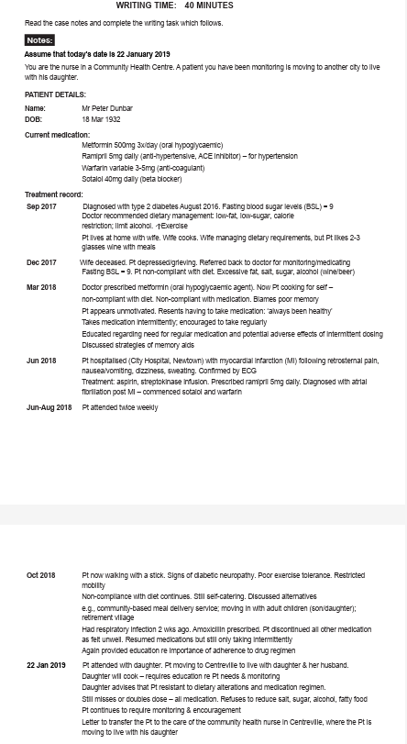

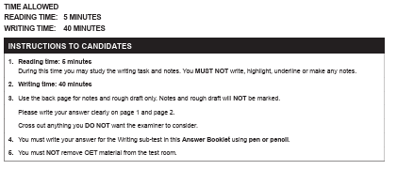
TASK 13

Slide 31
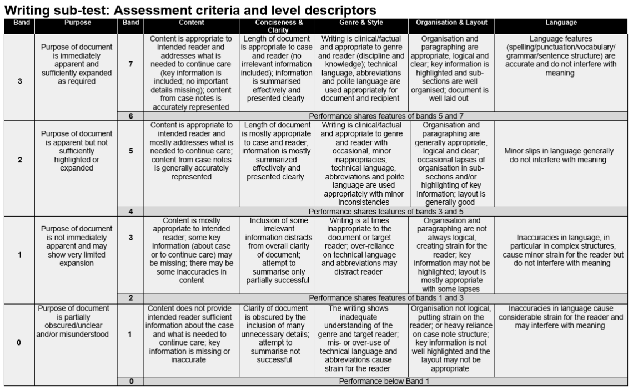

Slide 32
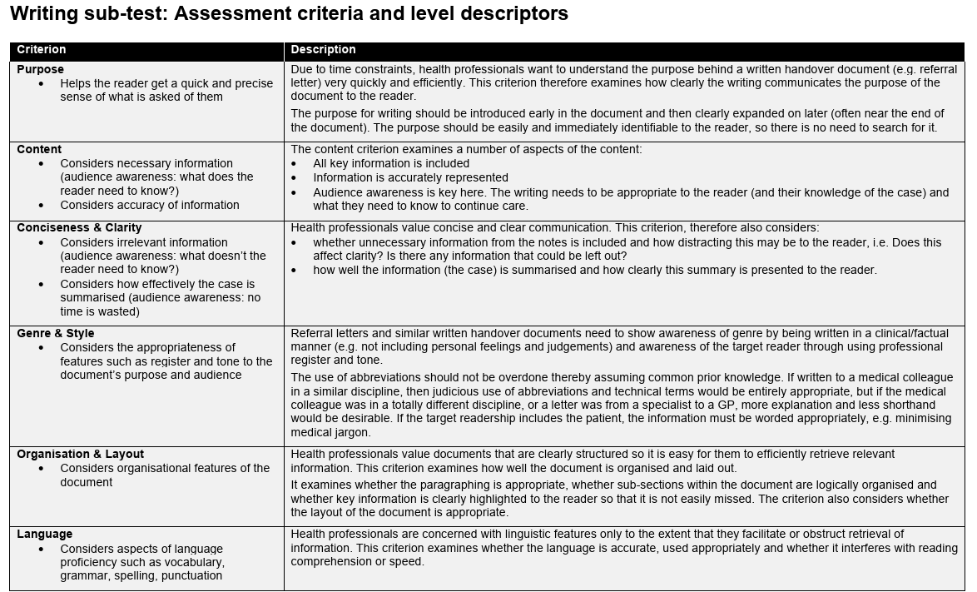

Slide 33
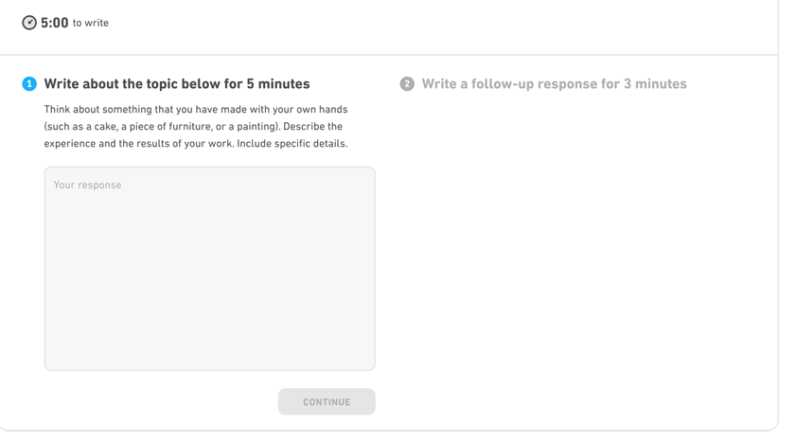
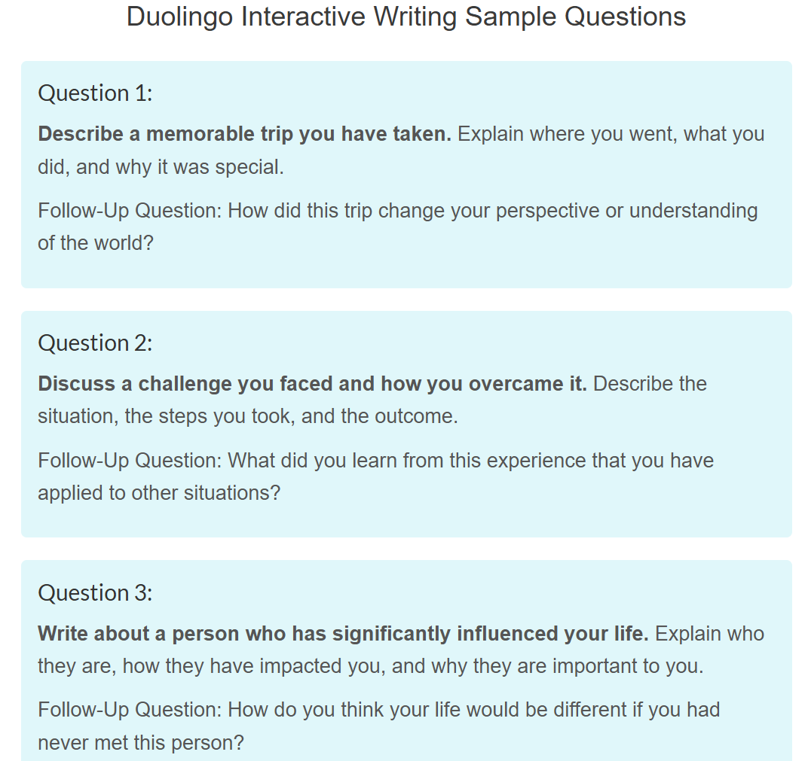
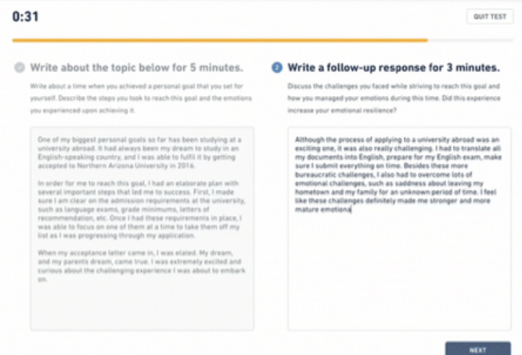
TASK 14

Slide 34
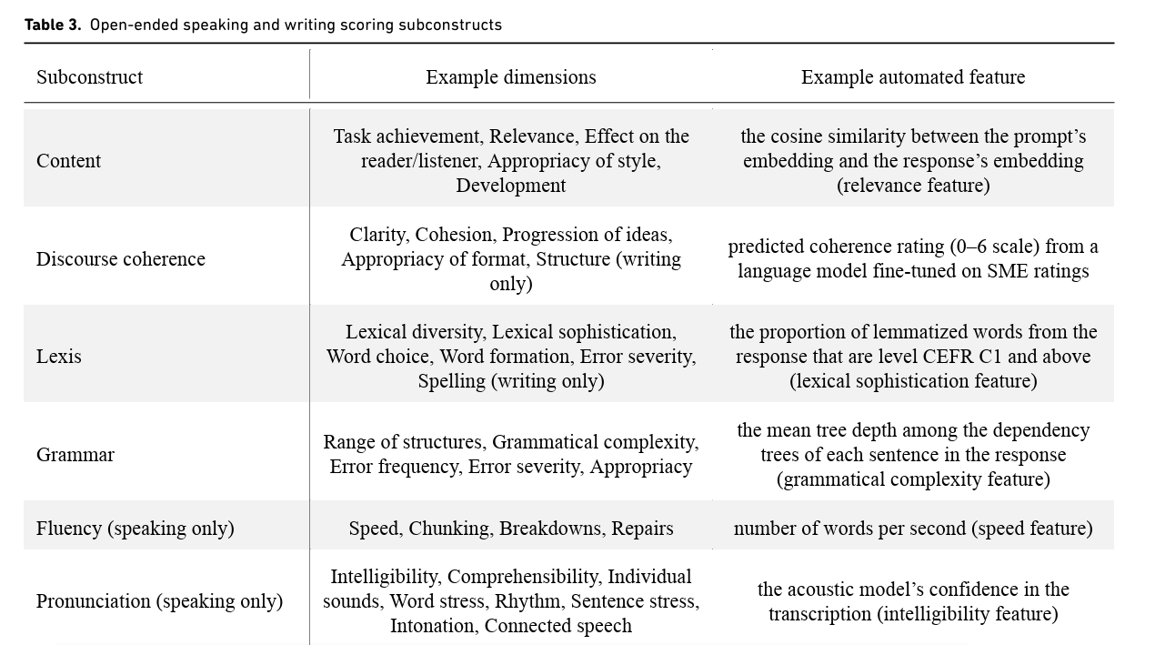

Slide 35
Conclusions
All High-Stakes Assessments and Tests are facing the challenge of maintaining Test Integrity in the light of tech savvy and well-prepared test takers.
30/11/2022 changed some things- but probably only accelerated reconsideration of what and how we assess writing skills in the 21st Century- Constructs- Modes- Item Types- Testing Conditions
Practice and preparation are necessary and virtuous in the pursuit of progression.
A fundamental question is whether the practice and preparation promotes +ve Washback. If they do- what is not to like? Authencity matters
If they promote –ve Washback-then we gain little trust and confidence of true and accurate language ability in context.
Task writing should attempt to make test takers to think on their feet and be reactive- however task formats need a level of familiarity to be fair and accessible.

