Slide 1
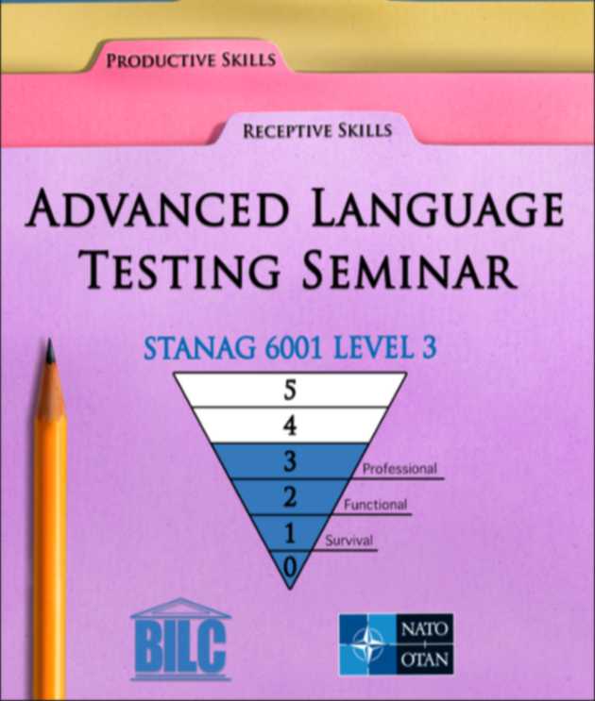
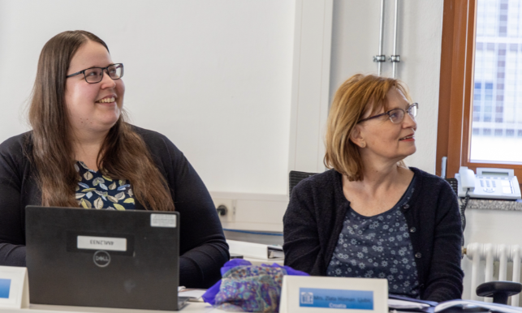
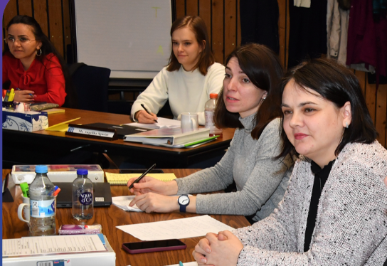
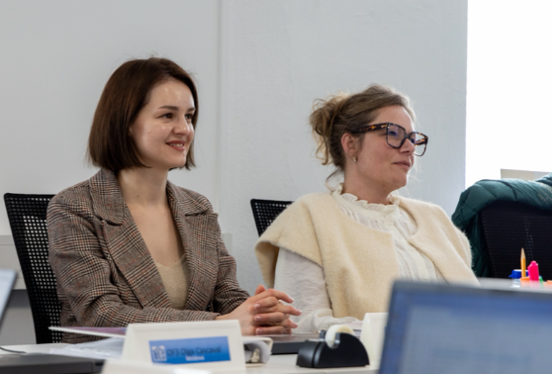
Updates to ALTS Module 2, Testing Writing
Peggy Garza, Merit Kompus
STANAG 6001 Testing Workshop
The Hague, 2025

Slide 2
ALTS Writing Module
Module 2, Testing the Productive Skills
Annual ALTS updates
Writing in the digital age; now the impact of AI
Balance between the “basics” & real-world transformational changes
Practical activities plus focused discussion groups

Slide 3
2024 BILC Writing Survey
Responses from 27 countries
Piloting often skipped due to limited resources
Shift to computer-based testing
Growing debate on use of aids
Real-world writing tasks

Slide 4
ALTS Writing Module Updates 2025
New set of prompts and scripts for norming
AI for prompt development - hands-on activity with ChatGPT
AI for assessing writing
Keeping up with research

Slide 5
Writing prompt samples from nations: Level 1
Notice for a notice board (e.g. about a found item)
Message or email to a friend or colleague (e.g. asking for help, inviting them to a trip or event, about a meeting, a social event, or a new pet)
Response to a friend’s letter (e.g. about their wedding or changing jobs)
Email to your supervisor (e.g. about being absent)
Email to book a hotel room

Slide 6
Writing prompt samples from nations: Level 2
Email to a friend (e.g. about a recent trip, postponing a party, or inviting them on a trip)
Social media story
Email to a colleague (e.g. about an exercise you participated in, or not being able to attend a meeting)
Report to a team leader/CO/superior (e.g. about a conference, course, training program, exercise, accident)
Letter of request
Letter of complaint

Slide 7
Writing prompt samples from nations: Level 3
Essay
Composition
Discuss and speculate on a topic
Discuss a quote
Letter to a magazine or editor

Slide 8
Thank you!

