Slide 1

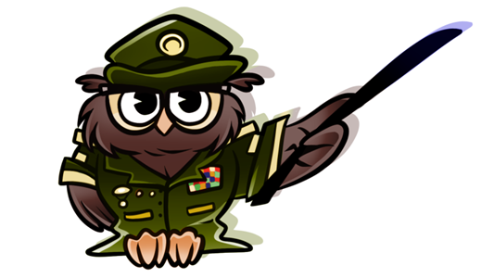
MINISTRY OF DEFENSE
CROATIAN ARMED FORCES
CROATIAN DEFENSE ACADEMY
”Dr. Franjo Tuđman”
FOREIGN LANGUAGE CENTER
”Katarina Zrinska”
Formative assessment as a tool for adapting to learners needs and bolstering learners attitude and motivation
Borjana Soldo, October 2024

Slide 2
CONTENT
Definition and focus of Formative Assessment
The original idea- how did it derive?
Benefits to the stakeholders
Formative assessment strategies and techniques
Practical examples – presenter’s experience

Slide 3
Types of assessment
 | ASSESSMENT
 | diagnostic (pre-assessment) | formative assessment | summative (post-assessment)
When? | - before the lesson / course |  | - after completing the learning process (mid-term exams or final exams)
What? | - evaluates students’ knowledge and skills before teachers’ instruction |  | - evaluates student learning and skill acquisition at the end of a unit, course, semester, etc.
Why? | - to place students in groups |  | - to give students grade (result is important)
Importance? | - usually low-stakes |  | - high-stakes
Form? | - usually standardized |  | - usually standardized
How often? | - only at the beginning |  | - only at the end

Slide 4
Types of assessment
 | ASSESSMENT
 | diagnostic (pre-assessment) | formative assessment | summative (post-assessment)
When? | - before the lesson / course | - during the learning process | - after completing the learning process (mid-term exams or final exams)
What? | - evaluates students’ knowledge and skills before teachers’ instruction | - collects detailed information on students’ progress throughout the learning process, their strengths and weaknesses | - evaluates student learning and skill acquisition at the end of a unit, course, semester, etc.
Why? | - to place students in groups | - to adjust instruction and improve student learning - no grades | - to give students grade (result is important)
Importance? | - usually low-stakes | - low-stakes or no-stakes | - high-stakes
Form? | - usually standardized | - any form | - usually standardized
How often? | - only at the beginning | - regularly, during the process | - only at the end

Slide 5
Inside The Black Box: Raising Standards Through Classroom Assessment,
Paul Black and Dylan Wiliam, 1998
Three main problems that they observed in regular classrooms:
1) the assessment methods that teachers use are not effective in promoting good learning,
2) grading practices tend to emphasize competition rather than personal improvement, and
3) assessment feedback often has a negative impact, particularly on low-achieving students, who are led to believe that they lack “ability” and so are not able to learn
Notes:
PAUL BLACK is emeritus professor of science education at King’s College London, United Kingdom. DYLAN WILIAM is deputy director of the Institute of Education, University of London, United Kingdom.

Slide 6
Assessment FOR learning
→ students who learn in a formative way achieve much more and obtain better results than other students
They showed that:
a) formative assessment is at the heart of effective teaching
b) formative assessment has a strong positive effect on achievement
c) improving formative assessment raises standards.

Slide 7
Key principles of AfL?
Communicate confidence that every learner can improve
Share learning objectives with learners
Empower learners to take an active part in their own learning
Develop learners’ confidence in peer and self-assessment

Slide 8
Benefits to the stakeholders
Students’ benefits:
regularity brings safety
break of the monotony in the traditional classroom environment
no pressure of traditional grades
engaged students – positive impact to language acquisition
Teacher’s benefits:
identifying weaknesses and strongpoints – thus adjusting the teaching methods
identification of problems earlier and faster than by summative assessment
no prescribed form, no prescribed timing – formative assessment is a flexible tool in hands of skilled teachers
helps you become a better teacher

Slide 9
Practical examples:
Formative assessment strategies and techniques:
Name on the paper, the Exit/Entry ticket, 30 seconds share, Thumbs up, Roll the dice…
Grammar-Fun with grammar book, Textplosion, Relay, Irregular verbs triangle
Vocabulary- You and me from A to Z, Countries, towns…
Spelling- flashcard group game, word chain, a rhyming verse
Pronunciation –Look at my mouth and repeat after me, Recording and rerecording
Error correction-Notice your mistakes, One more time
Listening-Listen and summarize, Voice blogging
Reading – partner reading, jigsaw reading, puzzle reading, creative reading
Speaking – plusses and minuses, somebody famous, roll the dice nad talk
Writing – Echoes, Secret meeting

Slide 10

Thank you for your attention!

