Slide 1
Proficient or Pretentious?
Can we tell the Difference?
Exploring rater sensitivity to inauthentic scripts
An Experiment by Tamar Shalamberidze
Testing Division, Ministry of Defence of Georgia
The Hague, Netherlands
2-4 September, 2025

Slide 2
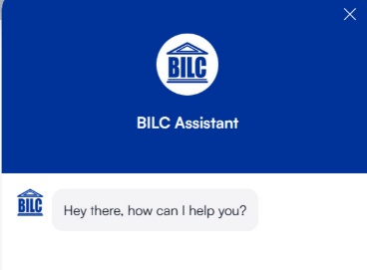
Why do we test Writing ?
“Testing writing is essential for several reasons. It helps assess language proficiency, ensuring individuals can effectively communicate in written form, which is crucial in both personal and professional settings… how digital tools can enhance or challenge writing skills“

Slide 3

“Basically, I have been compelled by curiosity.”
- Mary Leakey

Slide 4

If an AI took your national writing test tomorrow, would you know?

Slide 5
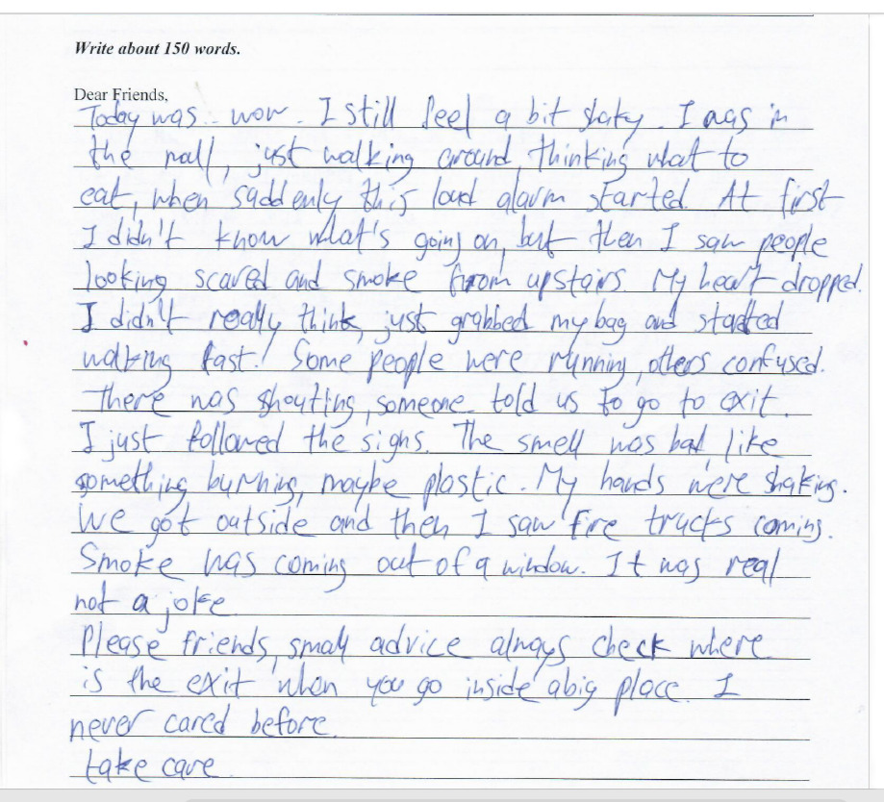
Let’s play a guessing game

Slide 6
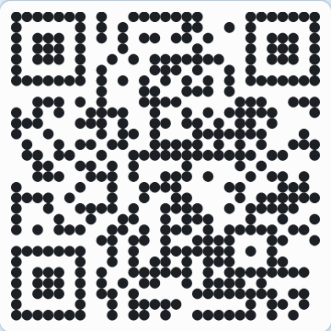
Respond at pe.app/ bilc
Notes:
* 42 workshop delegates participated in the poll

Slide 7
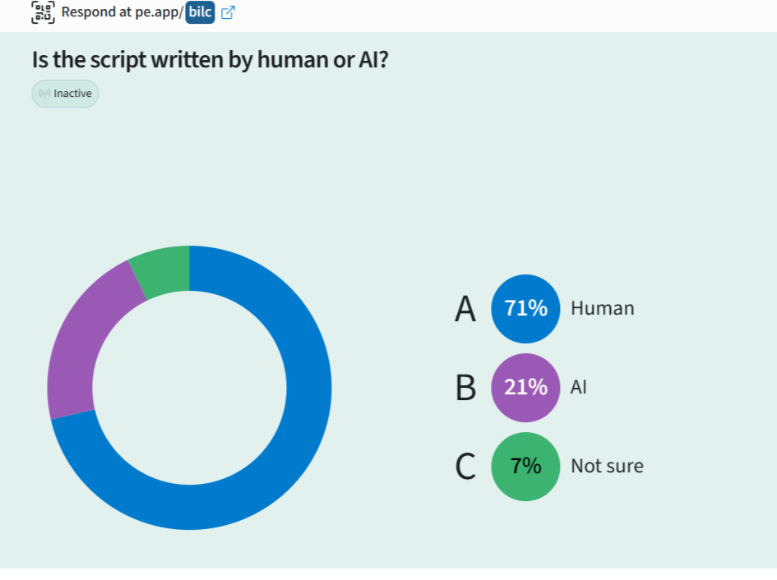
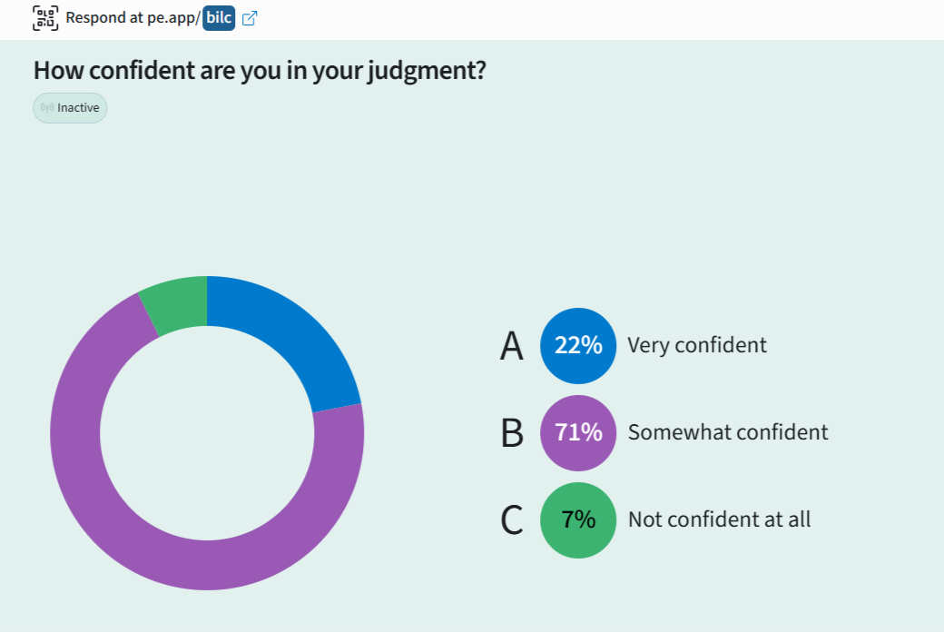
Live Poll: Results of 42 workshop delegates

Slide 8

You just played the same game my raters did – here’s how it went for them

Slide 9

“Whether it’s an online or in-person test, security is vital to stopping the sometimes extraordinary lengths to which some candidates are prepared to go…”

Slide 10

How it all started
Suspiciously polished exam scripts
Research at University of Reading
Curiosity – could raters really spot AI?

Slide 11
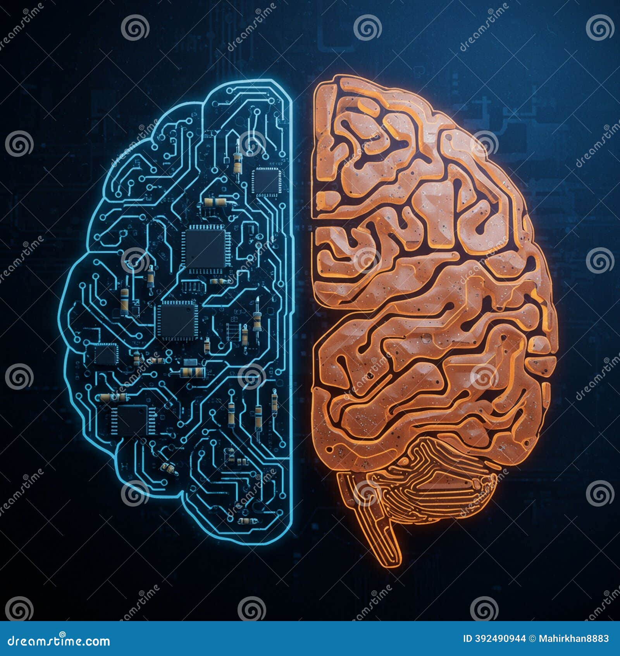
From Curiosity to a small-scale experiment
Generative AI = global concern
Real-world threat to validity and fairness
Are raters cognitively equipped to tell
human writing from AI?”

Slide 12
Project analysis slide 3
Behind the scenes
Time constraints
Enrolling raters in this experiment
Creating scripts using ChatGPT and Copilot
Creating handwritten scripts

Slide 13
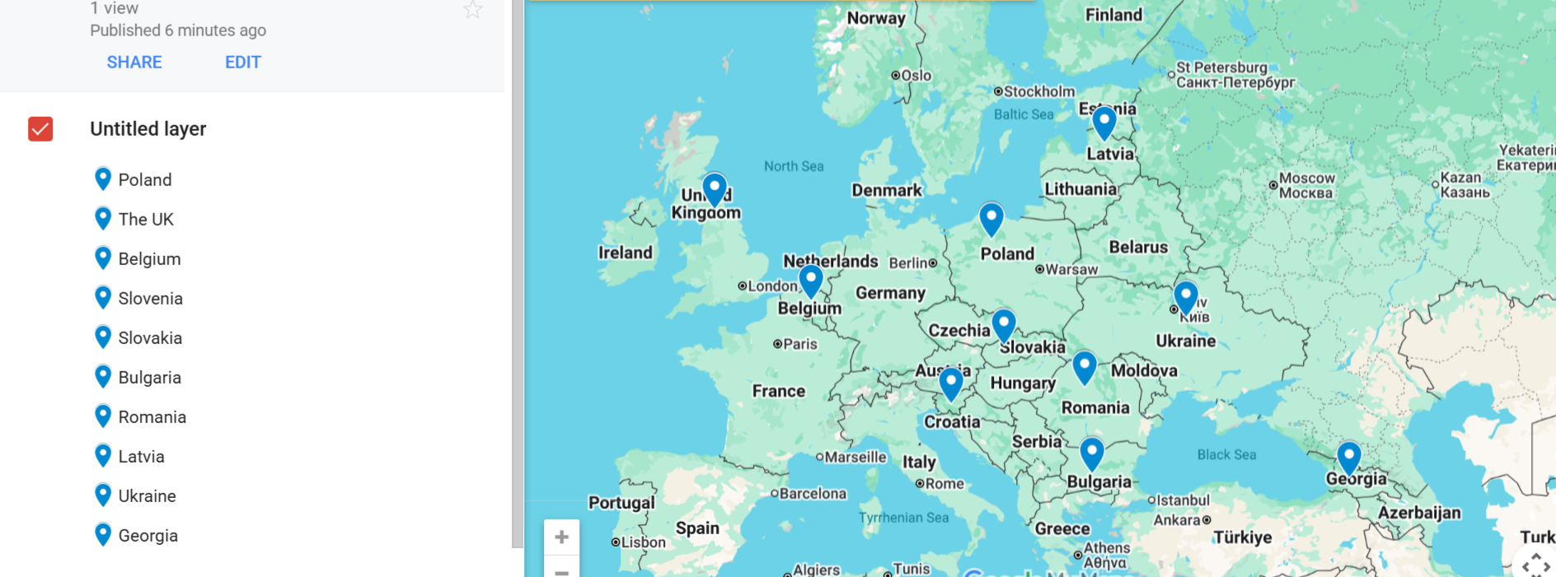
Countries involved

Slide 14
Project analysis slide 4
Experiment design
6 real scripts
5 fictitious
They were invited to join the experiment
55 real scripts
8 fictitious
It was part of the testing session
Team Georgia
BILC community
Stage I
They did not know about the infiltration
Blind raters
They knew they might encounter AI
They played the roles of “Detectives” .
5 raters
20 raters
Stage II
Surprise element

Slide 15
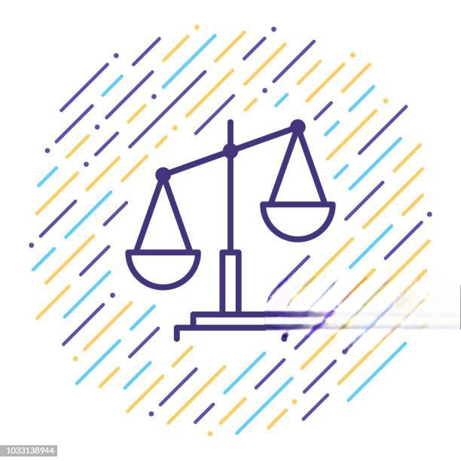
The impact of AI on Writing Test
Could test-takers using AI go undetected during exams?
Would AI get a test-taker a better result?

Slide 16
Findings – Informed Group “Detectives”
Rater | Real scripts | Fictitious scripts | Detected | Percentage
Rater 1 | 28 | 4 | 4 | 100%
Rater 2 | 28 | 4 | 3 | 75%
Rater 3 | 26 | 4 | 3 | 75%
Rater 4 | 22 | 3 | 1 | 33,3 %
Rater 5 | 14 | 3 | 3 | 100%

Slide 17
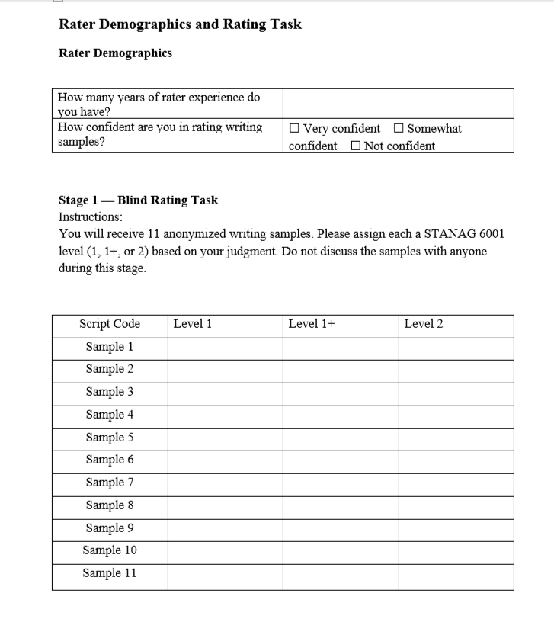
Stage 1 — Blind Rating
Uninformed Group – Blind Raters
Information included in the Rating Form
Rater Demographics
  Rater experience
  Rater confidence
Blind rating task
  Assign a STANAG 6001 level
No comments received about scripts being suspicious

Slide 18
Stage II — AI vs Human Writing Study
Uninformed Group – Blind Raters

Slide 19
Findings – Uninformed Group

Slide 20

Interesting Observations
Language was too perfect ( Too good to be true)
Mechanical organization
Lack of personal tone, emotion, authenticity
Awkward phrasing
Very smooth narrative style
Perfect grammar
Concept of the rule of three
Advanced and very specific topic-related vocabulary
Words and collocations not common for a L2 test-taker
Language was too perfect ( Too good to be true)
Mechanical organization
Lack of personal tone and emotion
Awkward phrasing
Very smooth narrative style
Perfect grammar
Lacks authenticity
Advanced and very specific topic-related vocabulary
Words and collocations not common for a L2 writer

Slide 21
Project analysis slide 8
Two Groups, Two Perspectives
Team Georgia
BILC Community
Detectives
Blind raters
The range between pretty confident to very confident
The range between somewhat confident to very confident
Scoring confidence
Overall confidence level clustered around pretty confident
Overall confidence level leaned towards somewhat confident
Judgment confidence

Slide 22

What makes writing human?
Intention
Originality and creative content
Personal experience
Depth of reasoning
Ethical standards

Slide 23
Closing remarks
It is not always easy to detect AI generated text
Out of 8 fictitious scripts 1 remained totally undetected (Copilot)
“False alarms” - even some of the real scripts flagged as suspicious
AI generated scripts attained higher scores than real ones

Slide 24

Could test-takers using AI go undetected during exams?
Would AI get a test-taker a better result?

Slide 25
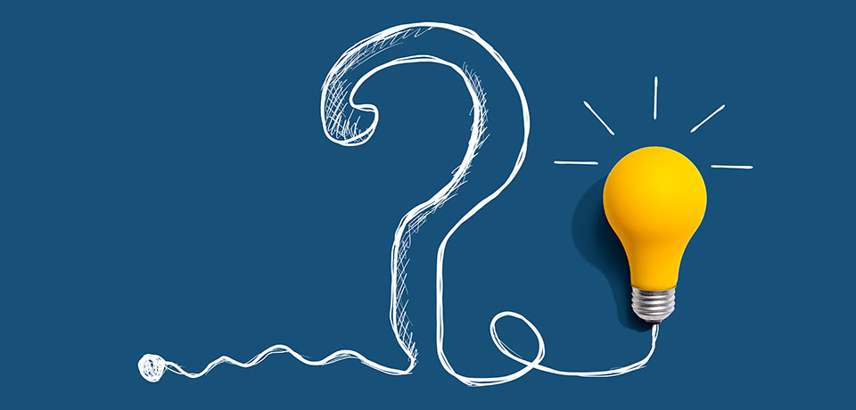
If raters can’t always tell real from fake, what does that mean for test integrity?

Slide 26
Thank You

