Slide 1


Maximizing AI for Receptive Skills in English Language Teaching
NATO BILC Professional Development Seminar
19-24 October, 2025
Presenters: Ana Intskirveli
Teona Kupatadze

Slide 2

School Structure
Head of the School
Teaching Department (AM)
Administration
English Language Program
German
French
Turkish
Russian
East (Tbilisi)
West (Kutaisi)

Slide 3
English Language Programs
English Language Intensive Program (Basic A1)
English Language Intensive Program (Functional B1)
International Military and Education Training Program (IMET)
English Language Refresher Program – Level I (A1)
English Language Refresher Program – Level II (A2)

Slide 4
Studies and Statistics
🗣Productive Skills (Speaking & writing) → Higher outcomes
👂 Receptive Skills (Reading & Listening) → Lower outcomes
Numerous studies highlight global challenges in reading comprehension;
Our learners reflect similar tendencies;
The linguistic distance between Georgian and English presents additional difficulty:
- Different alphabet and writing system;
- Distinct grammatical and structural patterns;
Limited exposure to authentic English input affects comprehension

Slide 5
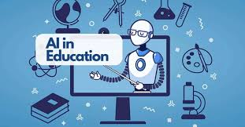
Artificial Intelligence (AI) in Education
AI is reshaping education and learning practices
Enhances instructional efficiency and learner engagement
Enables personalized and adaptive learning
Facilitates development or receptive skills

Slide 6
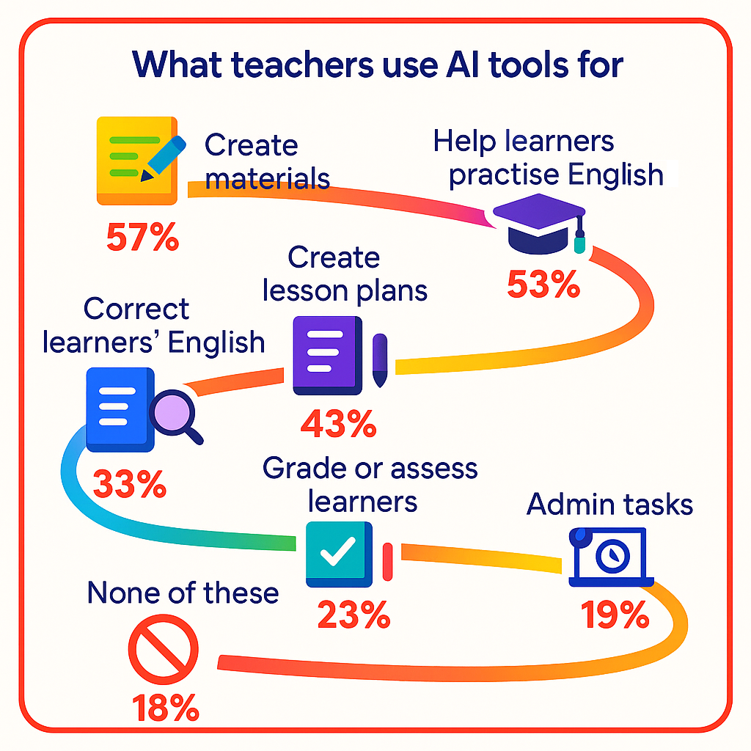
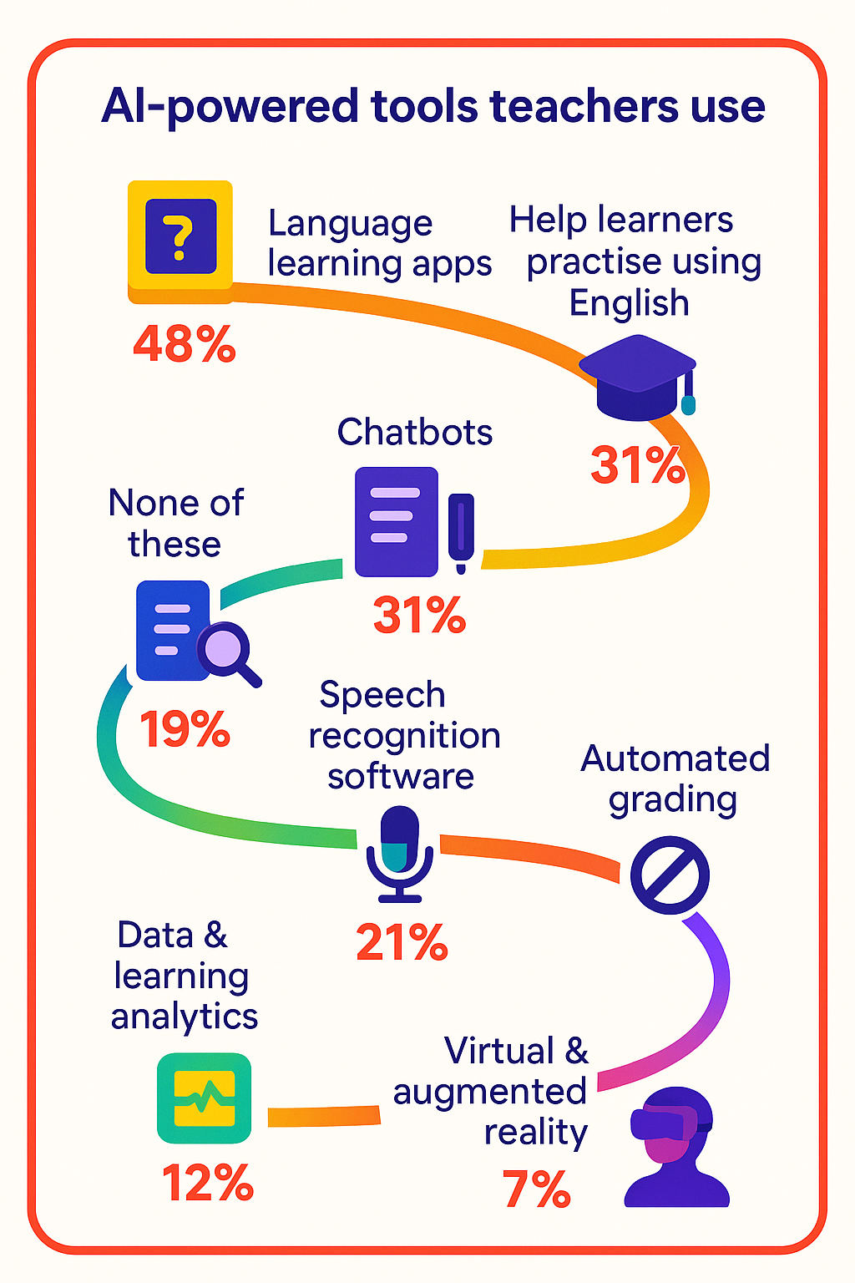
AI-powered Tools Teachers Use

Slide 7
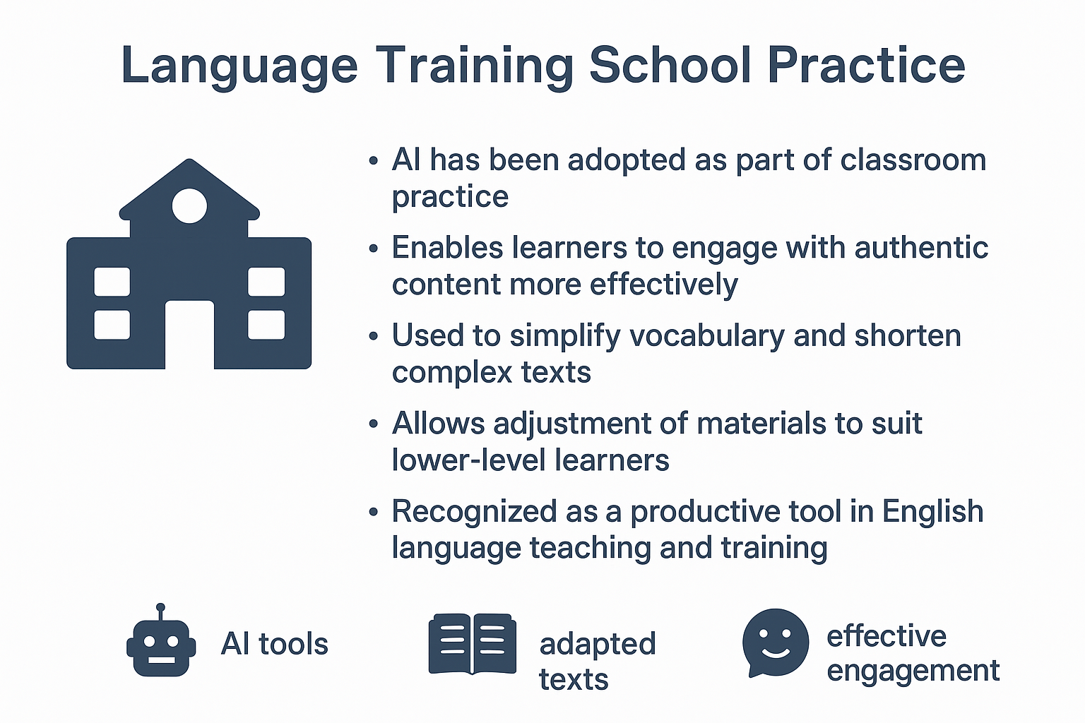

Slide 8
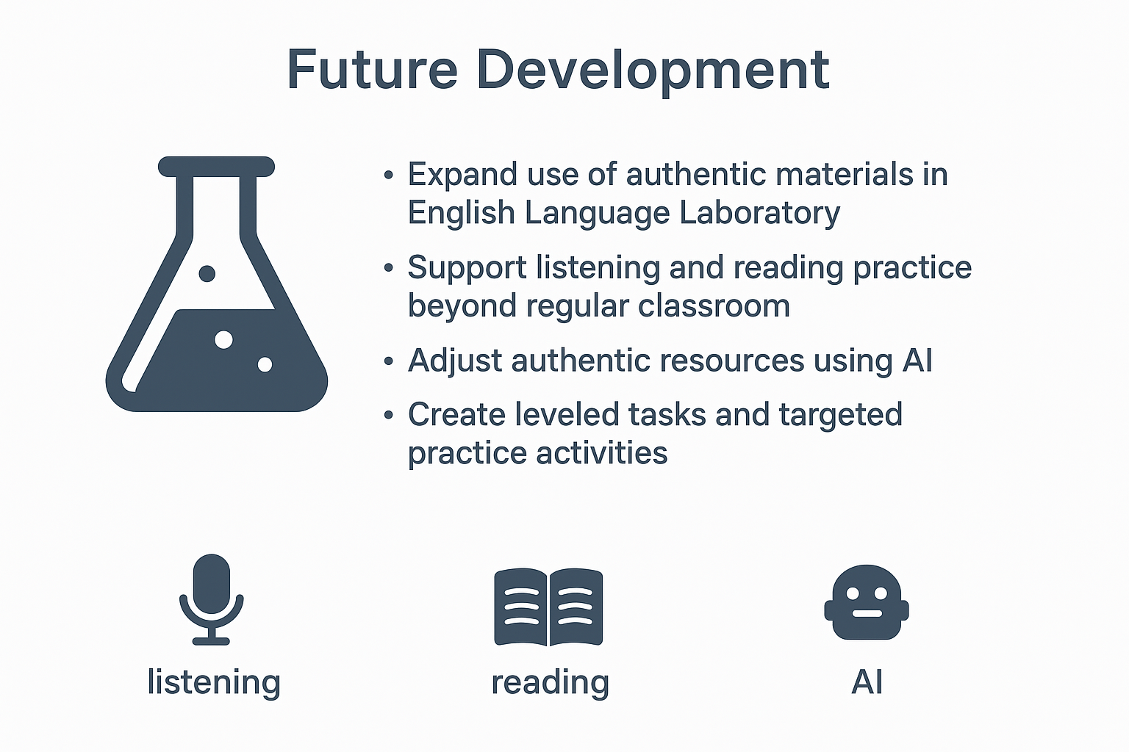

Slide 9
Google says 90% of tech workers are now using AI at work
The overwhelming majority of tech industry workers use artificial intelligence on the job for tasks like
writing and modifying code, a new Google study has found. The report, coming from Google’s DORA
research division and based on 5,000 responses from technology professionals around the world, found
that 90% of respondents are using AI in their job, up 14% from last year…
CEFR B2 (UPPER-INTERMEDIATE)
Google Study: 90% of Tech Workers Are Using AI
A new Google report has found that 90% of technology professionals now use artificial
intelligence in their jobs, a 14% increase from last year. The study, which surveyed 5,000
workers worldwide, shows that AI is most often applied to writing and modifying code…
CEFR A2 (SIMPLIFIED)
Most Tech Workers Now Use AI
A new Google study says 90% of people who work in technology now use AI at work. They use
it to write and change computer code. Last year the number was smaller.
Google and other companies like Microsoft and OpenAI make tools to help with AI coding…

Slide 10
Comprehension Questions
Multiple Choice
Vocabulary in Context

Slide 11

Alternatives
Alternatives
A2
B2

Slide 12
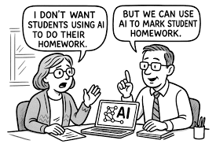
Thank you very much for your attention

