Slide 1

NATO BILC
Military Terminology Conference
2026

Slide 2
NATO BILC
Military Terminology Conference
Ljubljana 2022
Theme:
Giving Meaning to Military Language

Slide 3
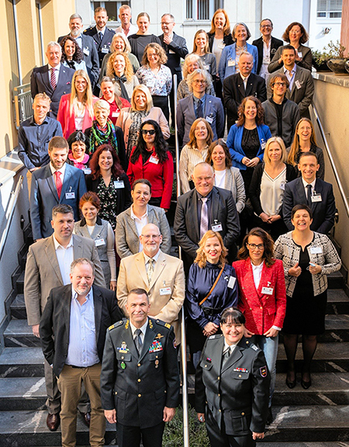

Slide 4
NATO BILC
Military Terminology Conference
Stockholm 2024
Theme:
Terminology Management in the 21st Century and the Potentials of New Technology

Slide 5
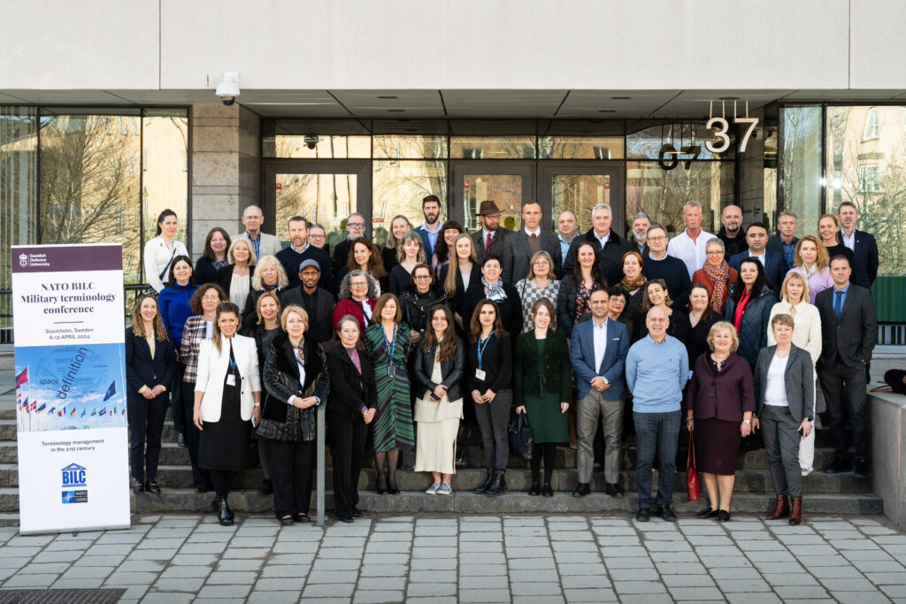

Slide 6
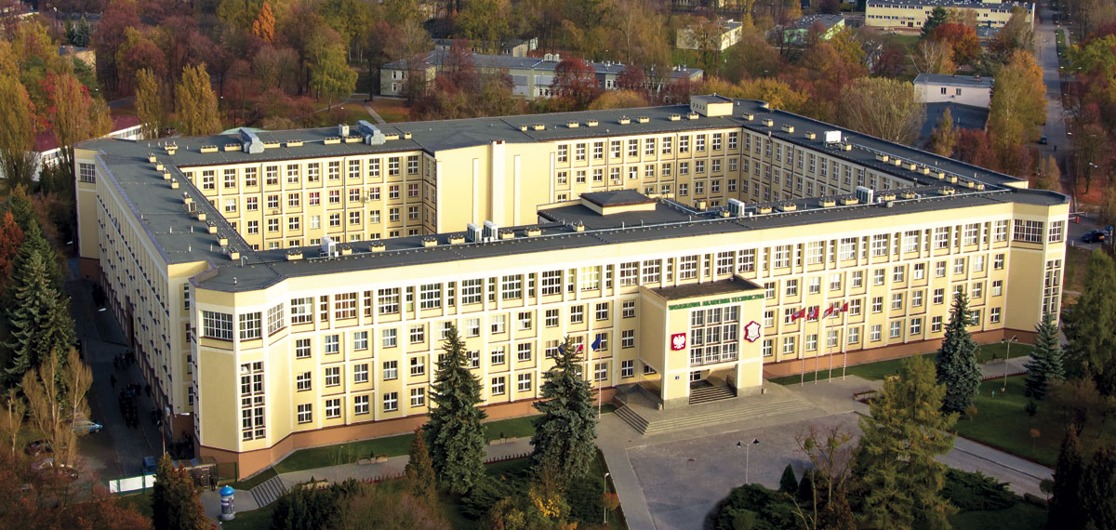
Military University of Technology,
Warsaw, Poland

Slide 7
NATO BILC
Military Terminology Conference
Warsaw 2026
Theme:
Military Terminology Application and Management
as Key Factors Enhancing Interoperability
and Language Security

Slide 8
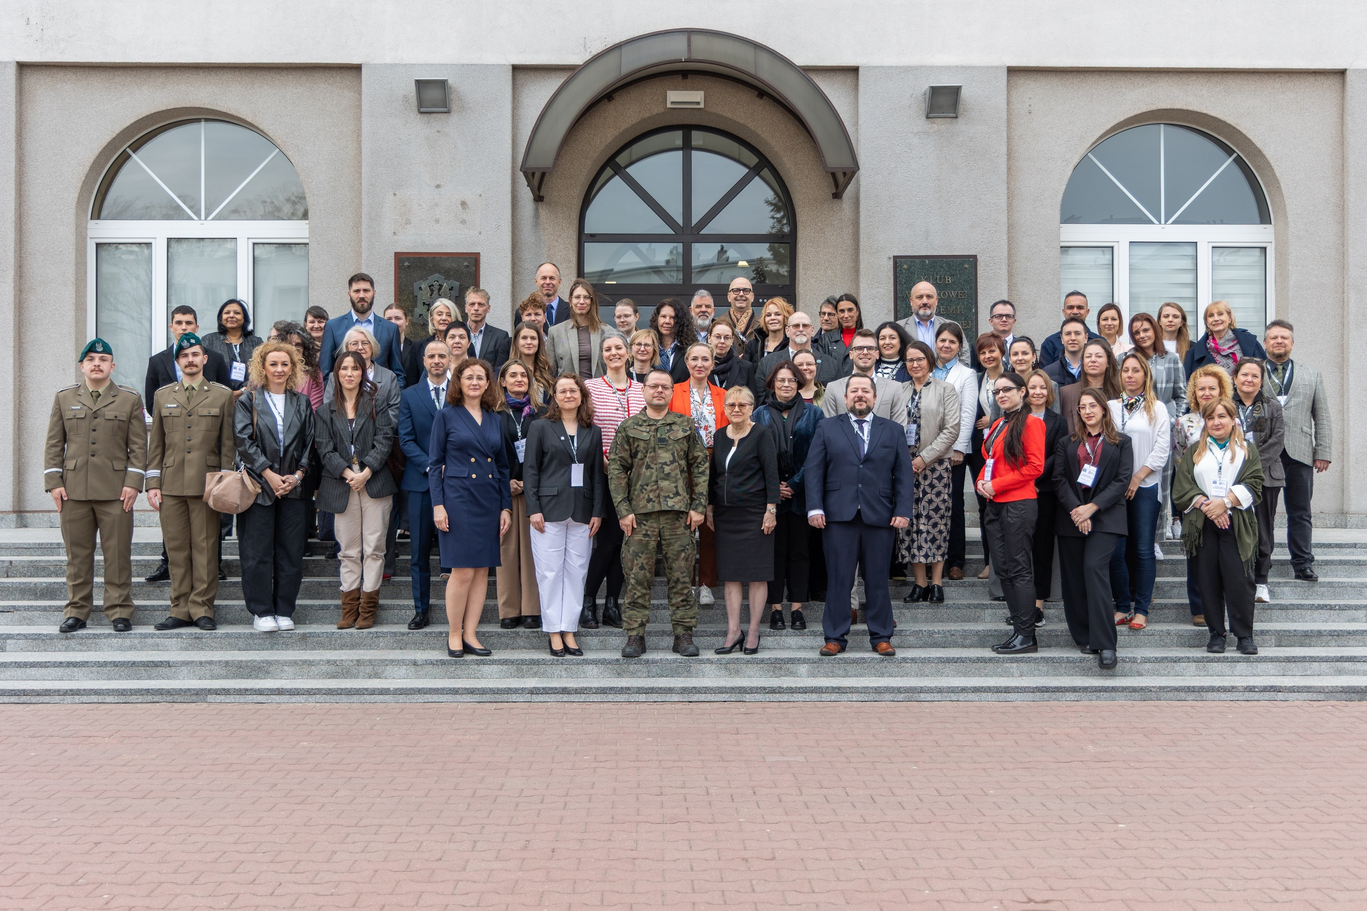
Military Terminology Conference
Warsaw 2026

Slide 9
BILC Military Terminology Conference
Warsaw 2026
60 participants
22 countries: Albania, Austria, Belgium, Bulgaria, Canada, Croatia, Czech Republic, Denmark, Finland, France, Germany, Latvia, Montenegro, the Netherlands, Poland, Portugal, Slovenia, Spain, Sweden, UK, Türkiye, Ukraine
15 presentations
3 workshops
30 national institutions and NATO NSO, NATO JATEC

Slide 10
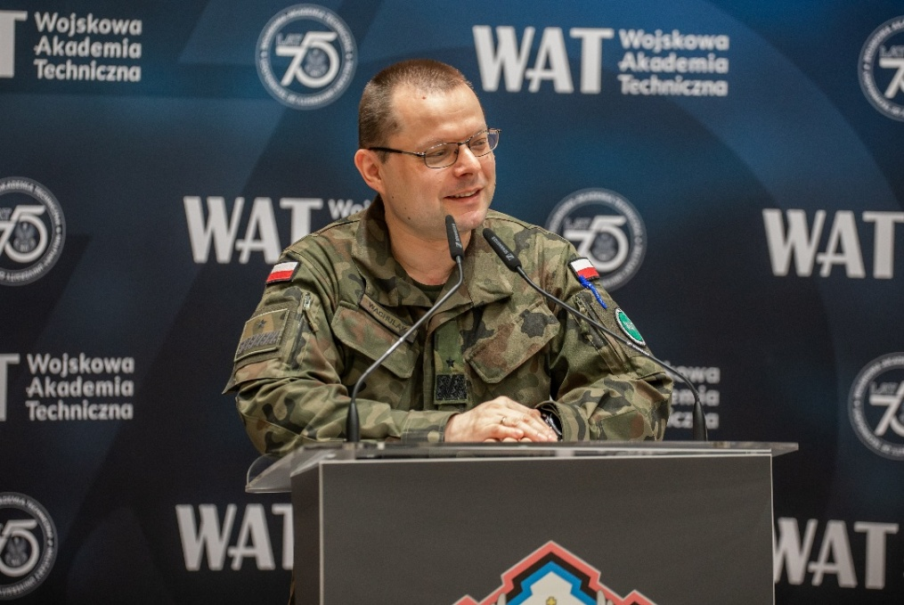
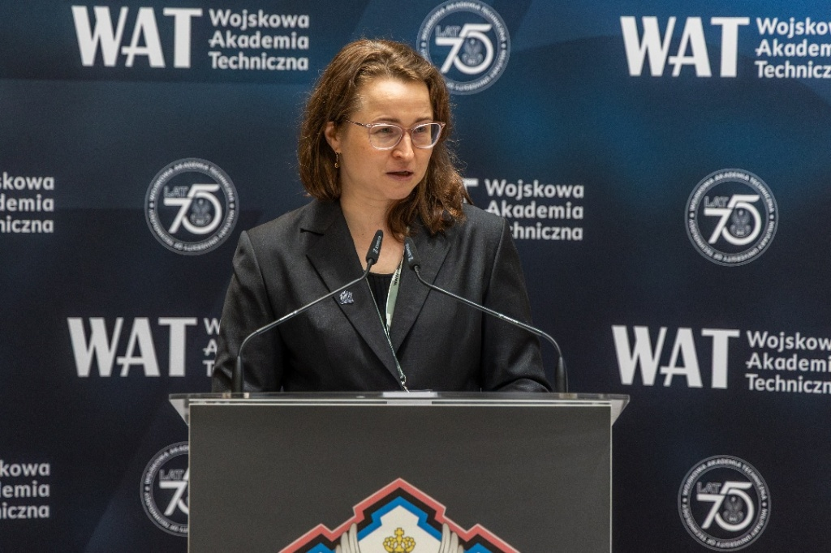
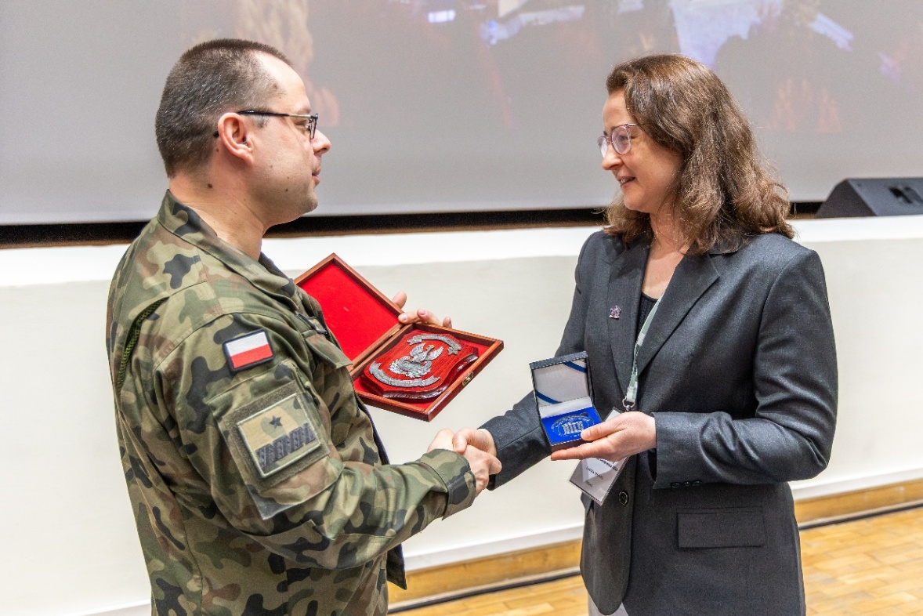
WAT Commandant-Rector
Brig. Gen. Prof. Przemysław Wachulak
BILC Chair
Laura Murto

Slide 11
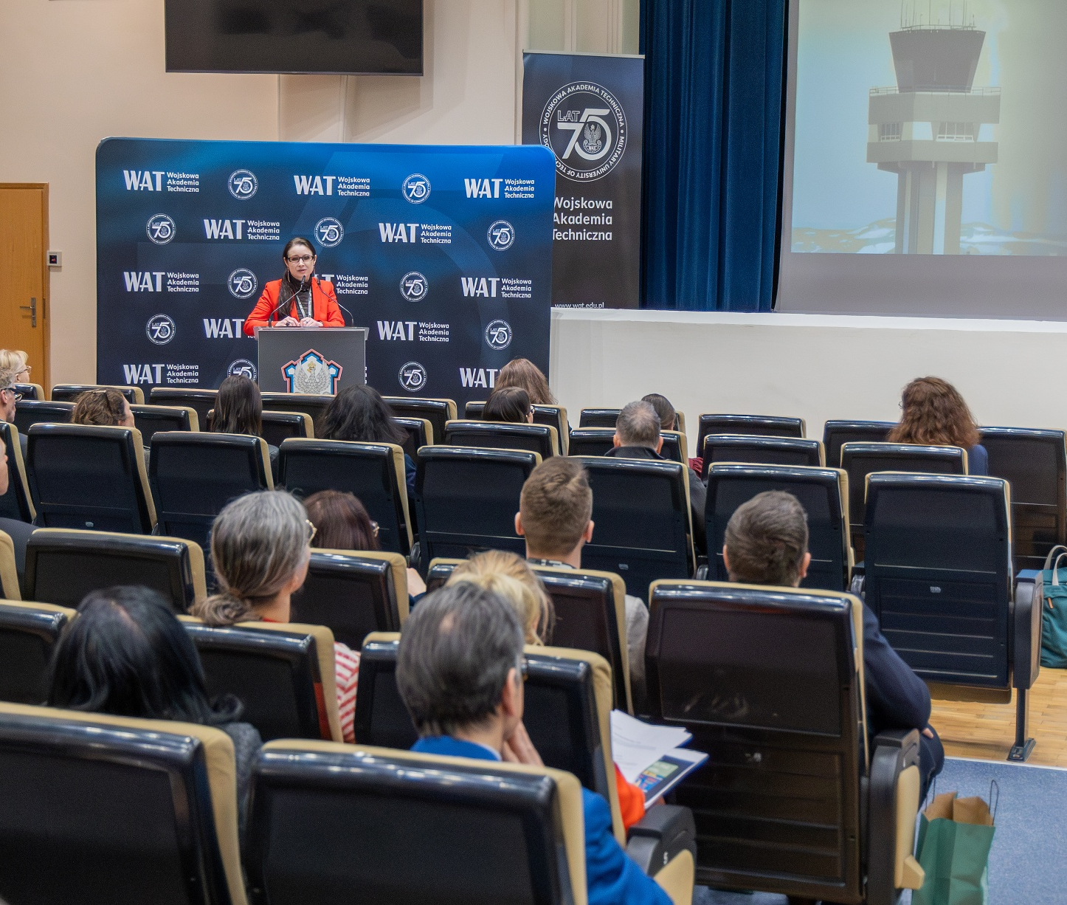
Keynote speech
Prof. Anna Borowska (POL)

Slide 12
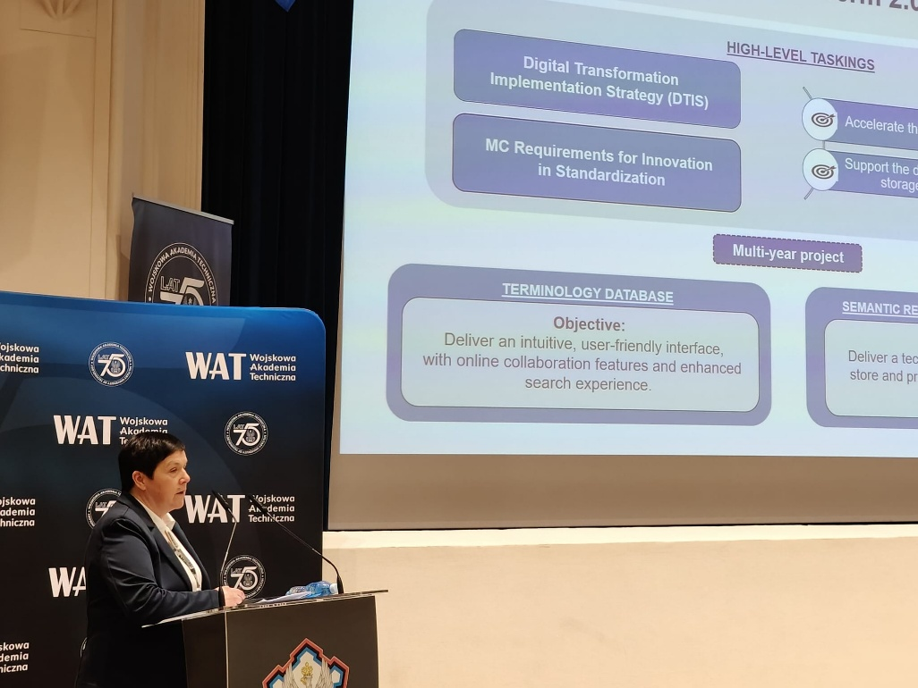
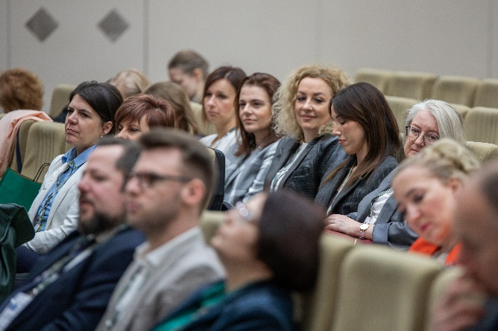
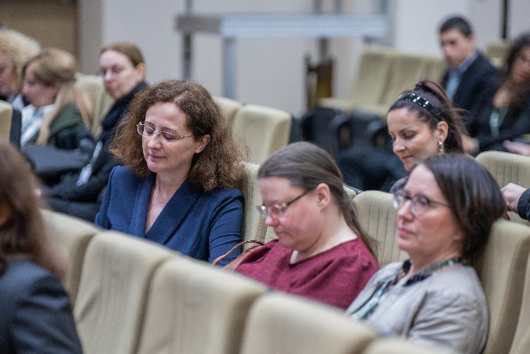
Session 1

Slide 13
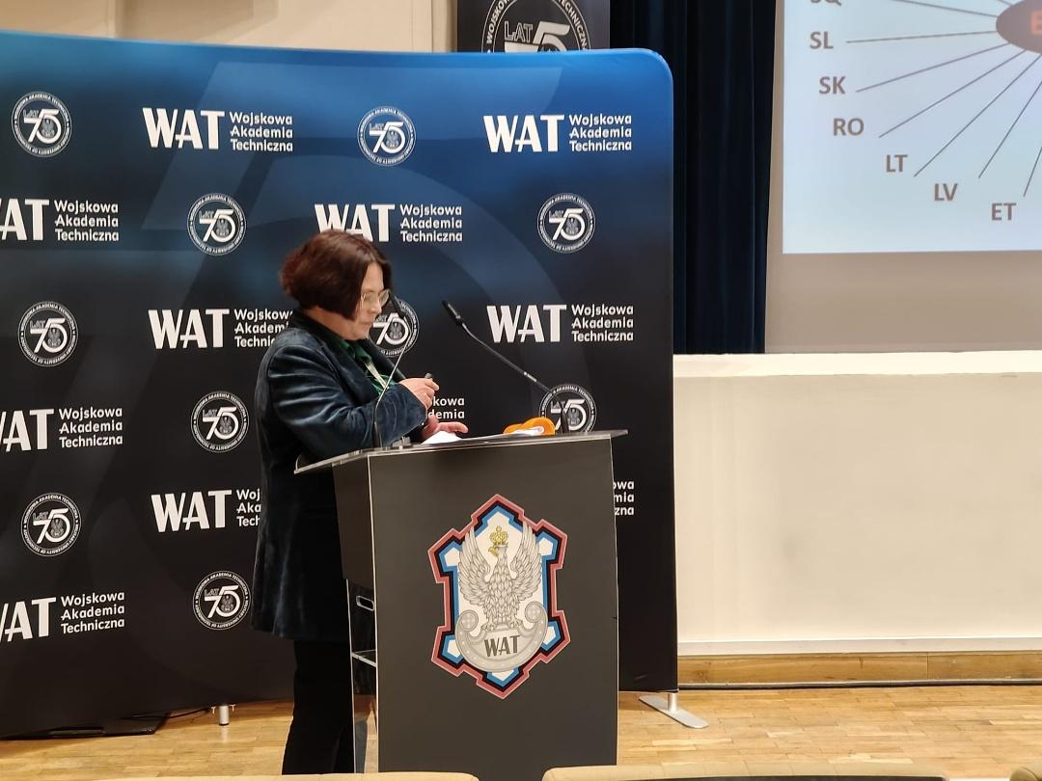
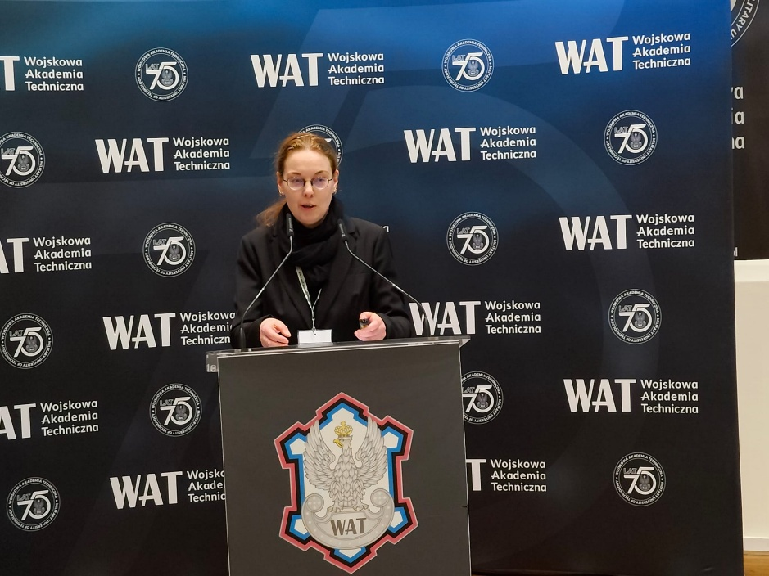


Session 1

Slide 14
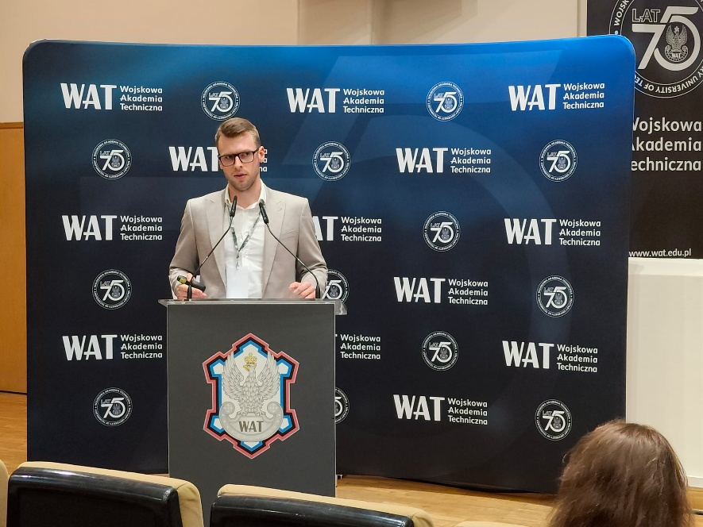
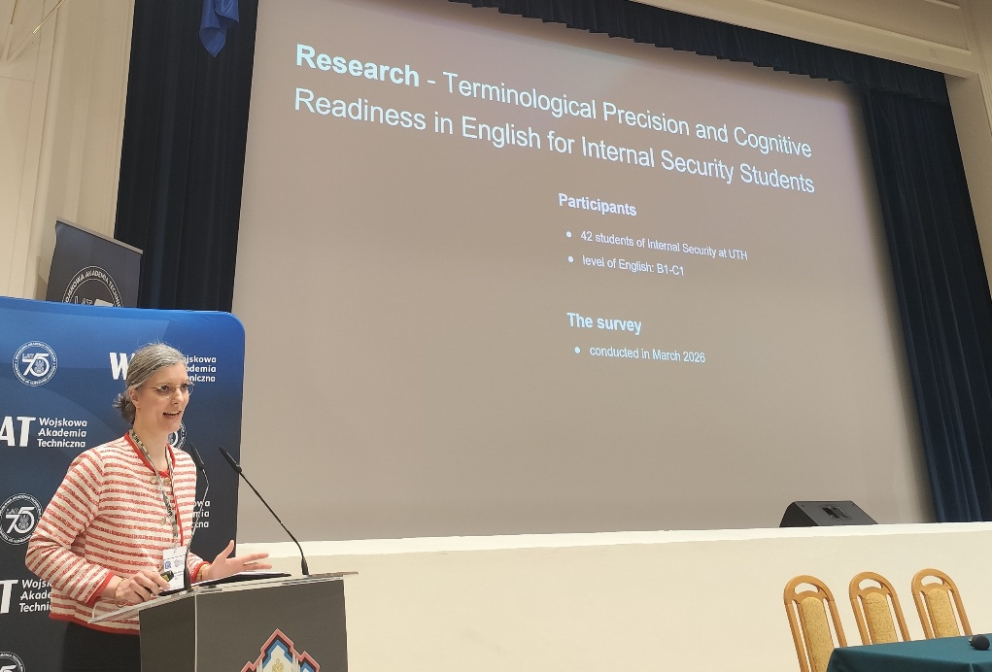
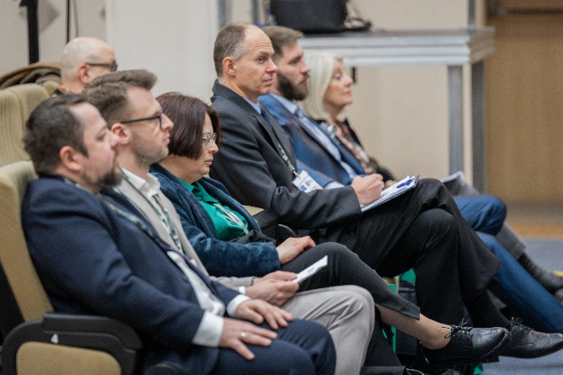
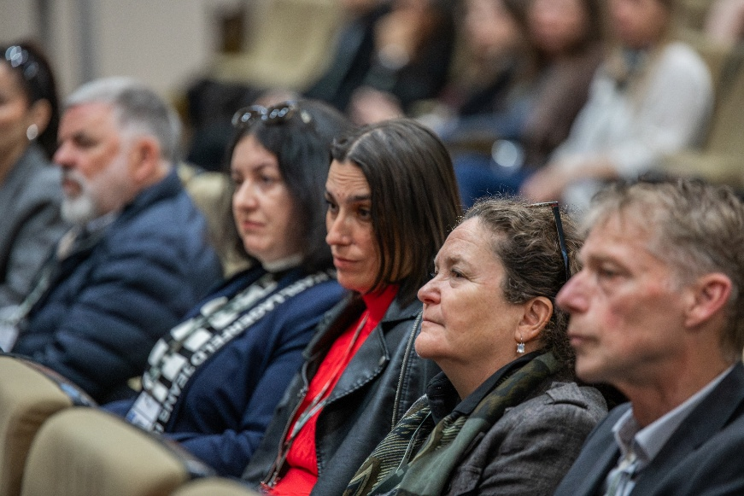
Session 2

Slide 15
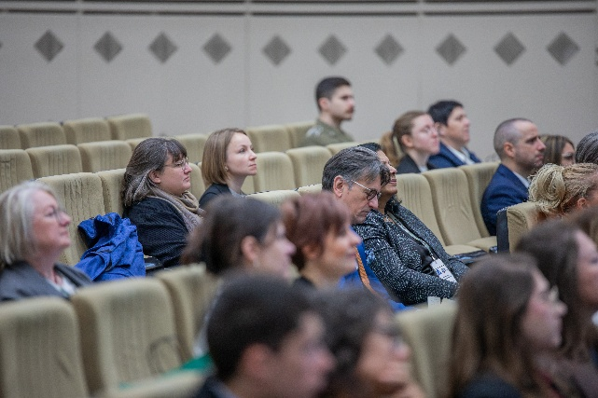
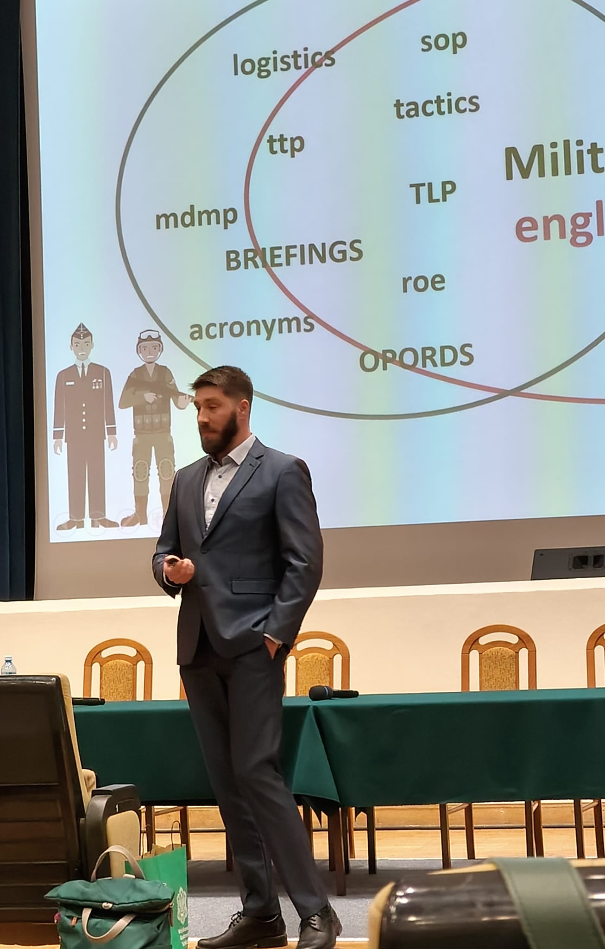
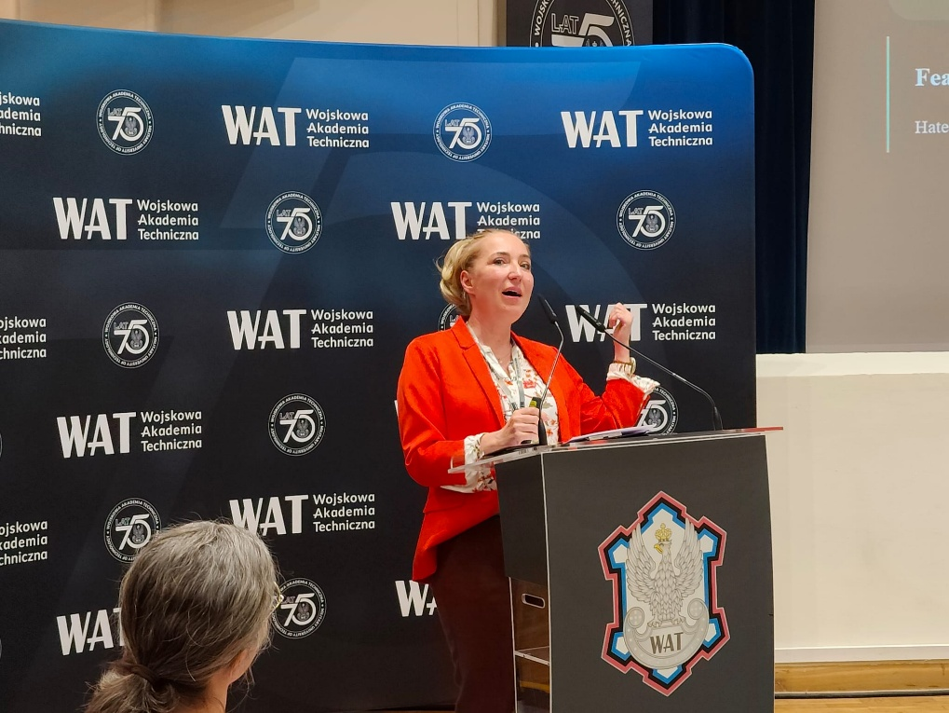
Session 2

Slide 16
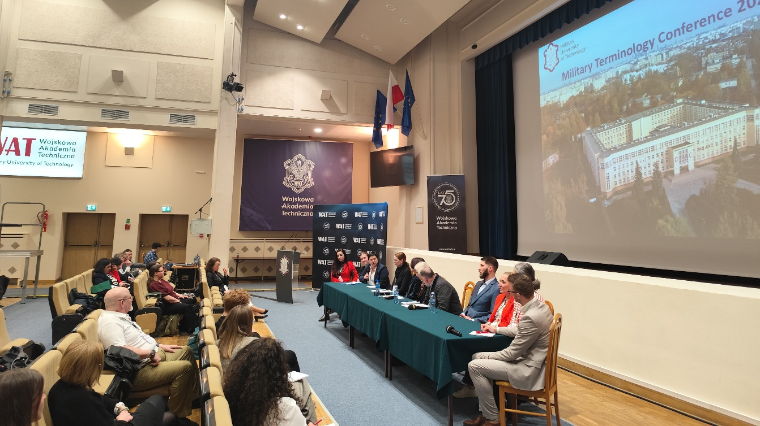
Panel discussion day 1

Slide 17
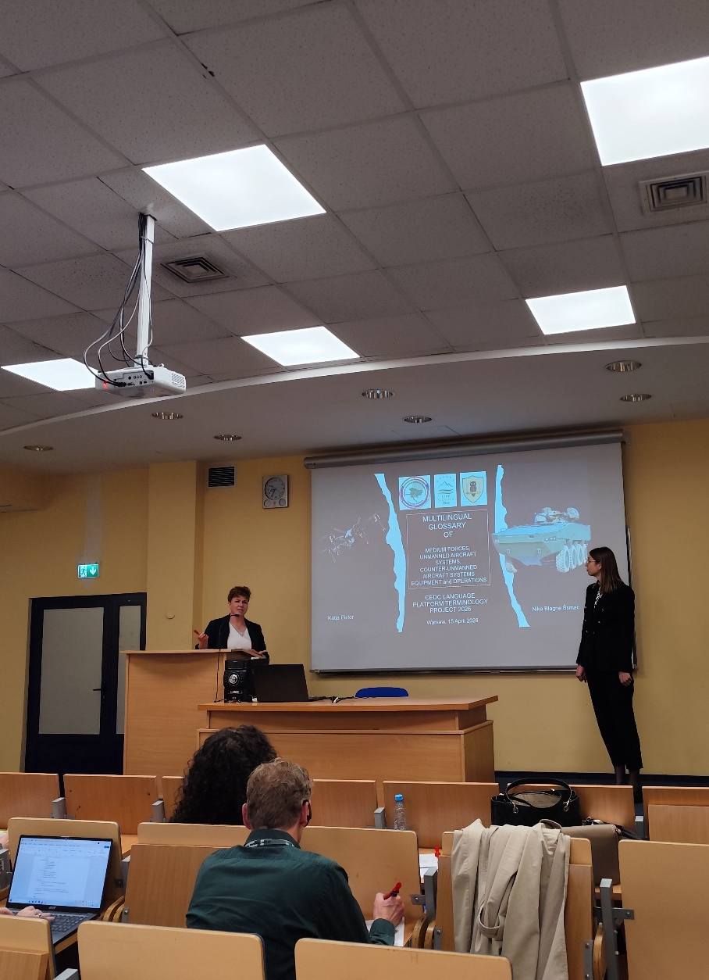
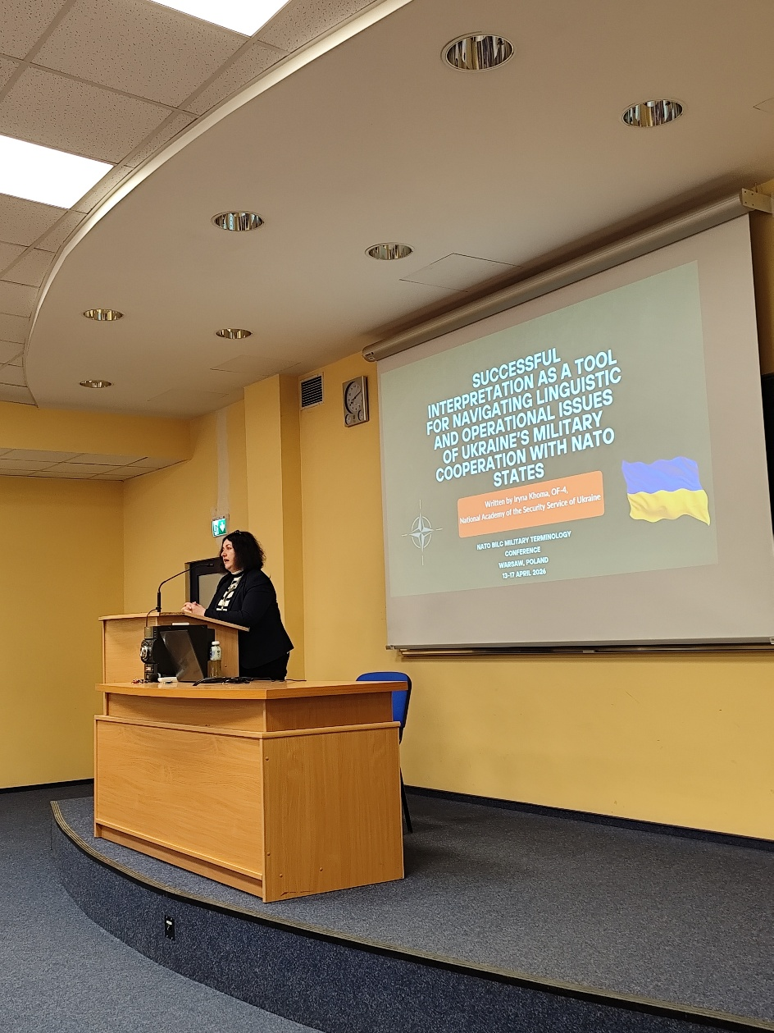
Session 3

Slide 18
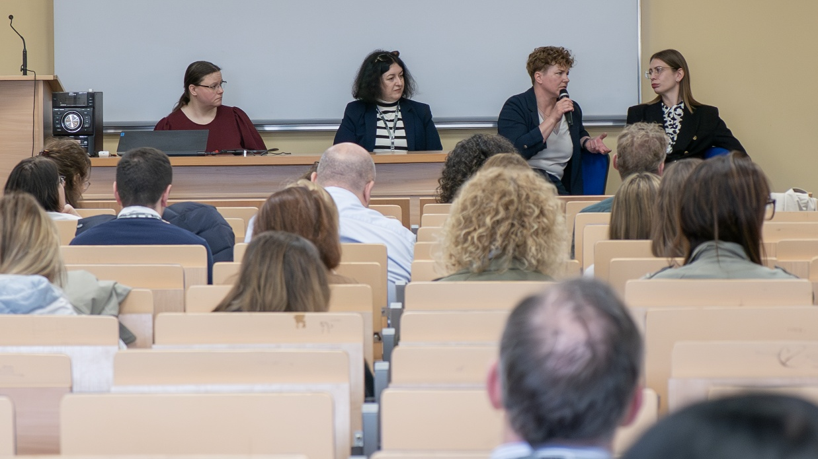
Panel discussion day 2

Slide 19
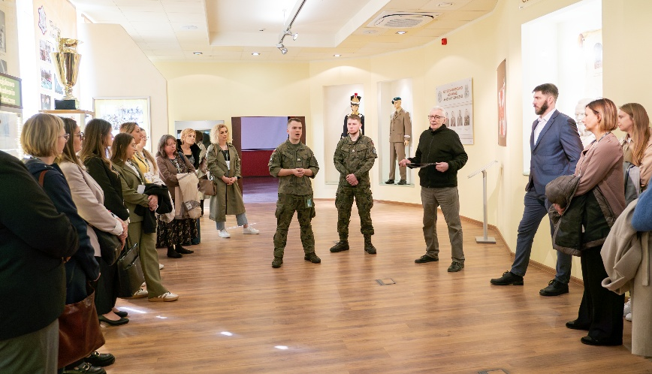
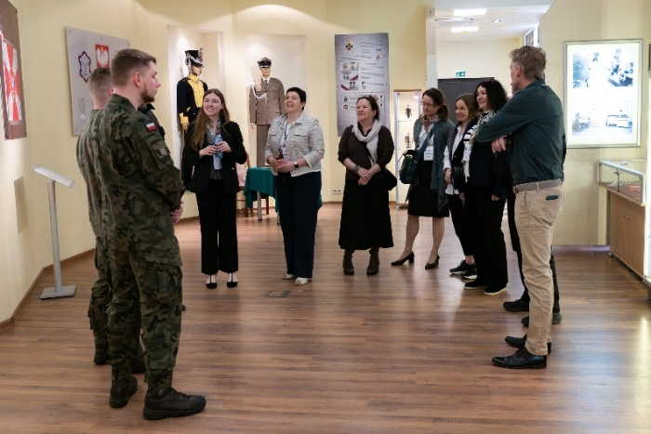
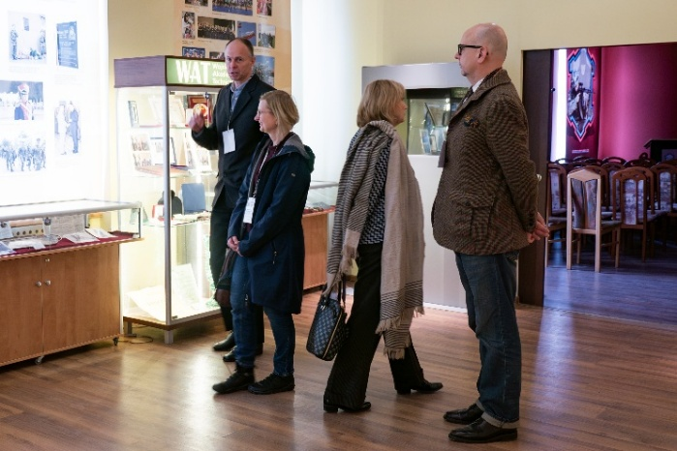
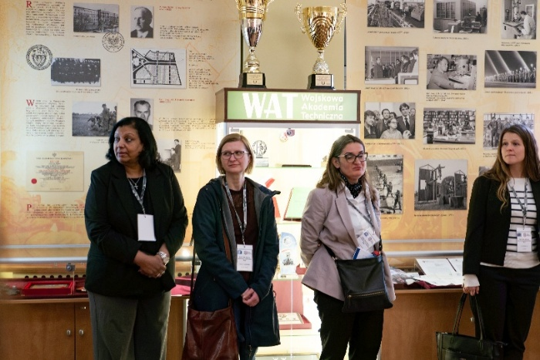
Hall of Tradition

Slide 20
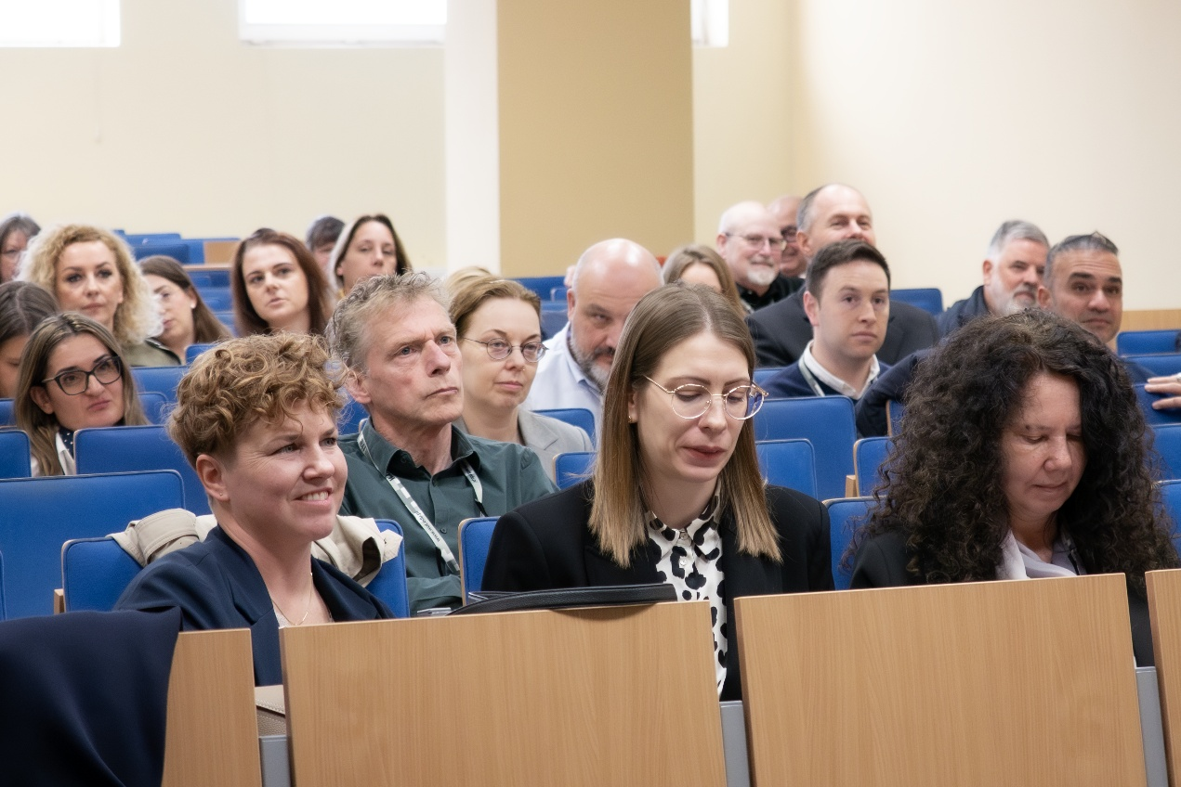
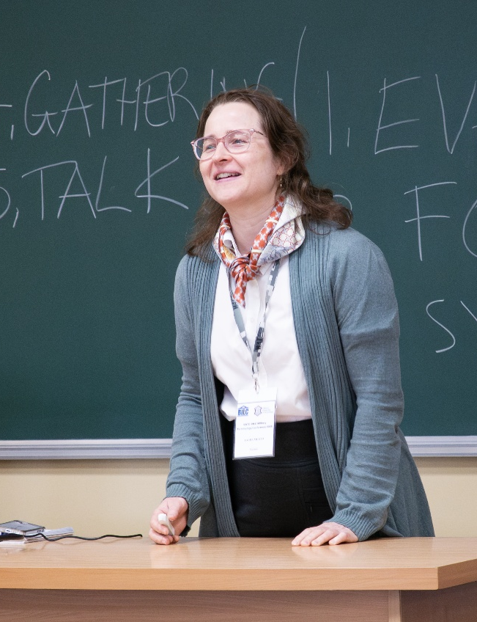
Voting on the name of the event

Slide 21
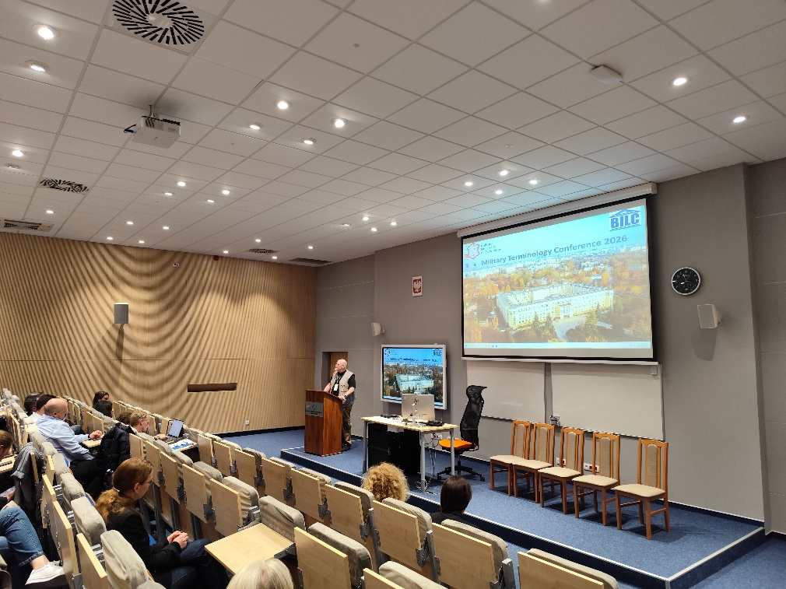
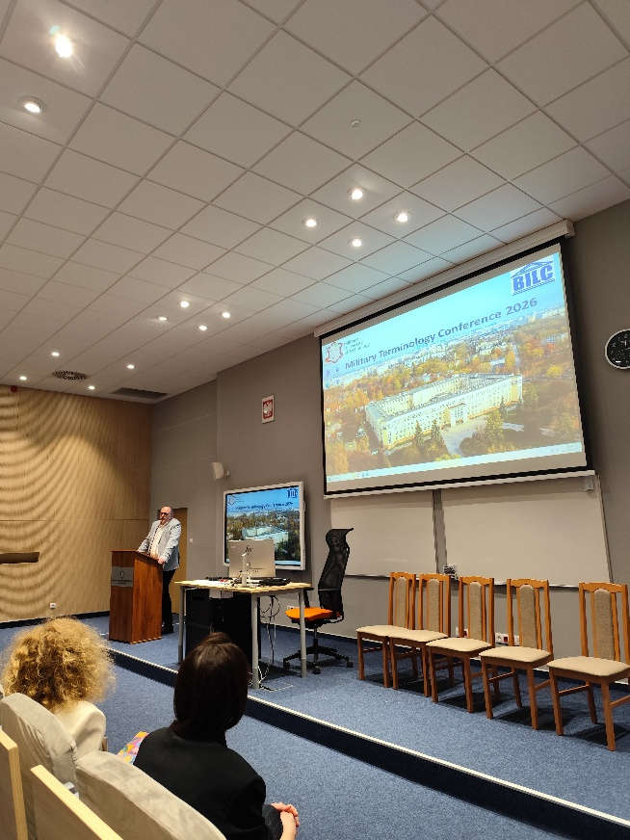
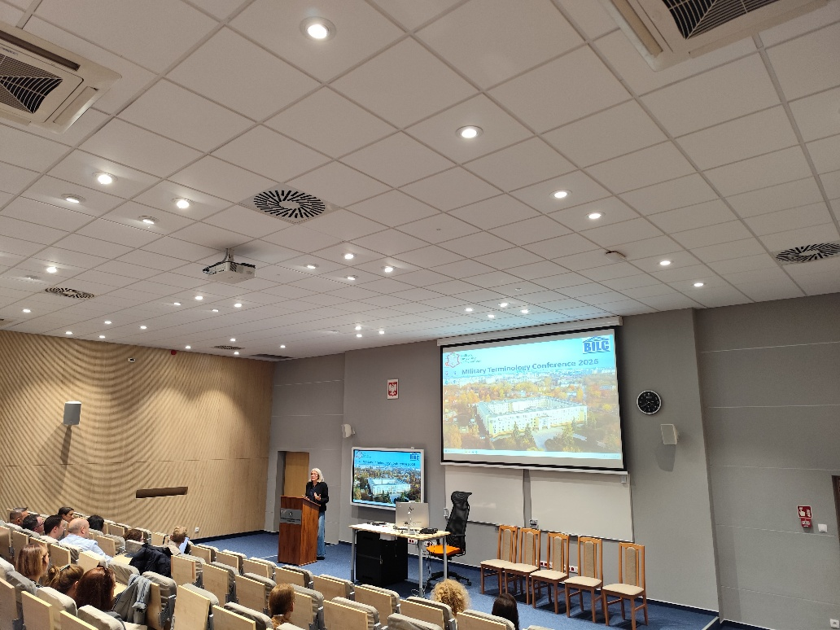
Final reports - workshops
Terminology needs for MAT developers, terminologists and educators as we move from national military doctrine to NATO doctrine.
Lynda W. Hansen (DNK)
Cognitive Warfare.
Building Cognitive Resilience Through Military Education
Jeremy Walters (POL)
Terminology Proposals: How to Better Understand Them
Serge Pelletier (CAN)

Slide 22
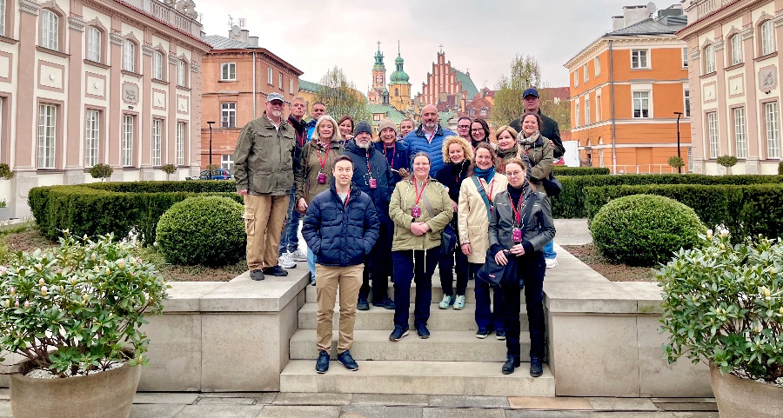
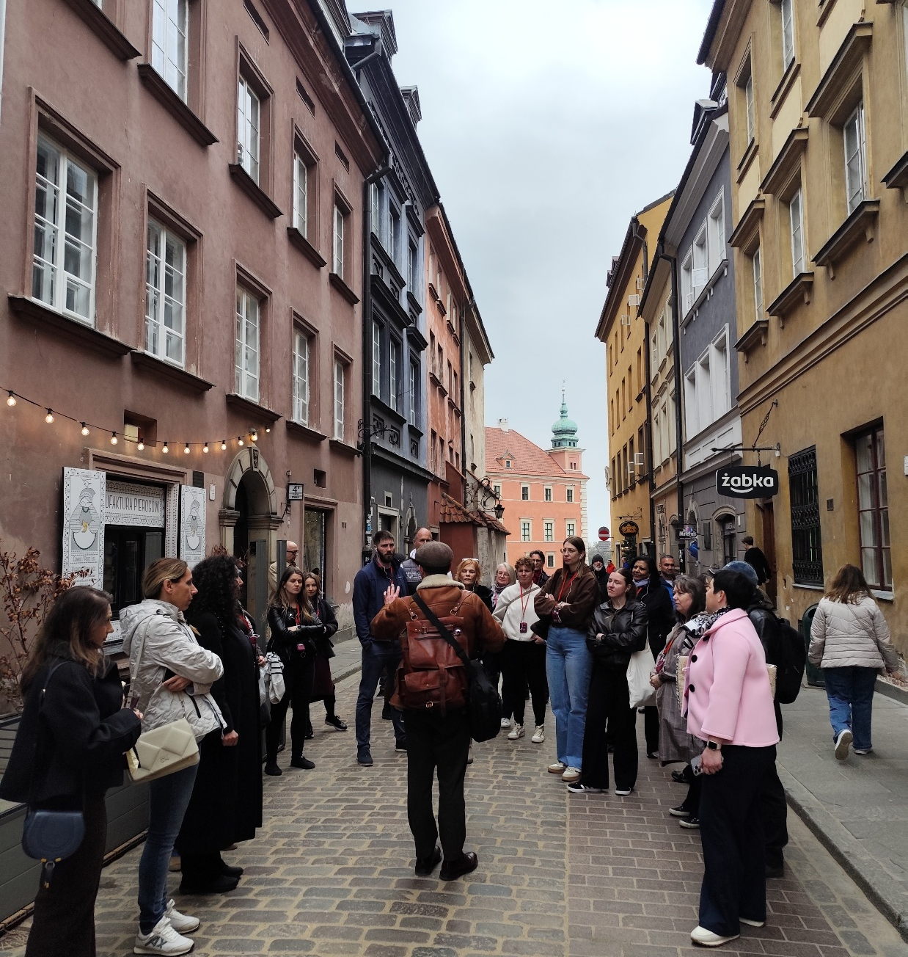
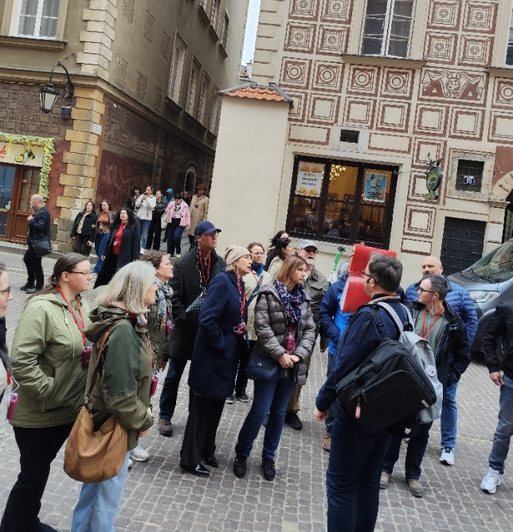

Warsaw Old Town

Slide 23
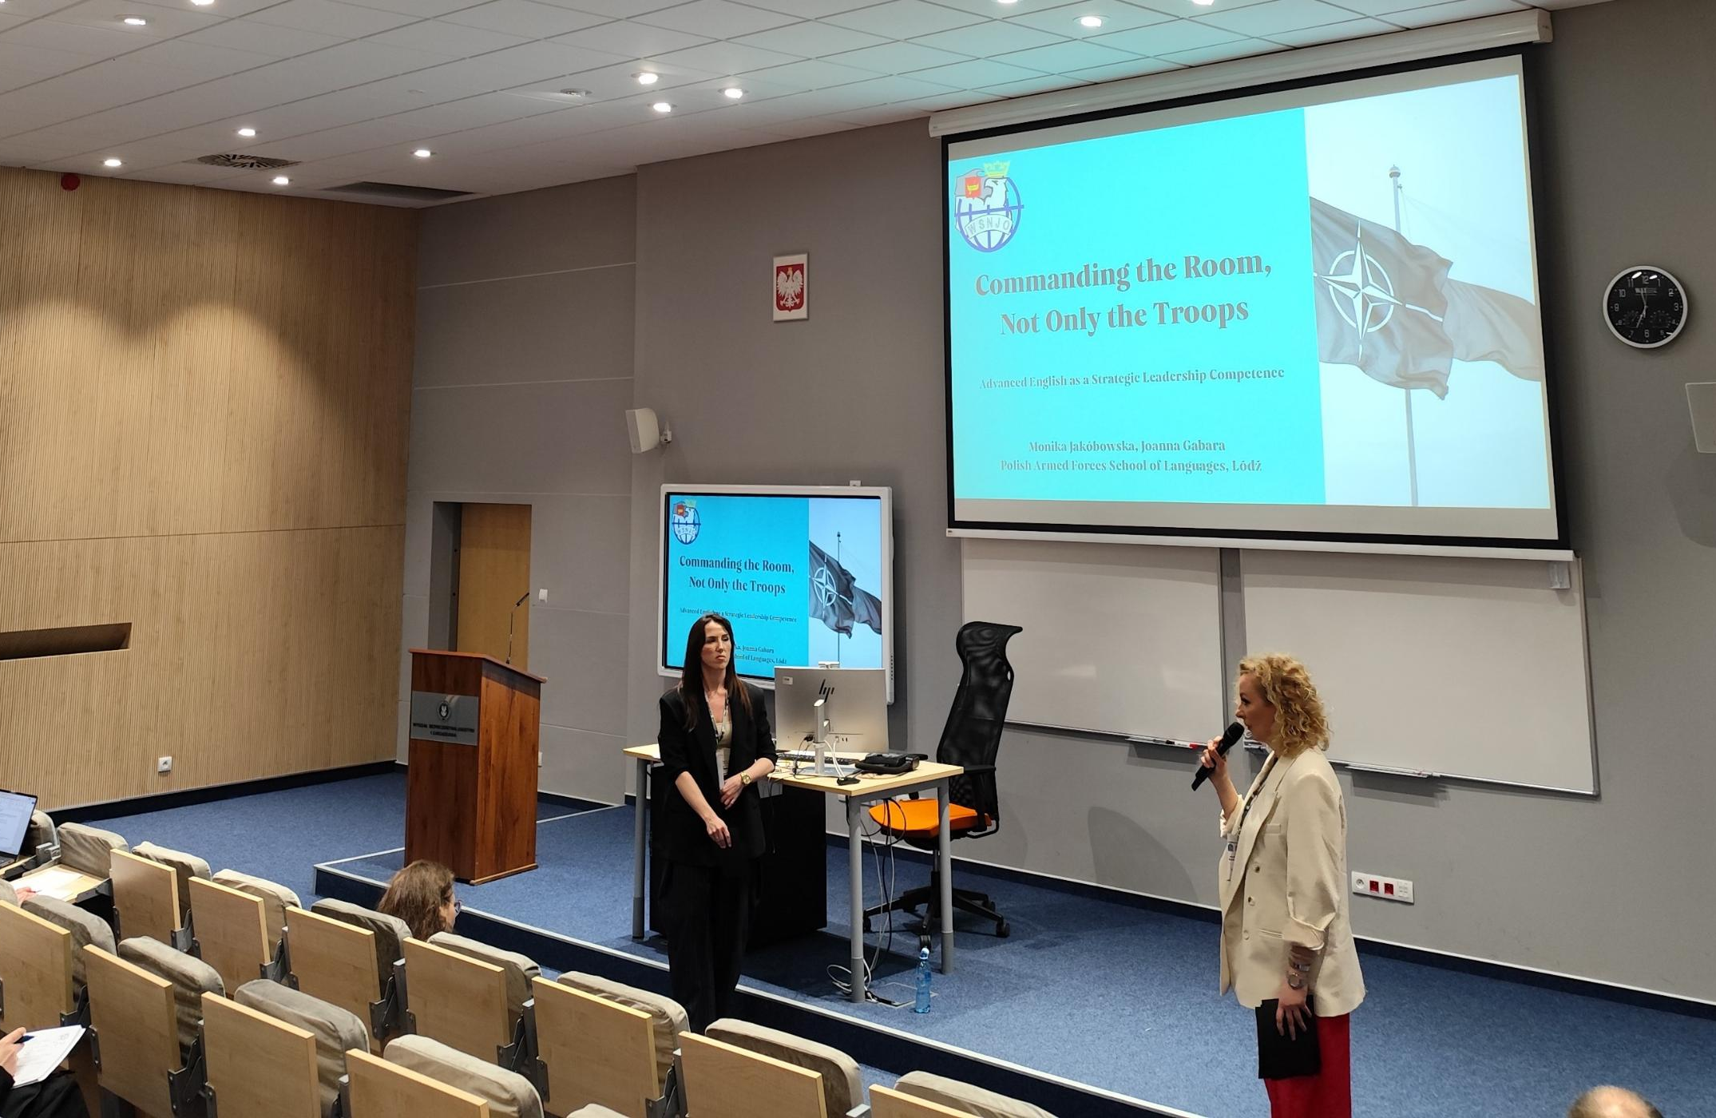
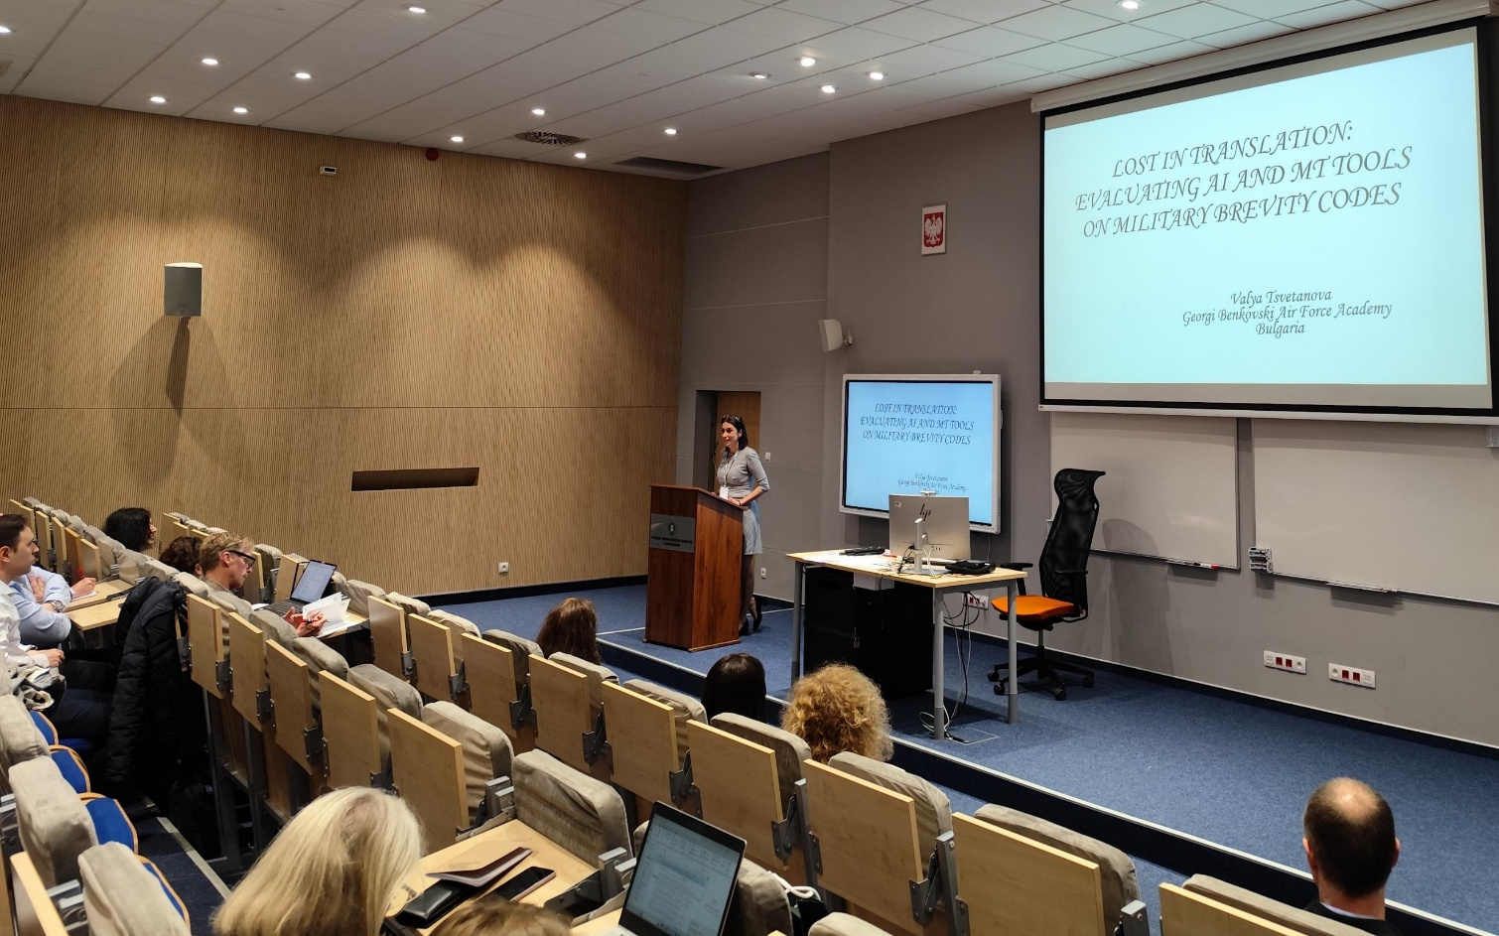
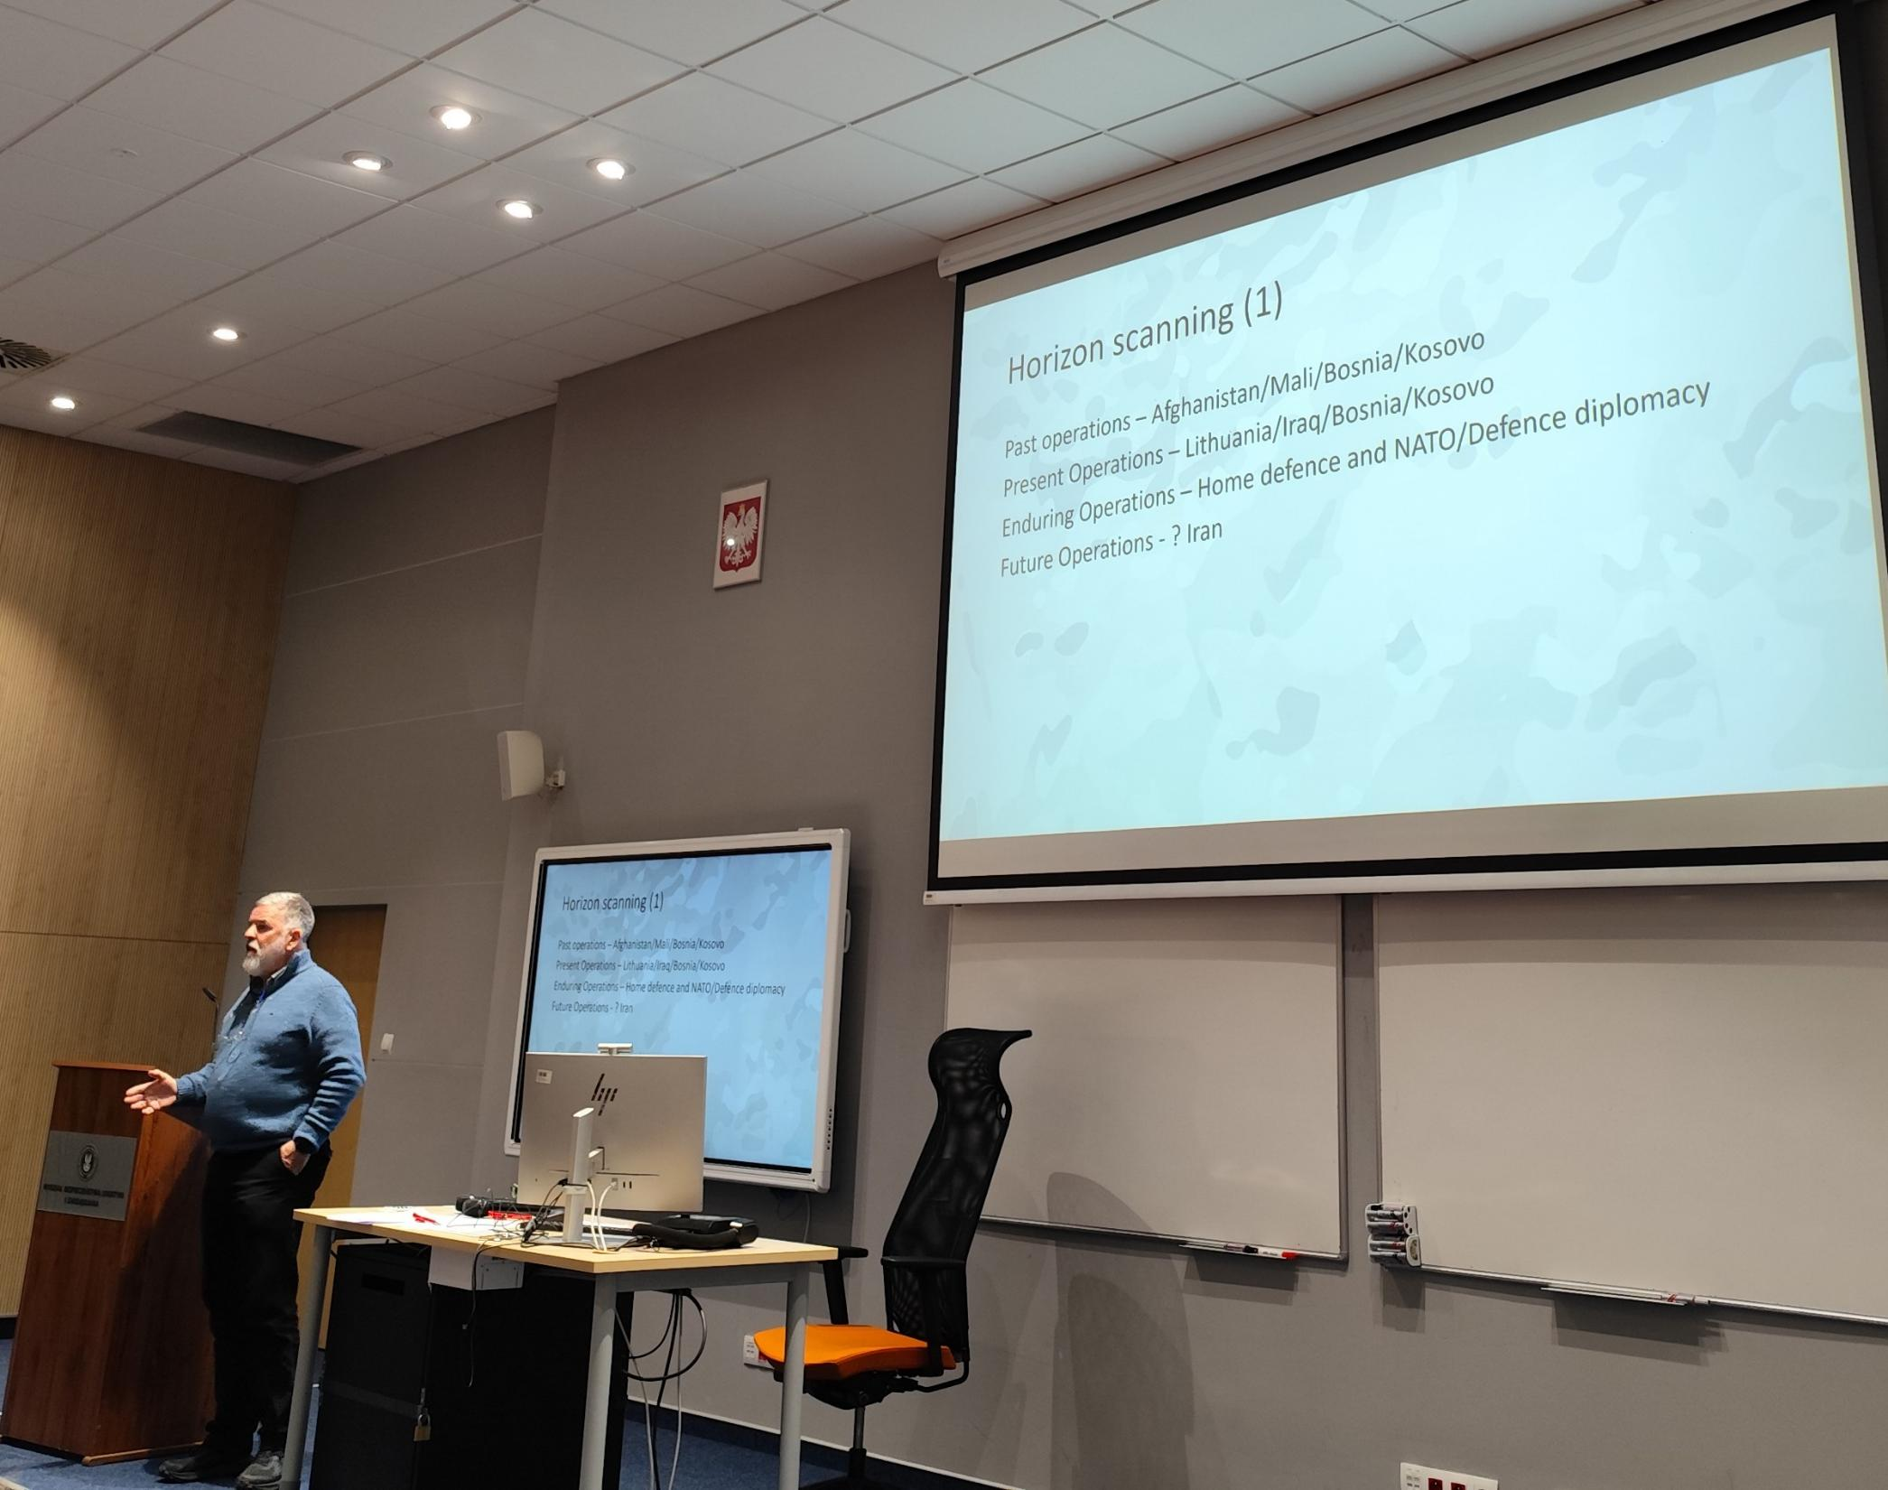
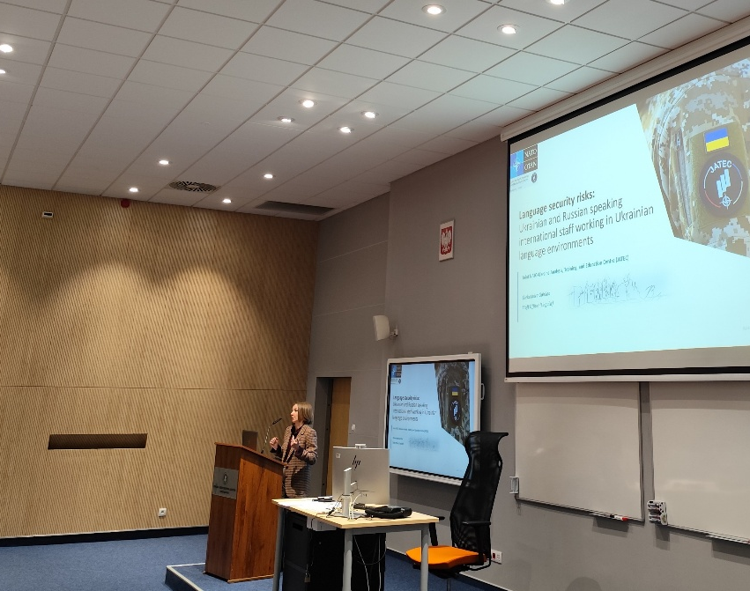
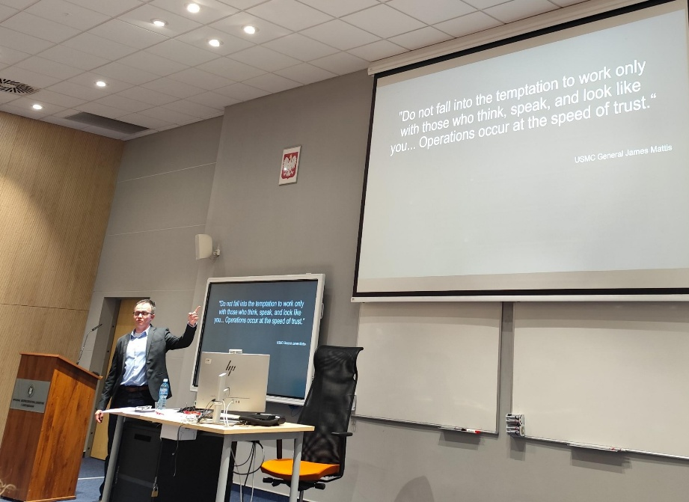
Session 4 & 5

Slide 24
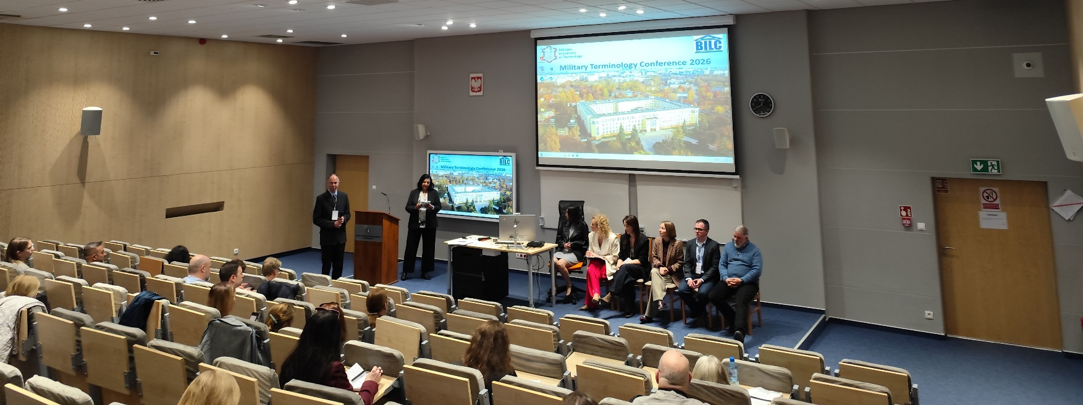
Panel discussion day 3

Slide 25
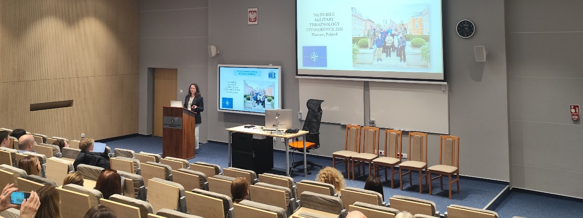
Concluding remarks

Slide 26

Thank you.

