Slide 1
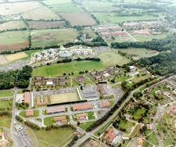
From Input to Impact: Adapting L2 Training for Evolving Learner Profiles and Operational Demands.
Mrs Anat Shpitzer

Slide 2
Who & What is DCLC
2* Comd DefAc
1* DComdt
International Group
Defence Centre for Languages & Culture
(DCLC)
Defence Attaché & Loan Service
International Section
Building Integrity (UK)
© Crown Copyright
Notes:
This is our organisational structure – will cover each of the elements in turn.
All united by delivery of training and development of knowledge, skills and behaviours which are required for a wide range of roles across UK Defence and with our overseas partners
Although newly formed, already identifying synergies between different elements and opportunities to explore these further as we mature as a group

Slide 3
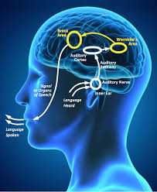
L2 Acquisition in Defence Context
From Input to Operational Output
Younger vs Older Learners
Notes:
Set context: language = operational capability, not academic exercise

Slide 4
Processing Model
Cognitive pathway from exposure to use
Input
Intake
Processing
Acquisition
Output
Notes:
Walk through diagram step by step

Slide 5
Younger Learners versus Older Learners
Implicit learning
Phonological advantage
Require structure & repetition
Explicit learning strength
Goal-oriented
Time constrained
WHY?
Notes:
Avoid assumption of natural acquisition without guidance

Slide 6
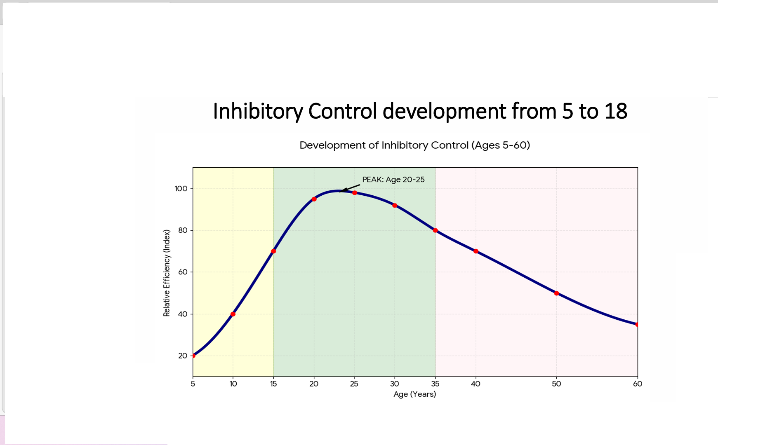
Inhibitory Control
Notes:
Link to mission prep and efficiency

Slide 7
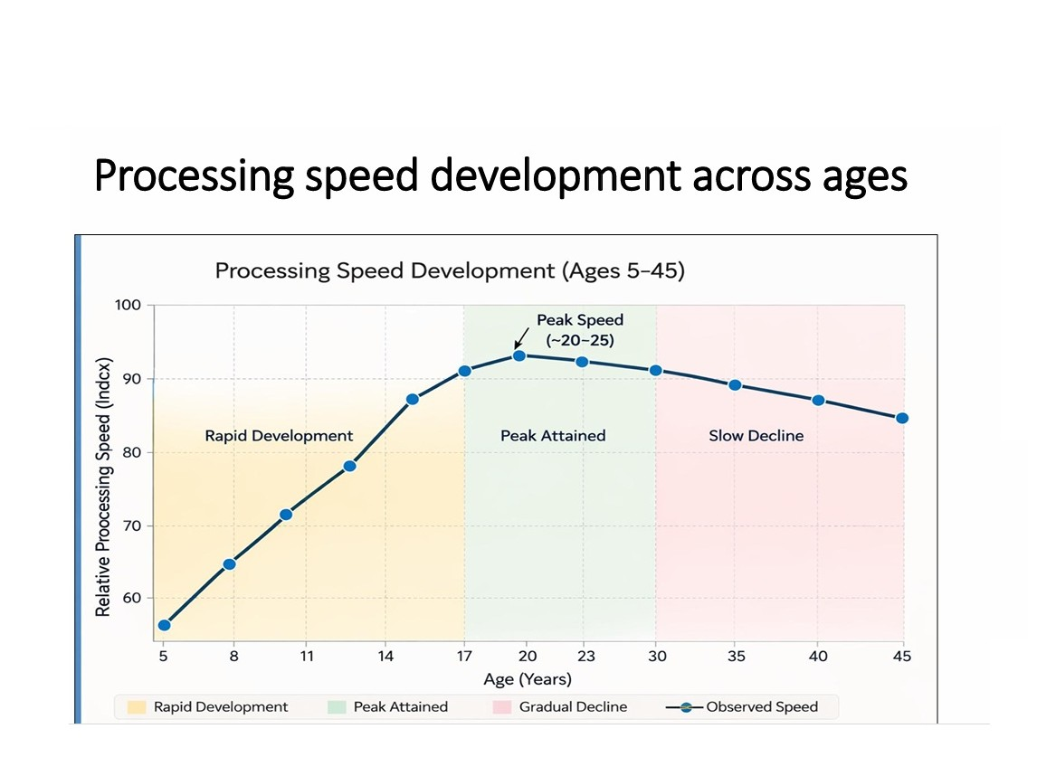
Processing Speed

Slide 8

Cognitive Load Theory (CLT)
Working
Memory
Long-Term Memory
Goal

Slide 9
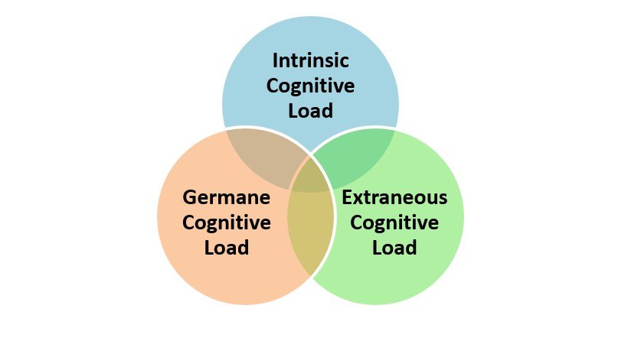
Cognitive Overload

Slide 10
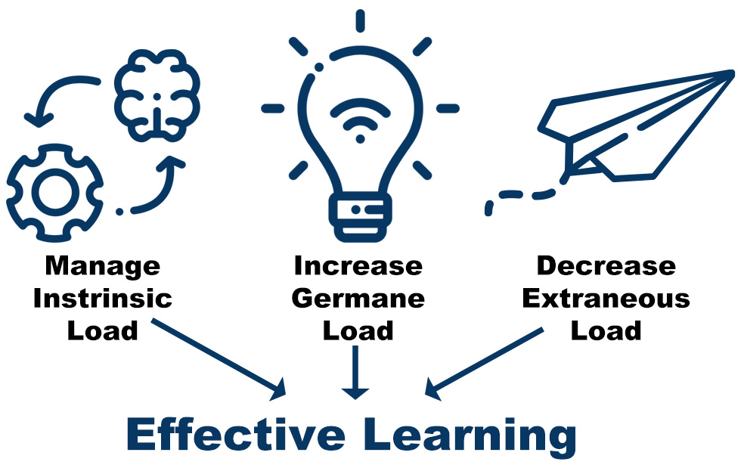
Optimum Learning

Slide 11
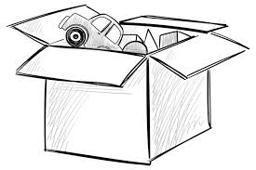
Working Memory
3 – 5 items simultaneously
Half of that in L2

Slide 12
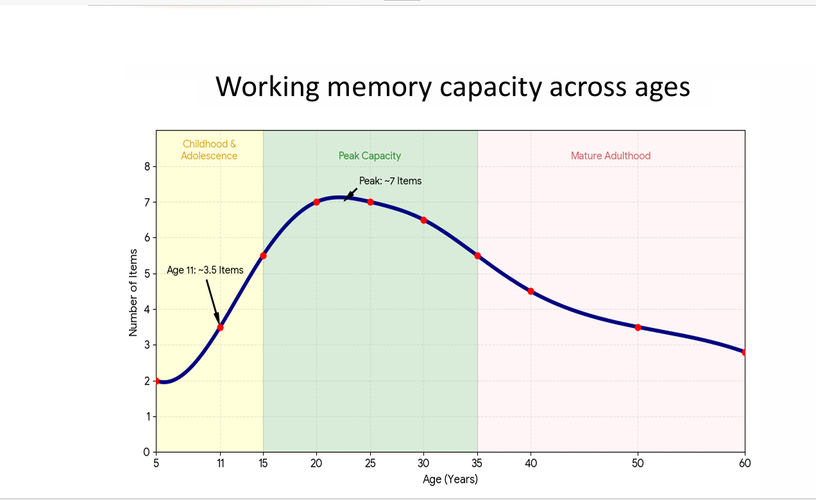
Working Memory

Slide 13
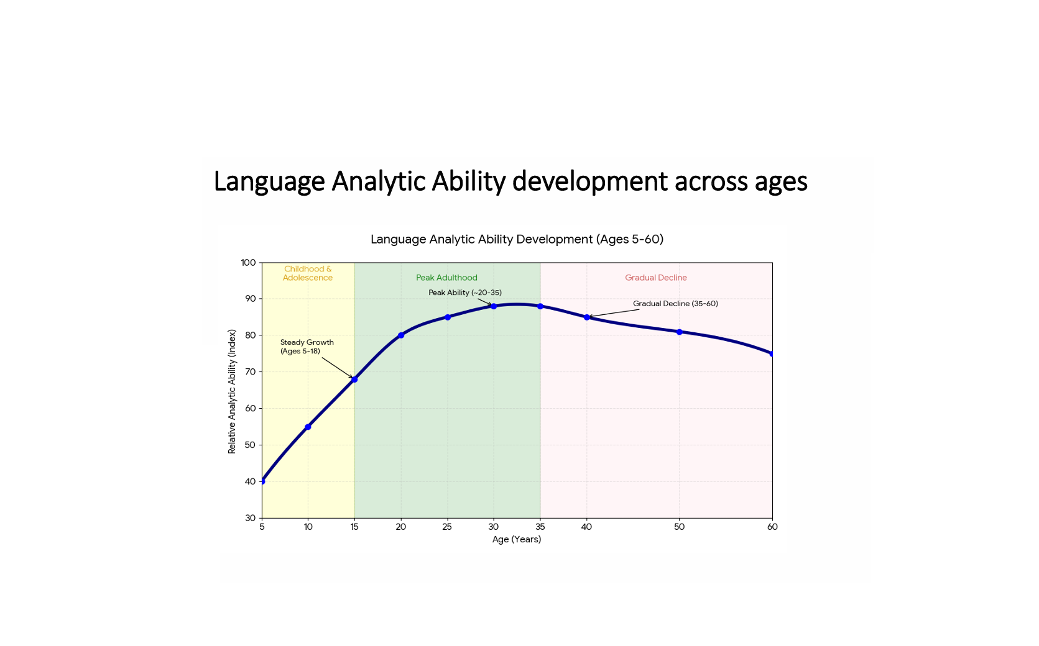
Language Analytic Ability
Notes:
Tie learning stages to real scenario

Slide 14
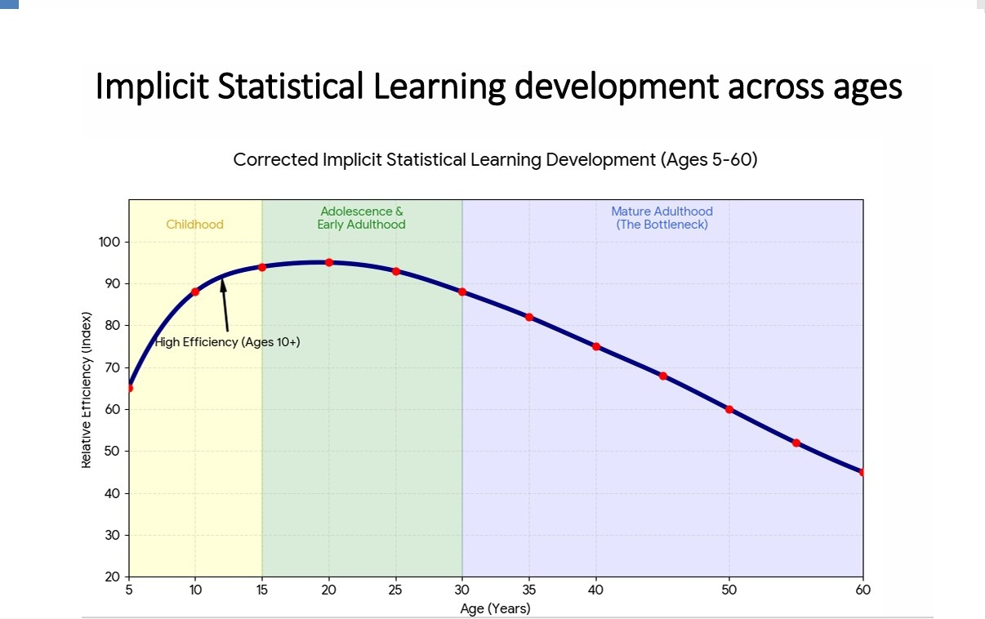
Implicit Statistical Learning
Notes:
Tie learning stages to real scenario

Slide 15
Other Factors Impacted
Processing Speed
Rote/Associate Memory
Phonetic Coding Ability
Phonological Memory
Notes:
Repetition builds fluency

Slide 16
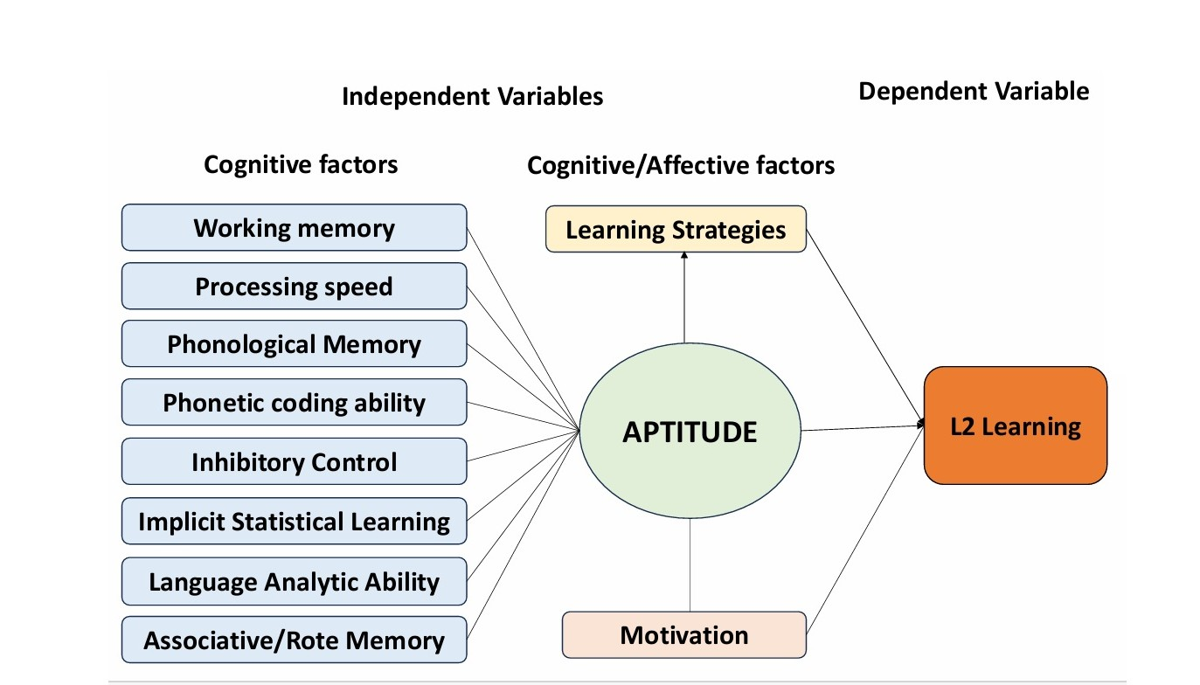
Independent and Dependent Variables

Slide 17
Academic Foundations
Input (Krashen)
Output (Swain)
Skill Acquisition (DeKeyser)
Notes:
Explain briefly: input alone insufficient, output + practice critical

Slide 18

Conti-Informed Model
Structured input
Repetition
Scaffolded output
Automatisation
Notes:
Stress deliberate practice over exposure

