Slide 1


Col Mario CRISTOBAL - Argentinean Army

Slide 2



ARMY LANGUAGE SCHOOL
Founded in 1992 – 34 years serving for excellence
We offer language courses of English, French, German, Portuguese, Italian, Chinese and Spanish as a Foreign Language. Also, Technical Military English and French courses are taught. At present, our Language School is a renowned centre for the preparation of Cambridge University international exams. As of 2025, our School also acknowledges exams administered by Oxford University and Trinity College.

Slide 3
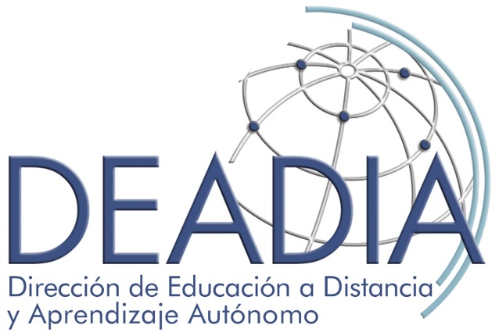

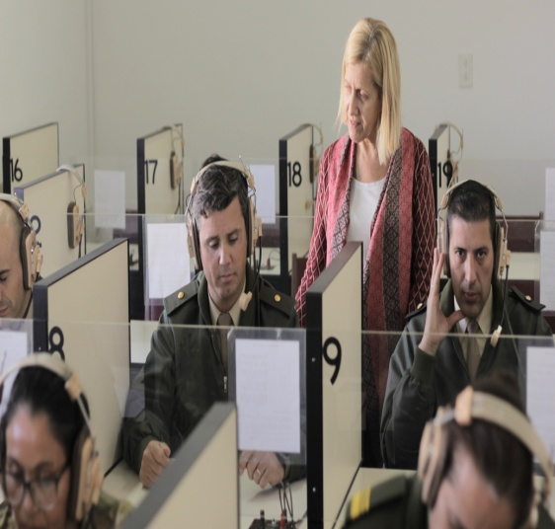
LANGUAGE SCHOOL
SECRETARY
ENGLISH DEPARTMENT
CLOSER
SPECIFIC
MILITARY
ENGLISH
OTHER LANGUAGES
REGULAR COURSES FOR CIVILIANS
ONLINE
BRIGADE
GERMAN
SPANISH
CHINESE
ITALIAN
PORTUGUESE
FRENCH
FRENCH
Tec Mil
TEENS
FIRST CERTIFICATE

Slide 4





ON-LINE COURSES
FORMAT
LANGUAGE
LEVEL
SYNCHRONIC
ENGLISH
I al VI
ENGLISH CLOSER
I al VI
ASYNCHRONIC
TECHNICAL ENGLISH
I al III
TECHNICAL FRENCH
I al III

Slide 5
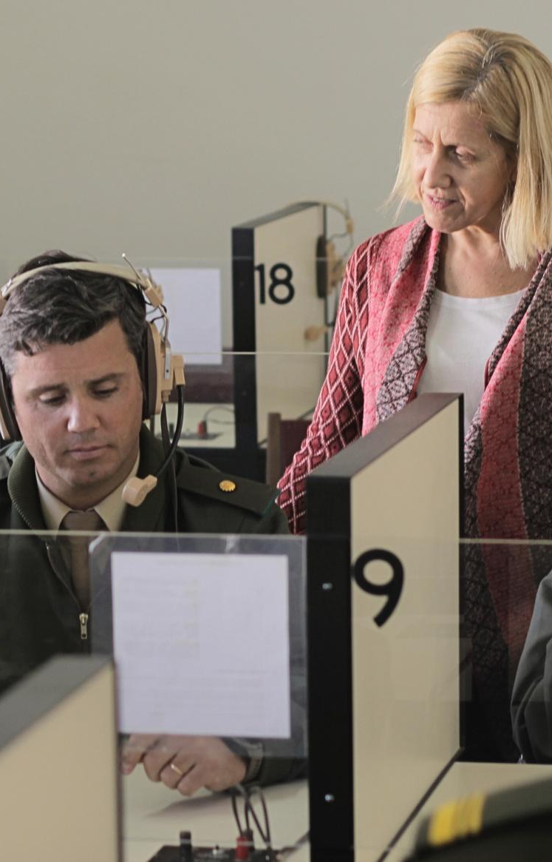
IN-PERSON
LANGUAGE
LEVEL
ENGLISH
I al VI
ENGLISH TEENS
I al V
FIRST CERTIFICATE
FRENCH - ITALIAN
GERMAN - CHINESE
PORTUGUES
SPANISH FOR FOREIGN OFFICERS
I al IV
SENIOR ENGLISH
SPECIFIC

Slide 6
STUDENTS
2025
2026
ON-LINE COURSES
1.175
ON-LINE COURSES
1.452
IN-PERSON COURSES
945
IN-PERSON COURSES
980
TOTAL STUDENTS: 2.120
TOTAL STUDENTS: 2.432

Slide 7
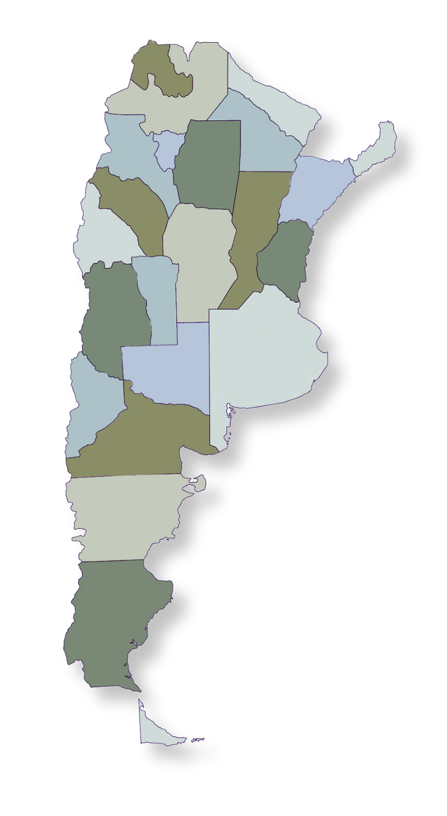

STAFF TESTING CENTRES 2025
3.700 Km Length
X
X
V
III
1. Cdo Br M V: SALTA
2. Cdo Br Parac IV: CORDOBA
3. Cdo Br Mec Xi: RIO GALLEGOS.
4. Cdo Br Mte XII: POSADAS
5. Cdo Br M VI: NEUQUEN
6. Cdo DE II: CORDOBA
7. Cdo Br Mec IX: COMODORO RIVADAVIA
8. Cdo Br Mec X: SANTA ROSA
X
X
XII
IV
X
X
II
VIII
DEADIA
1.400 Km Width
X
X
X
X
I
VI
X
IX
ASSESSED STAFF IN 2025
CENTRAL SCHOOL: 749
OTHER CENTRES: 570
TOTAL STAFF ASSESSED: 1319
X
From Madrid to Moscow 3.500 Km
XI

Slide 8
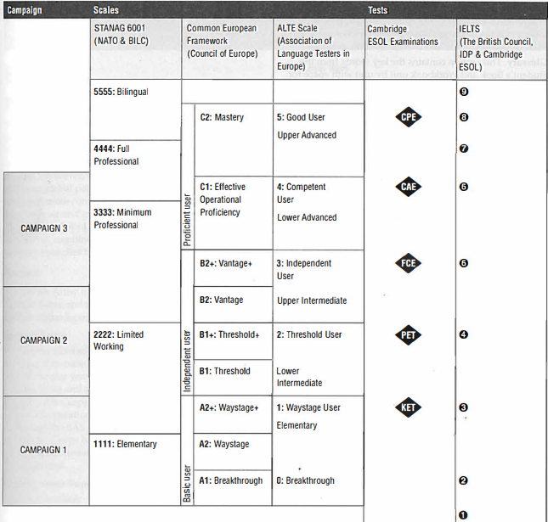
AN APPROACH TO EQUIVALENCIES OF INTERNATIONAL CERTIFICATES
STANAG 6001
SPECIFIC MILITARY ENGLISH
6
5
4
3
2
1
REGULAR COURSES
SME 3
SME 2
SME 1

Slide 9
Col Mario CRISTOBAL - Argentinean Army

Slide 11



Slide 12
Thank you for your attention

