Slide 1




332d Training Squadron
Assessment Engineering in Practice
Leveraging AI and Task Models to Generate STANAG-Aligned Listening Items
Assessment Engineering in Practice
Leveraging AI and Task Models to Generate STANAG-Aligned Listening Items
2026 NATO BILC Language Testing Workshop | Sarajevo, BiH
Petia Alexieva, PhD
Language Testing Analyst
ECL Program Manger
DLIELC Testing
Petia Alexieva, PhD
Language Testing Analyst
DLIELC Testing
This briefing is
UNCLASSIFIED
Current as of
21 AUG 2026
Notes:
As item developers we spend an enormous amount of time and effort writing, moderating, trialing and calibrating test items. But what happens after trialing? Are we truly learning as much as we can from our very expensive calibrated items? Are we truly listening to what our trialing data is telling us?
In the traditional craft approach, once an item is calibrated, it goes into the operational pool and sits there as a single "one-off“ lucky item. When it retires, all that item-writing effort retires with it. And what happens with the items that fail psychometric review—showing poor discrimination or falls outside our desired difficulty range? They are simply discarded as waste. All that empirical data is thrown away.
Assessment Engineering (AE) helps us get the most value of our calibrated items:
Cloning Exemplars: Instead of treating high-performing, calibrated items as lucky one-offs, AE provides a principled way to reverse-engineer them. We extract their underlying blueprint—the exact task model, cognitive load, and distractor mechanics that made them work—and clone them into parallel-by-design items that inherit that proven validity.
Extracting Intelligence from Failures: Instead of tossing out underperforming items, AE uses their psychometric defects as instructional diagnostics. By auditing where an item broke down against its task model, we extract actionable item-writing rules—turning trial failures into a blueprint for structural repair.

Slide 2
DLIELC
DLIELC Testing Mission
This briefing, presentation, or document is for information only. No U.S. Government commitment to sell, loan, lease, co-develop or co-produce defense articles or provide defense services is implied or intended. This information is furnished on the condition that it will not be released to another nation without specific authority of the Department of the Air Force of the United States, that it will be used for military purposes only, that individual or corporate rights originating in the information, whether patented or not, will be respected, that the recipient will report promptly to the United States any known or suspected compromise, and that the information will be provided substantially the same degree of security afforded it by the Department of War of the United States. Also, regardless of any other markings on the document, it will not be downgraded or declassified without written approval of the originating U.S. agency.
This briefing is
UNCLASSIFIED
Current as of
21 AUG 2026
Notes:
Mandatory disclaimer.

Slide 3

DLIELC Testing Mission
DLIELC Testing Mission
The Defense Language Institute English Language Center Testing Branch manages DoW English language proficiency assessments in support of Security Cooperation-sponsored training, military accessions, and U.S.-sponsored exercises.
The views expressed in this piece are those of the author and do not necessarily reflect the official policy or position of the Air Force, the Department of Defense, or the U.S. Government.
This briefing is
UNCLASSIFIED
Current as of
21 AUG 2026
Notes:
Mission statement and mandatory disclaimer.

Slide 4

Workshop Objectives
Workshop Objectives
Build authenticity features into listening specifications.
Apply Assessment Engineering to create item templates.
Generate targeted multiple-choice listening items using AI.
This briefing is
UNCLASSIFIED
Current as of
21 AUG 2026
Notes:
By the end of this session, participants will be able to:

Slide 5

Why Gemini?
Workshop Objectives
Free-tier users can create custom Gems
Deep Linguistic Analysis
Direct Audio Ingestion (Free Tier)
Vast Working Knowledge Capacity
Multi-Task Gem Architecture
Collaborative Workflows
This briefing is
UNCLASSIFIED
Current as of
21 AUG 2026
Notes:
Accessible to All Users: Free-tier accounts can create, run, and share custom Gems—enabling every item writer to adopt the workflow without paid subscriptions.
Deep Linguistic Analysis: Evaluates lexical density, syntactic complexity, cohesive devices, and pragmatic load to ensure rigorous construct calibration.
Direct Audio Ingestion (Free Tier): Accepts audio file uploads (MP3, WAV) for perceptual acoustic profiling, including speech rate, pauses, intonation, and background noise.
Vast Working Knowledge Capacity: Ingests complete proficiency standards (STANAG 6001/ILR), theoretical manuals, and extended passages simultaneously without losing instructions.
Multi-Task Gem Architecture: A clear, practical term describing a Gem configured with multi-functional capabilities rather than a single-purpose prompt.Standardized Collaborative Workflows: Distributes pre-configured item-generation and text-leveling blueprints across testing teams with zero technical setup.

Slide 6

332d Training Squadron
The Listening Construct
The Listening Construct
This briefing is
UNCLASSIFIED
Current as of
21 AUG 2026
Notes:
Issue with using authentic listening: time consuming to find, but an even bigger issue is they are not exactly aligned with STANAG levels because they weren’t produced with specific levels in mind.

Slide 7
Listening or Reading?
Listening or Reading?
(1) Prior to the convoy's base departure yesterday morning, a directive was issued to inspect the tactical vehicle fleet. (2) Initially, the inspection commenced with an evaluation of the tire pressure and fuel levels of the three lead transport vehicles, requiring approximately twenty minutes. (3) Subsequently, a minor oil leak was detected on the second vehicle, prompting immediate notification to motor pool maintenance personnel. (4) The mechanical anomaly was resolved within an hour, thereby ensuring adherence to the designated operational schedule. (5) Upon completion of the fleet inspection, maintenance logs were submitted to administration, followed by a tactical route briefing for the designated operators. (6) The convoy ultimately departed at precisely 0830 hours without further delay, culminating in successful mission execution.
(1)So, yesterday morning my boss asked me to check over the vehicles before the convoy headed out. (2) Well, first I checked the tires and fuel on the three lead trucks—and that took about twenty minutes. (3) And that’s when I noticed the second truck had a small oil leak, so I had to let the guys at the motor pool know right away. (4) But luckily, they fixed the problem in under an hour, so we were still able to stay on schedule.
(5) Anyway, as soon as I finished the inspection, I turned in the maintenance log to the front office, and then I briefed the drivers on our route. (6) So, we finally got on the road at exactly 0830, without any more delays, and the whole mission went really well.
This briefing is
UNCLASSIFIED
Current as of
21 AUG 2026
Notes:
• Nominalization: "before the convoy left" → "Prior to the convoy's departure"
• Passive Voice: "my supervisor asked me" → "a directive was issued" (removes personal agency)
• Latinate Vocabulary: "First" → "Initially"; "checked" → "commenced with an evaluation“
• Lexical Density: Replaces simple verbs with dense noun phrases.
• Formal Transition: "After that" → "Subsequently“
• Syntactic Density: Combines clauses to reduce coordination and increase subordinating structures.
• Precise Vocabulary: "fixed the issue" → "resolved the mechanical anomaly“
• Formal Cohesion: "allowing us" → "thereby ensuring adherence"
• Impersonal Register: Removes self-reference pronouns ("I") entirely.
• Noun-Stacking: "Once the inspection was completed" → "Upon completion of the fleet inspection“
• High-Frequency Written Idioms: "finally departed" → "ultimately departed"; "completed successfully" → "culminating in successful execution"

Slide 8

Activity: Spoken vs. Written Discourse
Activity: Spoken vs. Written Discourse
Card Sort Challenge
Spoken vs. Written Discourse
Why This Matters:
Goal: Understand the parameters needed to prompt AI effectively.
1) Work in pairs.
2) Separate the cards into spoken vs. written features. 3) Match the contrasting feature cards.
If we don't specify oral traits, AI defaults to writing "spoken reading texts."
This briefing is
UNCLASSIFIED
Current as of
21 AUG 2026

Slide 9
Activity Key
Selecting Items to Clone
More Typical of Spoken Discourse | More Typical of Written Discourse
Informal & Contracted | Formal & Full Forms
Imprecise | Precise
Repetitive | Rich Vocabulary
Personal & Subjective | Impersonal & Objective
Spontaneous | Edited
Discussion Questions
Can spoken features occur in writing?
Can written features occur in speaking?
In what specific text types and levels?
This briefing is
UNCLASSIFIED
Current as of
21 AUG 2026
Notes:
Can spoken features show up in writing? Sure—think of text messages.
Can written features show up in speaking? Absolutely—like a formal academic lecture or a radio briefing.
As test developers, our job is to deliberately control these features to ensure our listening items are standardized and don't accidentally measure reading comprehension instead.

Slide 10
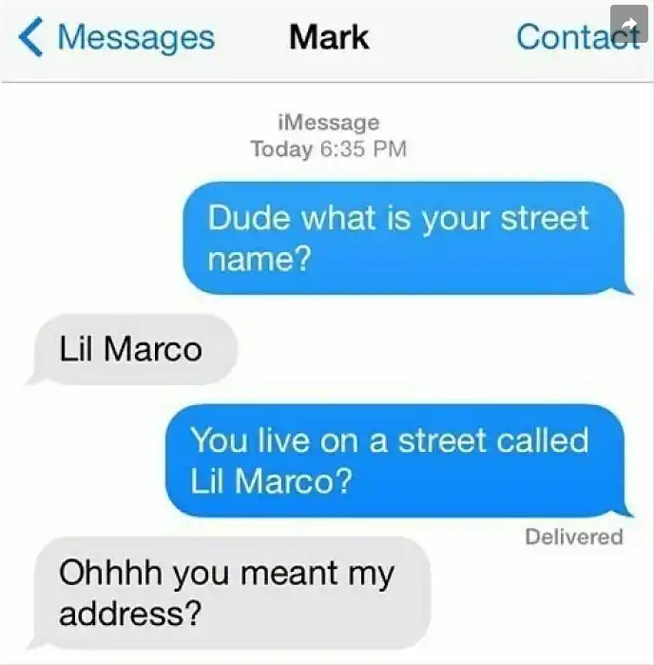

Listening or Reading?
Listening or Reading?
Cloning Items
This briefing is
UNCLASSIFIED
Current as of
21 AUG 2026
Notes:
Would you put this text on a test? Why (not)?

Slide 11




Spoken - Written Continuum
SPOKEN TO WRITTEN CONTINUUM
More Spoken
More Written
The boundaries between spoken and written discourse frequently overlap depending on the text type and context.
This briefing is
UNCLASSIFIED
Current as of
21 AUG 2026
Notes:
We have to treat this as a continuum. On the far spoken side, you have spontaneous face-to-face chats. On the far written side, you have edited textbooks and formal academic essays.
Public addresses and formal military briefings live right in the middle. For STANAG Level 2 listening, we want to target that middle-left sweet spot—standard spoken language that is planned and formal, but still fundamentally oral and conversational in its structure.

Slide 12
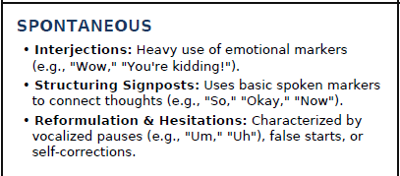
Design Decisions
Design Decisions
Review the Text Analyzer specs and make strategic tweaks.
Example of level-aligned design decisions:
This briefing is
UNCLASSIFIED
Current as of
21 AUG 2026
Notes:
These are your parameters for generation. How can you adjust them. Ex. Do you need to shift parameters down, especially for Level 1?

Slide 13
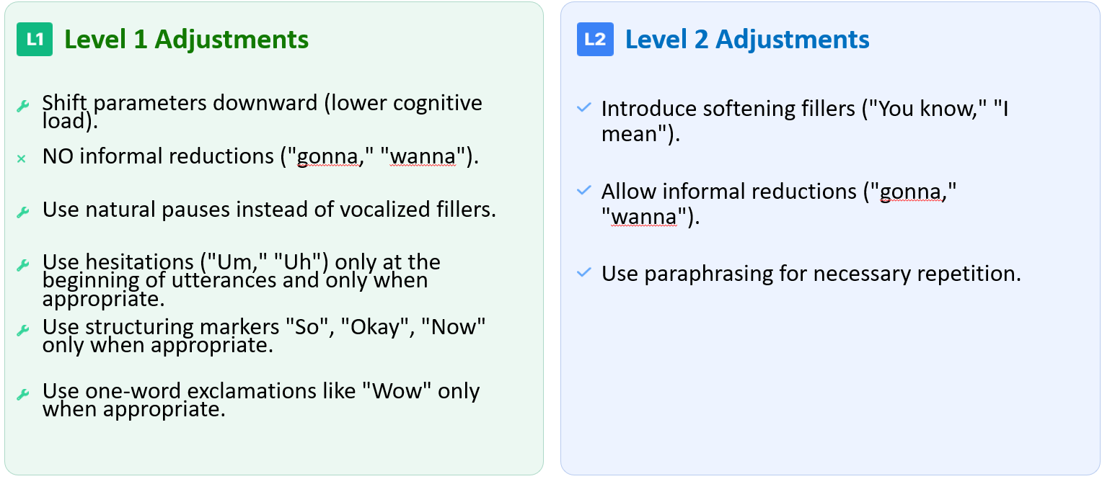
Design Decisions (Continued)
Design Decisions
This briefing is
UNCLASSIFIED
Current as of
21 AUG 2026
Notes:
These are your parameters for generation. How can you adjust them. Ex. Do you need to shift parameters down, especially for Level 1?

Slide 14


Tech Demo: Text Analyzer Gem
Tech Demo: Text Analyzer Gem
The Text Analyzer Gem serves as a dual-modality linguistic analyzer and automated editing partner.
Gem Capabilities:
Continuum Mapping: Evaluates lexical density and identifies spoken vs. written features.
Autonomous Leveling: Diagnoses exact STANAG base and plus levels (0+ to 3) based on ATrainP-5.
Modality Conversion: Converts written reading passages into listening scripts and vice versa.
Text-Type Shape-Shifting: Re-engineers texts into authorized STANAG text types.
This briefing is
UNCLASSIFIED
Current as of
21 AUG 2026
Notes:
This custom Gem focuses on the stimulus. It can polish existing stimuli and create new ones.
It has several functions: Linguistic analysis based on the listening and reading features we sorted at the beginning of the workshop. Level, skill and text type conversion.

Slide 15
AI Prompts to Use
Top-Down Cloning Strategy
Linguistic Analysis
“Analyze this text: [paste text]”
“Is this listening or reading?"
Modality Conversion
“Convert to listening/reading.”
“Convert this passage into an authentic listening script.”
Level Change
“Scale this text up/down to … ”
Text-Type Shape-Shifting
“Rewrite as Level 2 radio briefing.”
This briefing is
UNCLASSIFIED
Current as of
21 AUG 2026
Notes:
Since we already programmed our Gem with a comprehensive system blueprint, you don't have to write a complex prompt. Simply type 'Analyze this text:' followed by your passage, and watch the AI execute our four-step assessment workflow!"

Slide 16
What Is Lexical Density?
What is Lexical Density?
The ratio of content words to grammatical/function words within a clause.
Spoken Discourse
Written Discourse
Is less lexically dense than written discourse. Content words tend to be spread out over a number of clauses.
Content words seem to be tightly packed into individual clauses, significantly increasing the density.
This briefing is
UNCLASSIFIED
Current as of
21 AUG 2026

Slide 17
Content vs. Function Words
Content vs. Function Words
Content Words (more stress) | Function Words (less stress)
Nouns | Prepositions
Main Verbs | Auxiliaries and Modals
Adjectives | Determiners (a, the, some, six, this + N)
Possessive Pronouns (Those are hers.) | Most Pronouns
This/that, these/those as pronouns (Look at that!) | This/that, these/those as determiners (Look at that car!)
Adverbs formed from adjectives with -ly (slowly, nervously) | Adverbs not formed from adjectives (now, then, very, only, just)
Negation words (no, not, isn’t won’t) | Linking verb ‘be’ (She’s right.)
Wh-words (why, what, how) | Conjunctions
This briefing is
UNCLASSIFIED
Current as of
21 AUG 2026

Slide 18



Content Words Receive the Stress
Content words receive the stress
Cows eat grass.
The cows eat the grass.
The cows will eat the grass.
The cows will be eating the grass.
The cows will have eaten the grass.
This briefing is
UNCLASSIFIED
Current as of
21 AUG 2026
Notes:
Content words carry the main meaning in the sentence and naturally carry the stress. Function words glue the sentences together and are unstressed or reduced.
Read the first line: 'Cows eat grass.' Three syllables, three content words. It takes about one second to say. Now look at the last line: 'The cows will have eaten the grass.' It’s nine syllables, but it still only has three stressed content words. It takes almost the exact same amount of time to say because native speakers compress all those unstressed function words.
If we write listening scripts that pack too many unstressed grammatical clusters together, that also drastically increases the auditory processing load.

Slide 19


332d Training Squadron
Framework Overview
Framework Overview
This briefing is
UNCLASSIFIED
Current as of
21 AUG 2026

Slide 20

Intended Proficiency Levels
Intended Proficiency Levels
Clifford and Wilcox (2023) Validation Framework
L3
Alignment! Alignment! Alignment!
ITEM DIFFICULTY
L2
Proficiency Levels =
Separate Constructs
L1
This briefing is
UNCLASSIFIED
Current as of
21 AUG 2026
Notes:
This is a top-down (or construct-driven) model.
1. It Starts with the Construct, Not the Items. Alignment of the three models – the theoretical construct model, the test development model, and the psychometric scoring model.
2. Each Level is a separate Construct. Each level has its own unique, qualitative requirements (the Task, Condition, and Accuracy matrix), the test specifications for each level must be engineered from the top down to target those specific boundaries. 3. Direct Alignment of Speaker Purpose and Listener Task
As Clifford and Wilcox (and Cox) emphasize, a top-down model ensures that the speaker's communicative purpose in the audio text aligns perfectly with the listener's task in the test item.
Alignment happens during the development phase:
2. Aligning the item: The TCA Matrix (Task, Condition, Accuracy)
The Task is what the listener has to do. Are they just orienting themselves to find a quick location, or are they evaluating a complex, abstract argument?
The Accuracy is how well they have to do it. Are they just getting the gist, or do they need to catch every single detail?
The Conditions of the stimulus (Author Purpose, Text Type and Topical Domain). In other words, aligning the stimulus.
When we define the Task, the Accuracy, and the Conditions this clearly, we create a foolproof template. We take the guesswork out of item writing, and we guarantee that a Level 2 item actually tests Level 2 ability. Every single time.“

Slide 21
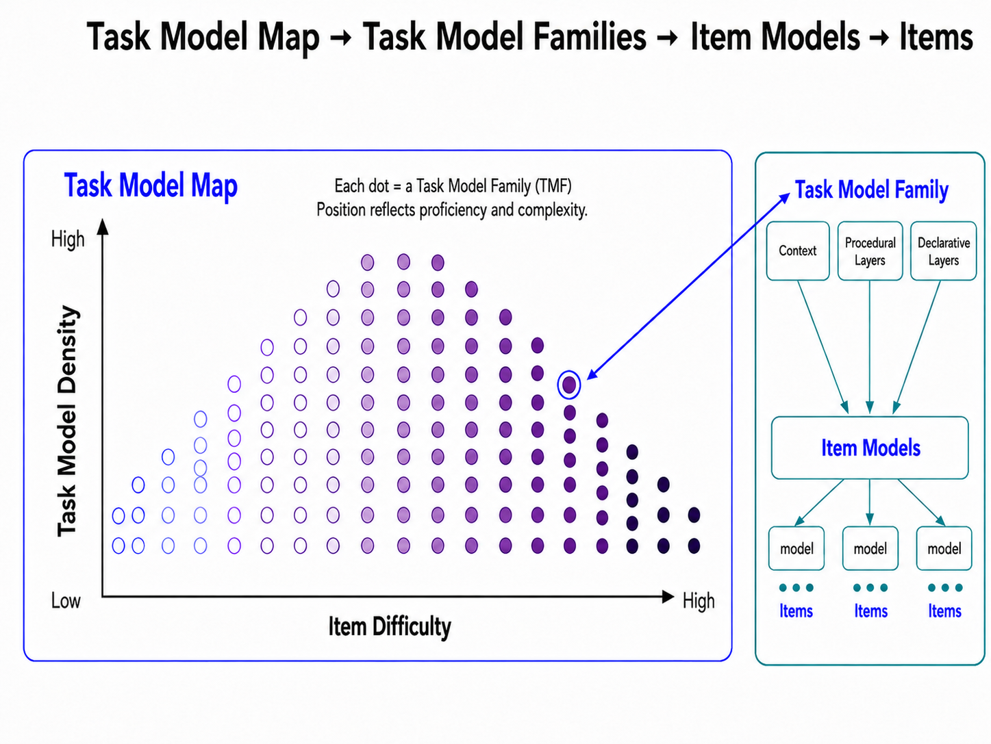
Assessment Engineering Framework
Luecht 2025: Assessment Engineering Framework
Luecht 2025: Assessment Engineering in Test Design; Methods and Applications
This briefing is
UNCLASSIFIED
Current as of
21 AUG 2026
Notes:
While both frameworks are obsessed with alignment, their starting points are different or even opposite.
Luecht takes a bottom-up approach because he anchors the entire test design to a continuous, empirical psychometric scale. The starting point is the statistical behavior of the items (item difficulty). The item difficulty scale is the proficiency scale because it shows increasing complexity. The levels are treated as points along the item difficulty scale. The model is predictive and generative – the logit sale dictates the target boundaries of the task models. Focus on Task Complexity variables which can be coded and manipulated by AI. The goal is to build a predictive assembly line for items.
Ideal Bell curve distribution for a norm-based test, not a proficiency test. But the framework is flexible because the highest density of tasks should be located where the cut scores are.

Slide 22
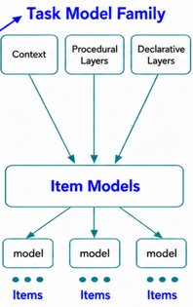
Mapping to the Proficiency Scale
Mapping to the Proficiency Scale
Task Model Map
L1
L2
L3
This briefing is
UNCLASSIFIED
Current as of
21 AUG 2026
Notes:
Instead of writing blindly, we engineer items to fit perfectly into a specific level's bucket. This requires strict adherence to level-specific constraints: vocabulary, grammar, and lexical density. Again, we want there to be at 0.5 to 1 logit gap between one level’s ceiling and the next level’s floor.

Slide 23


Task Model Families
Task Model Families
TMFs = core tasks within each level
L1
L2
Level 1 examples of core tasks:
Level 2 examples of core tasks:
This briefing is
UNCLASSIFIED
Current as of
21 AUG 2026
Notes:
Ask participants what kinds of core tasks they test at Levels 1 and 2.
For this workshop, I’ll focus on Topic for Level 1 and Cause-Effect Relationships for Level 2.

Slide 24
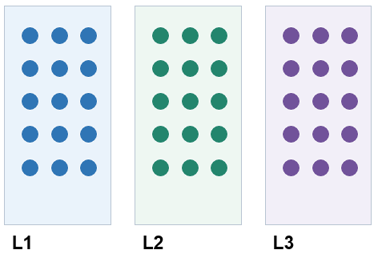
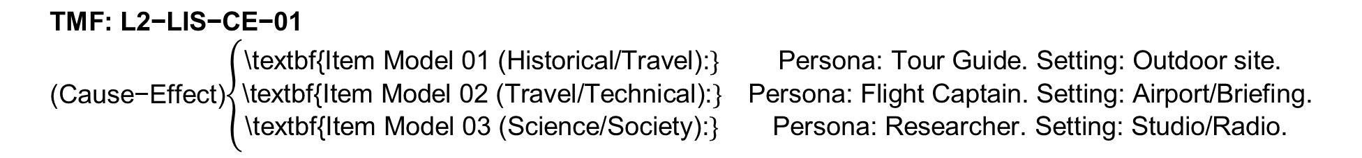
TMF Architecture
Data and Context for AI
Task Model Map
Task Model Families
Item Models
Items
$$\text{TMF}\text{: }\text{L}\text{2−}\text{LIS}\text{−}\text{CE}\text{−01 }\text{(}\text{Cause}\text{−}\text{Effect}\text{)}\left\{\begin{matrix}\text{\backslash }\text{textbf}\text{\{}\text{Item} \text{Model}\text{ 01 (}\text{Historical}\text{/}\text{Travel}\text{):}\} & \text{Persona}\text{: }\text{Tour} \text{Guide}\text{. }\text{Setting}\text{: }\text{Outdoor} \text{site}\text{.} \\ \text{\backslash }\text{textbf}\text{\{}\text{Item} \text{Model}\text{ 02 (}\text{Travel}\text{/}\text{Technical}\text{):}\} & \text{Persona}\text{: }\text{Flight} \text{Captain}\text{. }\text{Setting}\text{: }\text{Airport}\text{/}\text{Briefing}\text{.} \\ \text{\backslash }\text{textbf}\text{\{}\text{Item} \text{Model}\text{ 03 (}\text{Science}\text{/}\text{Society}\text{):}\} & \text{Persona}\text{: }\text{Researcher}\text{. }\text{Setting}\text{: }\text{Studio}\text{/}\text{Radio}\text{.}\end{matrix}\right.$$
This briefing is
UNCLASSIFIED
Current as of
21 AUG 2026
Notes:
Feed AI the AE framework and the test-specific TMM and TMFs first to give it the larger context.
Then, Item Models = Templates or blueprints for cloning similar items that target a similar difficulty range.

Slide 25
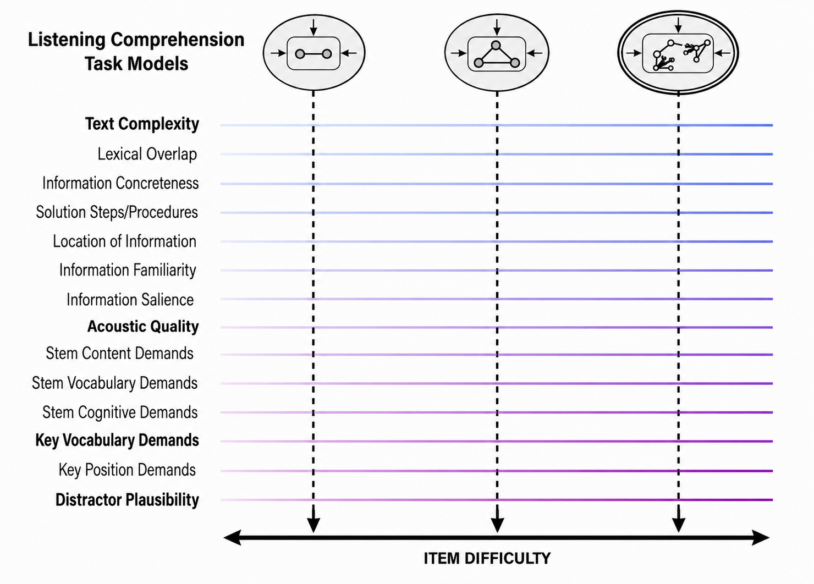
Complexity Design Layers
Design Decisions
This briefing is
UNCLASSIFIED
Current as of
21 AUG 2026
Notes:
The Item Model Extraction Mechanism
The Task Model Generator Gem reverse-engineers calibrated items using 20 empirical difficulty criteria derived directly from the seminal second-language listening comprehension research by Amber Bloomfield, Sarah Wayland, Elizabeth Rhoades, Allison Blodgett, Jared Linck, and Steven Ross (2010), titled “What Makes Listening Difficult? Factors Affecting Second Language Listening Comprehension”.
The STANAG Text Analyzer Gem serves as a dual-modality linguistic gatekeeper and re-engineering engine for NATO STANAG 6001 stimuli development:
Diagnostic Profiling: Evaluates raw texts against empirical benchmarks—measuring lexical density (Benchmark C), profiling discourse along the 9-dimensional Spoken vs. Written Continuum (Benchmark B), and assigning precise base or plus proficiency levels (0+ to 3+) under official ATrainP-5 criteria.
Changes the modality L to R and vice versa. Shifts the level up or down and can change the text type.

Slide 26

The Paradigm Shift
The Paradigm Shift
Traditional Method
Assessment Engineering (AE)
Relies on broad level descriptors.
Builds item models around each core task.
Creates single, one-off items.
Creates items from very detailed templates.
Trials individual items.
Trials and validates task models.
High pre-trialing costs and unpredictable
difficulty.
Reduces trialing cost because items are designed to target specific difficulty ranges.
Test forms equated post-hoc
Parallel-by-Design Test Forms
This briefing is
UNCLASSIFIED
Current as of
21 AUG 2026
Notes:
Traditional Method: "Equated Test Forms" (Difficulty equivalence is not guaranteed during writing; it must be adjusted post-hoc using complex statistical equating because the items are unpredictable).
Assessment Engineering: "Parallel-by-Design Test Forms" (Difficulty equivalence is guaranteed a priori because every cloned item strictly conforms to the exact same pre-calibrated task model parameters).

Slide 27
332d Training Squadron
Cloning Items
Cloning Items
This briefing is
UNCLASSIFIED
Current as of
21 AUG 2026

Slide 28
Selecting Items to Clone
Selecting Items to Clone
Discussion Questions
What constitutes an exemplar item?
How should we handle poorly performing items?
What is small batch learning?
This briefing is
UNCLASSIFIED
Current as of
21 AUG 2026

Slide 29
Tech Demo: Task Model Generator Gem
Tech Demo: Task Model Generator Gem
This custom Gem creates Task Models from exemplar items.
Gem Workflow:
AI prompt: Extract blueprint from this exemplar item: [Stats + Item]
Ask for tips on how to make the item highly discriminating at that level.
This briefing is
UNCLASSIFIED
Current as of
21 AUG 2026
Notes:
AI prompt: Creates a task model and extracts the distractor logic.

Slide 30

Tech Demo: Task Model Generator Gem
Tech Demo: Task Model Generator Gem
This Gem clones exemplar items.
Take several minutes to discuss the items amongst yourselves.
Gem Workflow:
AI prompt: Generate 2 parallel items.
This briefing is
UNCLASSIFIED
Current as of
21 AUG 2026
Notes:
AI prompt: Creates a task model and extracts the distractor logic.

Slide 31
Tech Demo: Task Model Generator Gem
Tech Demo: Task Model Generator Gem
It also learns from poorly performing items.
Gem Workflow:
AI prompt: Audit this poorly performing item: [Stats + Item]
Ask for tips on how to repair the item and make it highly discriminating.
This briefing is
UNCLASSIFIED
Current as of
21 AUG 2026
Notes:
AI prompt: Creates a task model and extracts the distractor logic.

Slide 32




4 Task Model Generator Gem Workfows
Top-Down Cloning Strategy
Extract the Task Model Blueprint
Clone items
Repair poorly performing items
Compile TMF Library
This briefing is
UNCLASSIFIED
Current as of
21 AUG 2026

Slide 33

Wrap-Up & Q&A
Wrap-Up & Q&A
What you need to have for Assessment Engineering:
Well-trained staff
Save your Task Model templates!
Task Model Map
Calibrated exemplar items (for the DOs)
Calibrated poorly performing items (for the DON'Ts)
Custom Gems will remain accessible after the workshop.
Solid Task Models/Templates
Moderation sessions
Watch for AI drift
This briefing is
UNCLASSIFIED
Current as of
21 AUG 2026
Notes:
AE literature to upload so AI knows the

Slide 34
Resources
Bloomfield, Amber & Wayland, Sarah & Rhoades, Elizabeth & Blodgett, Allison & Linck, Jared & Ross, Steven. (2010). What makes listening difficult? Factors affecting second language listening comprehension.
Luecht, R. M. (2020). Generating performance-level descriptors under a principled assessment design paradigm: An example for assessments under the Next Generation Science Standards. Educational Measurement: Issues and Practice, 39(4), 105–115. https://doi.org/10.1111/emip.12356
Clifford, R., & Wilcox, M. P. (2023). A framework for the evaluation of reading proficiency tests. PLTCE, George C. Marshall European Center for Security Studies.
Luecht, R. M. (2025). Assessment engineering in test design: Methods and applications. Routledge. https://doi.org/10.4324/9781003451051
Cox, T. L., & Clifford, R. (2014). Empirical validation of listening proficiency guidelines. Foreign Language Annals, 47(3), 379–403. https://doi.org/10.1111/flan.12096
Bureau for International Language Co-ordination. (2013). STANAG 6001 overview of listening text characteristics by level (J. Vasilj-Begovic & M. Herzog). PDF
Luecht, R. M. (2003). Multistage complexity in language proficiency assessment: A framework for aligning theoretical perspectives, test development, and psychometrics. Foreign Language Annals, 36(4), 527–535. ERIC record
NATO Standardization Office. (2016, May). NATO STANDARD ATrainP-5: LANGUAGE PROFICIENCY LEVELS (Edition A, Version 2). North Atlantic Treaty Organization. PDF
This briefing is
UNCLASSIFIED
Current as of
21 AUG 2026
Notes:
[Sources]
- https://doi.org/10.1111/flan.12096
- https://eric.ed.gov/?id=EJ789563
- https://doi.org/10.1111/emip.12356
- https://doi.org/10.4324/9781003451051
- https://natobilc.org/wp-content/uploads/2024/11/Overview-of-Listening-Text-Characteristics-by-Level.pdf
- https://nato-bilc.org/wp-content/uploads/2024/11/ATrainP-5-EDA-V2-E.pdf
[/Sources]

Slide 35
332d Training Squadron
Questions?
Gem links? Email
Petia.Alexieva@gmail.com
Petia.alexieva@us.af.mil
This briefing is
UNCLASSIFIED
Current as of
05 AUG 2026

