Slide 1





2026
STANAG 6001
TESTING WORKSHOP
BILC Chair
CLOSING REMARKS
3 SEP 2026

Slide 2

It’s over – already?!
JS J1 Deputy Chief opening address
1 host nation presentation
1 keynote
9 presentations
3 panels
17 panellists / 3 panel moderators
6 mini workshops
31 nationalities
60 participants

Slide 3
Are you truly listening?
Advancing Standardization and Quality Assurance in Listening Assessment
Use of audio sources and copyright compliance
Computer-delivered assessment of listening: opportunities, challenges, best practices
Best practices in listening item moderation
Testing formats/techniques as influencers of construct validity
Operationalizing the listening proficiency construct
Content selection and text analysis: aligning the author’s and listener’s purpose
Use of scripted versus unscripted authentic passages
Listening in participatory versus non-participatory situations
Text selection considerations: acceptable versus inacceptable content
What makes texts unrateable? Panel discussion or presentation.
Editing listening texts
Content considerations: ratio of military versus non-military texts
2026

Slide 4

Streamlining BILC: joint responsibility
BILC Secretariat has one POC in each nation
National POC manages the national mailing list → establish a process
National POC coordinates with local specialists who goes to which BILC event
BILC vision:
To achieve levels of excellence where
progress made by one is shared with all.

Slide 5

nato-bilc.org
BILCteam.fin@mil.fi

Slide 6
You’ve got mail – later in September!
List of Testing Workshop participants, incl. emails
Survey on Testing Workshop – including ideas for 2027 Testing Workshop!

Slide 7
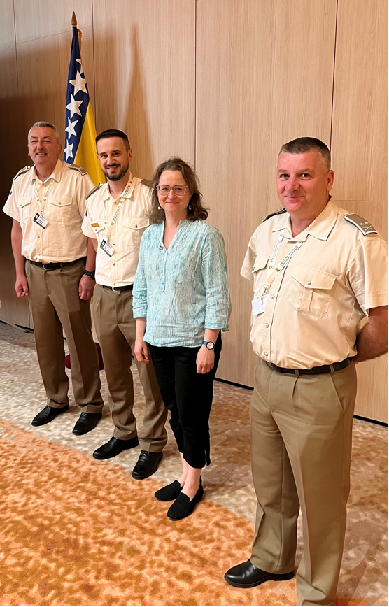

Puno hvala!

Slide 8

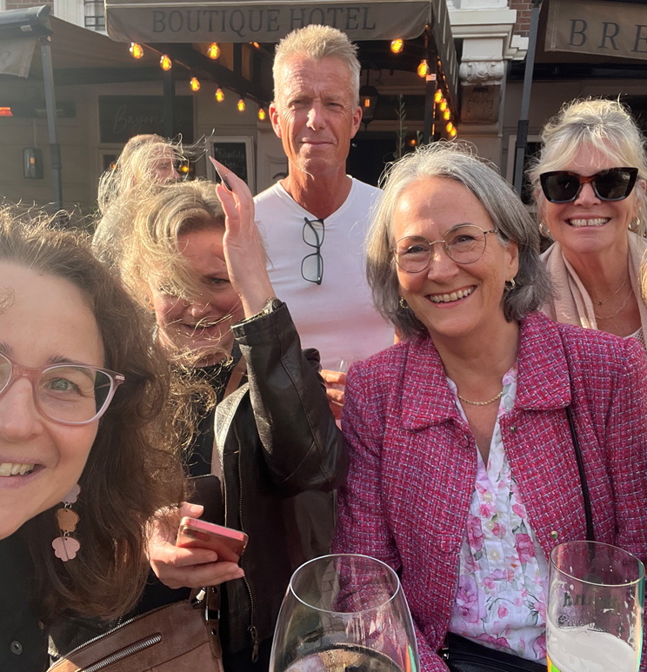

Slide 9
Images
Cover photo and icons from noun project. Do not reproduce.
Photos from BILC events from nato-bilc.org
Helsinki image: https://pixabay.com/users/tap5a-12431592/
People in colorful hot air balloon in sky by Scopio from <a href="https://thenounproject.com/photo/people-in-colorful-hot-air-balloon-in-sky-0goD80/" target="_blank" title="People in colorful hot air balloon in sky Photo">Noun Project</a> (CC BY-NC-ND 2.0)

