Slide 1





2026
STANAG 6001
TESTING WORKSHOP
BILC Chair Update
1 SEP 2026

Slide 2

In this update …
The BILC organogram
BILC then … and BILC now
BILC’s three Ts: testing, teaching and terminology
Testing Workshop 2025, 2026
BILC website – new address!

Slide 3


HOST
NATION
HOST
NATION
HOST
NATION
BILC Steering Committee
BILC Secretariat
Associate BILC Secretariat
BILC Chair
Laura Murto
BILC Secretaries
Satu Patronen
Anne Rivinoja
Senior Advisor
Dr Ray Clifford
Peggy Garza
Edelmira Nickels
Julie Dubeau
Jana Vasilj-Begovic
HOST
NATION

Slide 4

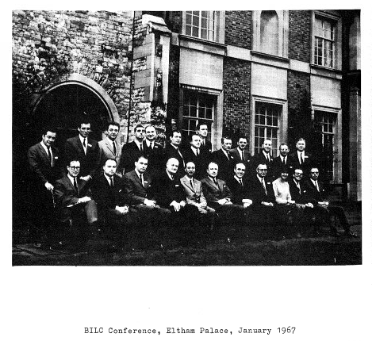








Notes:
“There have always been profitable contacts between interested countries in the field of language training. The simple aim of the Bureau is to make these contacts even easier and more profitable in the future, and to extend their benefits more widely.”
BILC Bulletin 1967, Editorial, p. 5

Slide 5
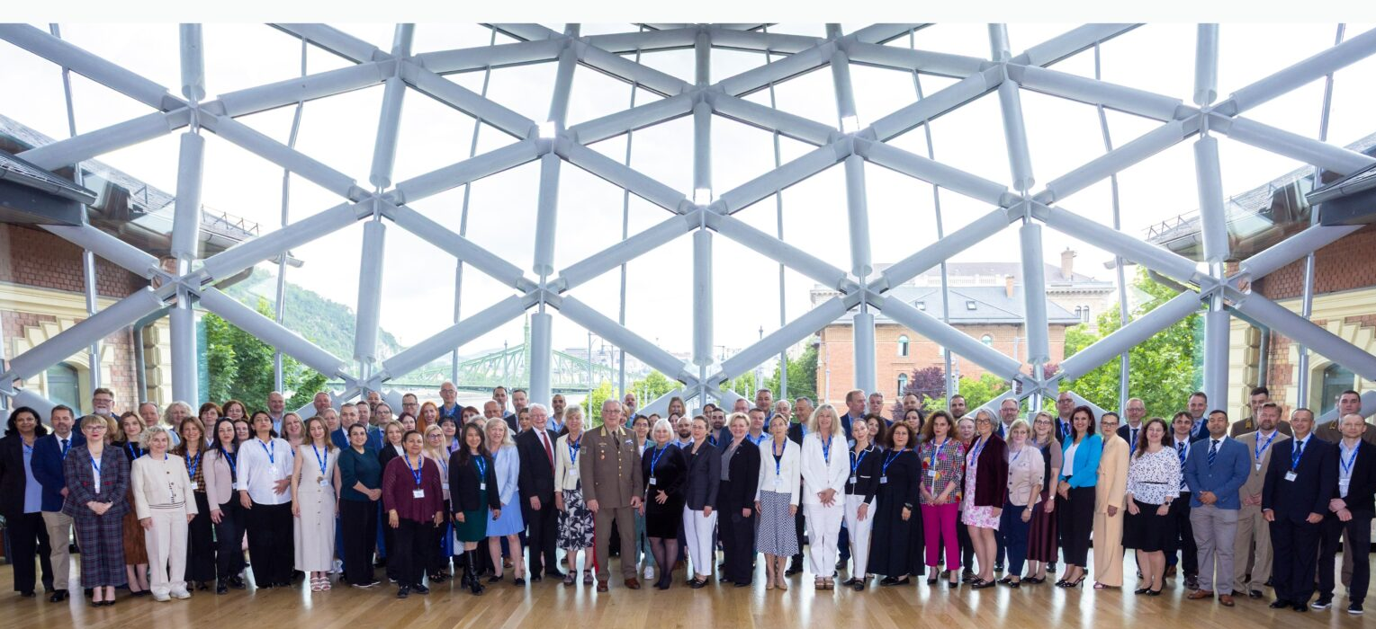
2026: A “club” of 29 active member states and min. 27 other cooperation partners

Slide 6

Streamlining BILC: joint responsibility
BILC Secretariat has one POC in each nation within BILC network
National POC manages the national mailing list → process
National POC coordinates with local specialists who goes to which BILC event

Slide 7

If remains the same…
Venue size?
Overall cost of events for hosts – and participants!
Effectiveness – are invitations reaching the right people?
Are people aware of who else is registering within their own country?
Remember:
No BILC HQ, no supra national budget
All BILC work done in addition to national duties
Secretariat (and PLTCE) working with some 60 POCs – or +200?...

Slide 8

BILC vision:
To achieve levels of excellence where
progress made by one is shared with all.

Slide 9

BILC’s three Ts
Testing
Teaching
Terminology

Slide 10
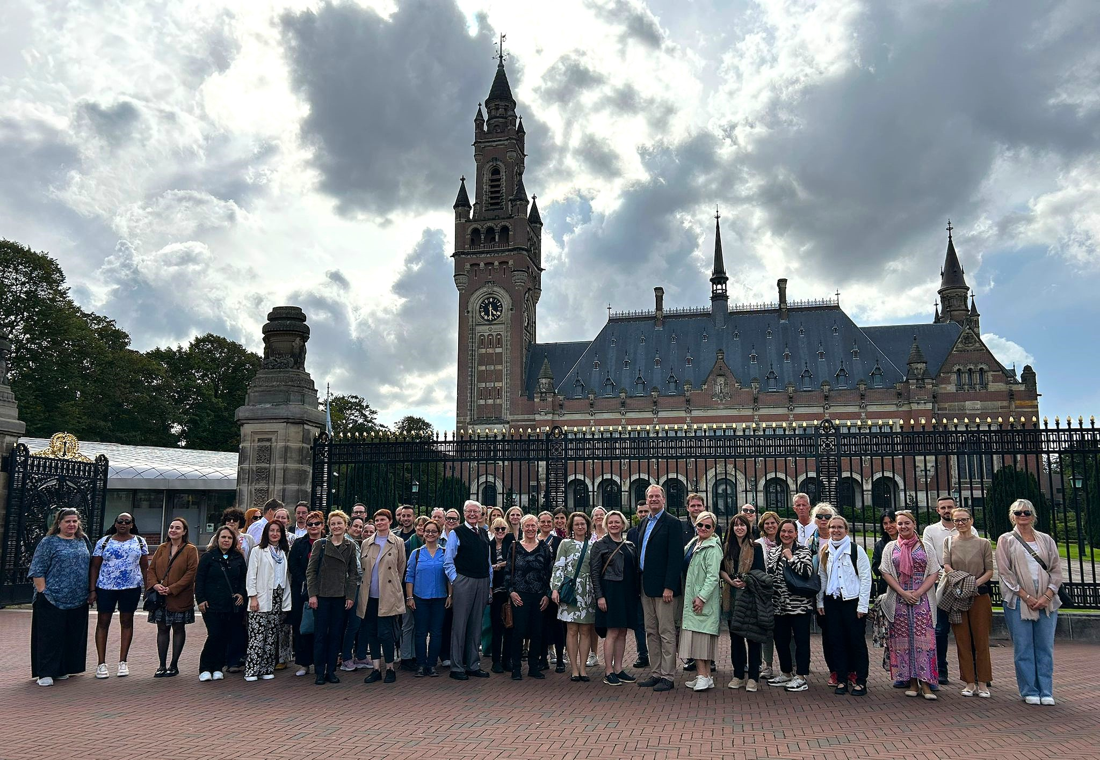
Assessing Writing Proficiency in an AI Era:
Validity Challenges and Future Directions
Testing Workshop always in September!
The Hague, NL, 2 – 4 SEP 2025

Slide 11
Are you truly listening?
Advancing Standardization and Quality Assurance in Listening Assessment
Use of audio sources and copyright compliance
Computer-delivered assessment of listening: opportunities, challenges, best practices
Best practices in listening item moderation
Testing formats/techniques as influencers of construct validity
Operationalizing the listening proficiency construct
Content selection and text analysis: aligning the author’s and listener’s purpose
Use of scripted versus unscripted authentic passages
Listening in participatory versus non-participatory situations
Text selection considerations: acceptable versus inacceptable content
What makes texts unrateable? Panel discussion or presentation.
Editing listening texts
Content considerations: ratio of military versus non-military texts
2026

Slide 12

nato-bilc.org
Croatian BILC Secretariat and NATO DEEP eAcademy completed redesigned the BILC website in spring 2025
Summer 2026: Polish Association for Security (PAS) → Institute for Research and Social Education Foundation (IRSEF)
DEEP eAcademy covers all costs
Information on past BILC events, policy documents, calendar = BILC’s online archive
In future newsletters there too → queries to BILC Secretariat

Slide 13


“There have always been profitable contacts between interested countries in the field of language training. The simple aim of the Bureau is to make these contacts even easier and more profitable in the future, and to extend their benefits more widely.”
BILC Bulletin 1967, Editorial, p. 5

Slide 14
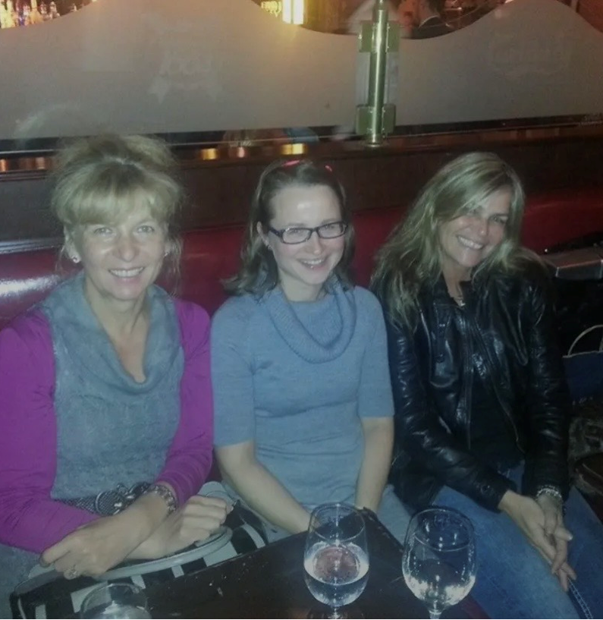

Slide 15
Images
Cover photo and icons from noun project. Do not reproduce.
Photos from BILC events from nato-bilc.org
Helsinki image: https://pixabay.com/users/tap5a-12431592/
People in colorful hot air balloon in sky by Scopio from <a href="https://thenounproject.com/photo/people-in-colorful-hot-air-balloon-in-sky-0goD80/" target="_blank" title="People in colorful hot air balloon in sky Photo">Noun Project</a> (CC BY-NC-ND 2.0)

