Slide 1
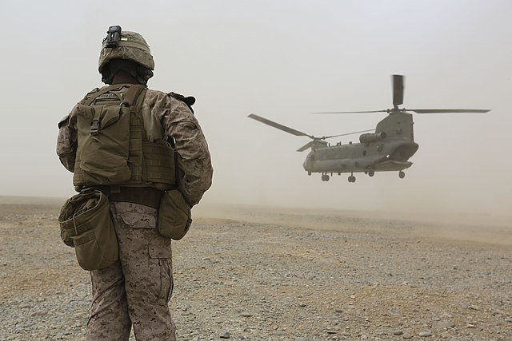

BILC JTAC
Working Group (WG) Update

Slide 2

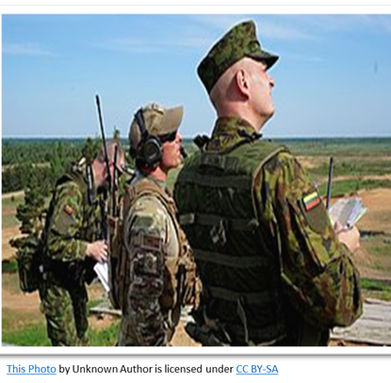



BILC Study Highlights
BILC WG members:
Consulted with JTAC SMEs
Observed JTAC exercises and training
Conducted a survey on critical JTAC language tasks and unique Target Language Use (TLU) factors
  246 responses from JTACs SMEs and stakeholders
The study was published May 2023.

Slide 3
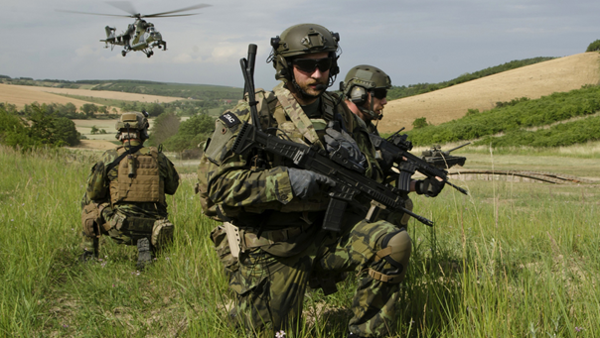
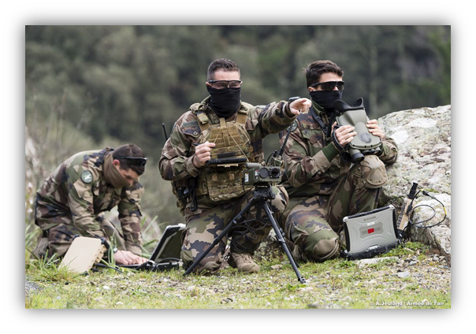
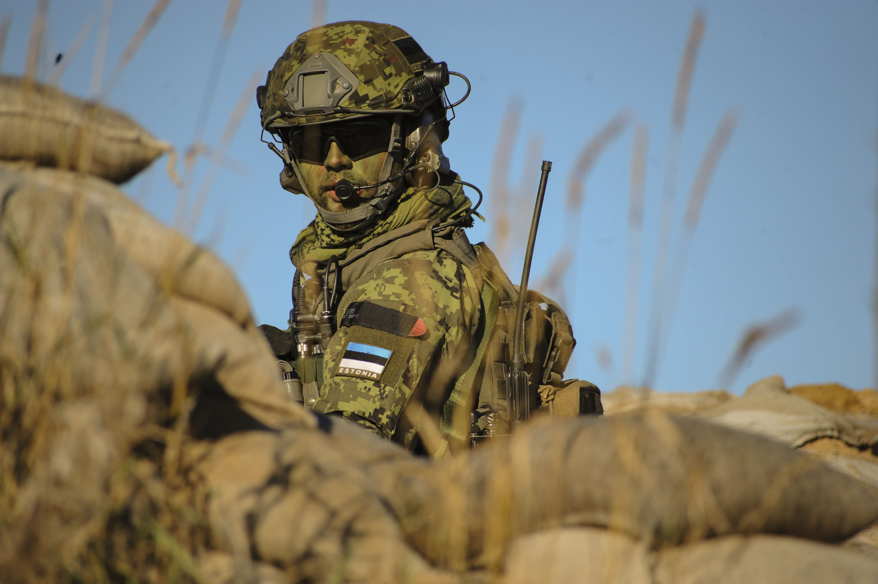
Unique JTAC Language Tasks
    Communicating under pressure
    Demonstrating interactional competence in a dynamic multinational environment
    Comprehending multimodal communications from digital and human sources
    Timely responses with clear pronunciation

Slide 4
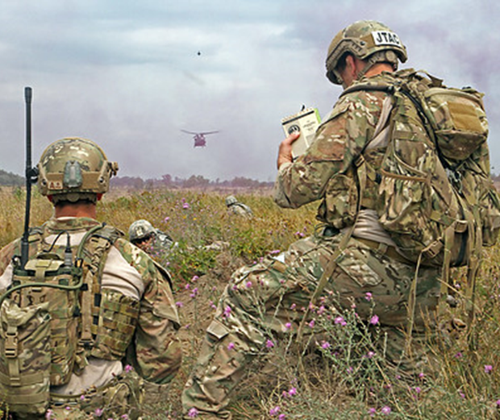
Bureau for International
Language Co-ordination
Findings
There is a misalignment between the STANAG 6001 Level 3 General Proficiency test and the actual JTAC language tasks
Recommendations
A JTAC-specific language test to replace the STANAG 6001 SLP 3/3/3/2 requirement

Slide 5








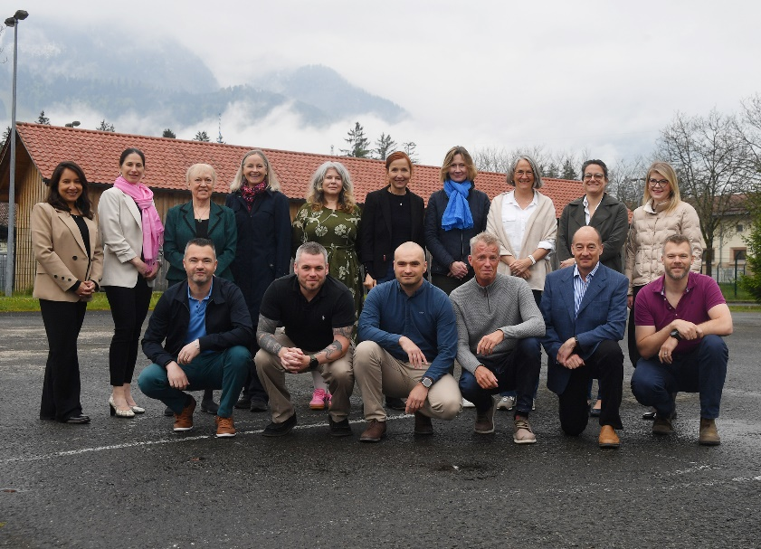

JTAC Language Assessment
WG Meeting, 6-9 May 2025
Eleven language experts from ten nations
Team of Subject Matter Experts (SMEs)
from NATO Close Air Support Capabilities
Section (CCS), Ramstein Air Base

Slide 6

JTAC Language Assessment Overview
Purpose:
A screening tool to determine language readiness for JTAC training
Design:
One score (Go/No); not separate tests for Listening, Speaking, Reading and Writing, such as with STANAG 6001 testing
International Civil Aviation Organization (ICAO)-inspired approach to the test design and rating practices
Delivery Method:
  Centrally developed and computer administered
  to ensure standardization and fairness

Slide 7
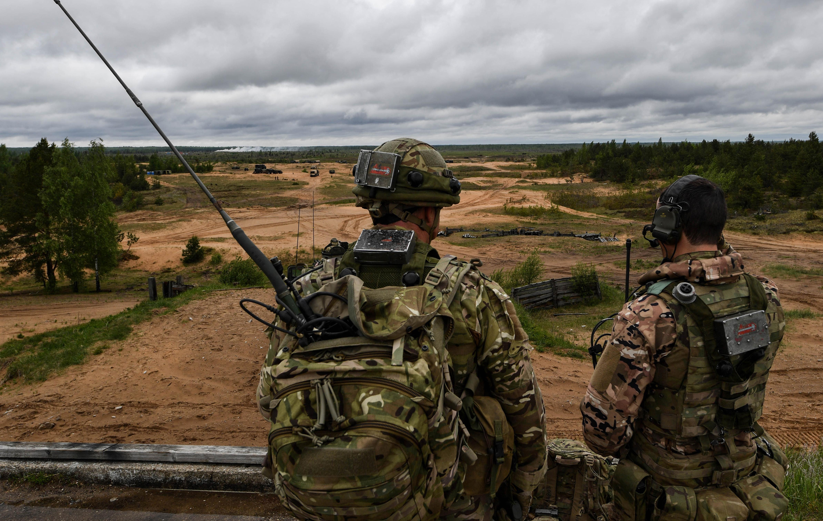
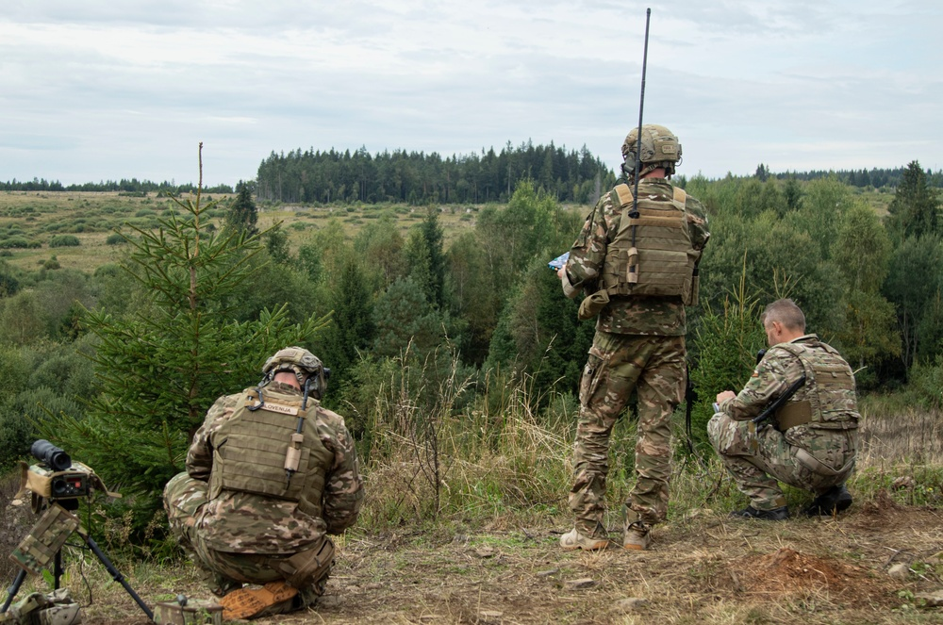
NATO Close Air Support
Capabilities Section (CCS)
  Provides conceptual and subject matter support
  Coordinating a visit to the FRA-DEU Air Ground Operations School (AGOS) in Nancy, France
  Does not provide financial support
    WG members’ participation funded by their nations
    No identified solution for financing a remote delivery of the test

Slide 8
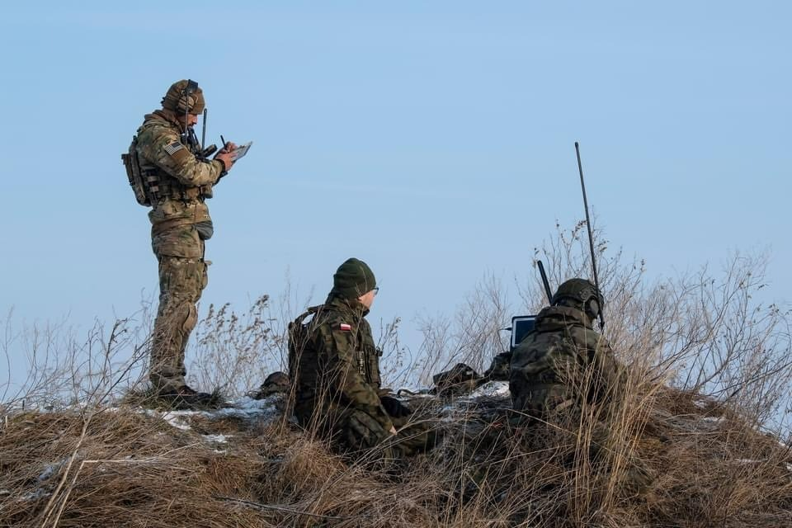
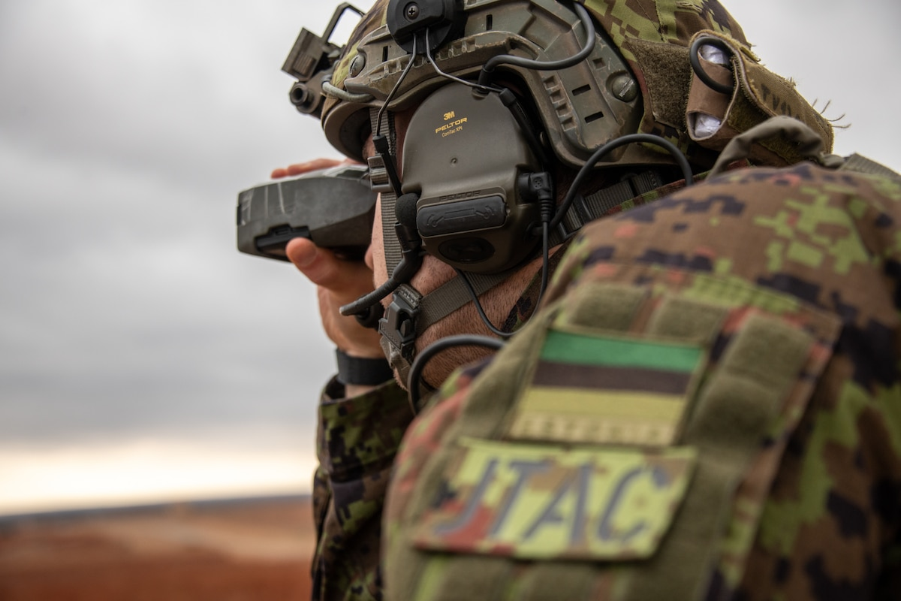
Test Design
Integrated skills performance test
Mirrors real-life language tasks in a multinational operational environment
Emphasizes clear Plain English communication
Will not require knowledge of technical jargon or brevities

Slide 9
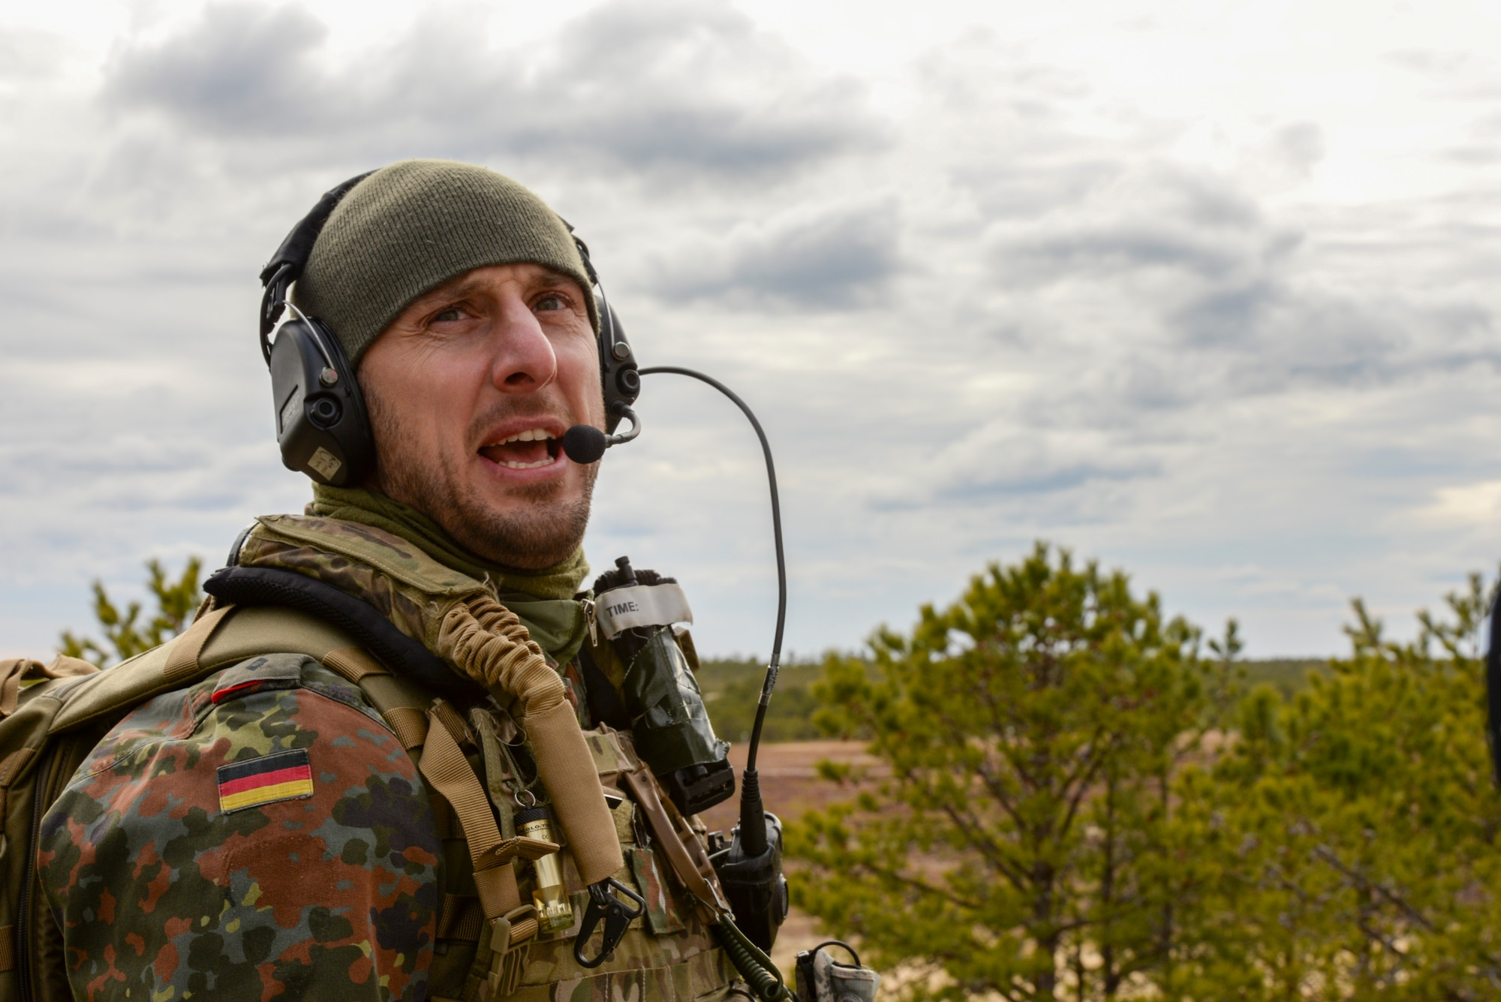
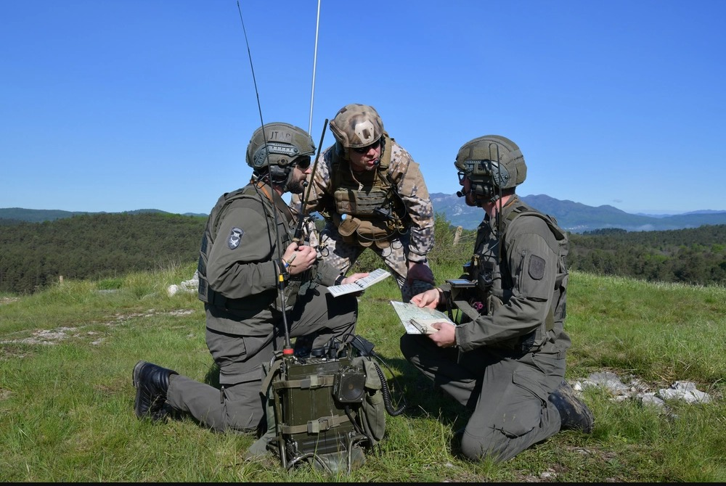
Test Tasks in Progress
JTACs must describe terrain features, buildings and structures
  Given a visual image, test takers will describe terrain features, buildings and structures (spoken or written responses)
JTACs must understand oral military briefings
  Given a short military briefing, test takers will produce an oral summary or will respond to short answer questions
JTACs must read written military orders
  Given an OPORD, test takers will produce an oral summary or will respond to short answer questions

Slide 10
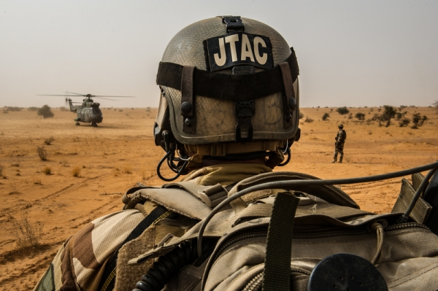
Next Steps
Visit to FRA-DEU Air Ground Operations School (AGOS)
BILC Team:
Agenda
  Presentation of project background and progress
  Observation of training activities
  Structured focus groups with SMEs
    Evaluate proposed language tasks for determining
    language readiness for JTAC training
    Provide feedback on speech samples for distinguishing successful and unsuccessful performances

