Slide 1


Are you truly listening?
How your view of the world biases your understanding
LTC Dr. Karl TESTOR
@ BILC Testing Workshop SARAJEVO September 2026

Slide 2
Are you….
truly listening?!
Notes:
Lightning McQueen, NUR Audio… Thema zieht sich durch Vortrag durch….

Slide 3
The question is…
what did you hear…
What was IT?

Slide 4
What is “true“?
“In order to discover wether the picture [of the world] is true or false we must compare it with reality.“¹
¹ Wittgenstein, 1922.

Slide 5
What is “real(ity)“?

Slide 6
Constructive Realism²
Wirklichkeit
Realität
Real world/Environment
Reality
“Wirklichkeit” is understood as the world “with which we live, that is, everything that is there before our reflection“.
While “Realität is what we construct and what we reflect”. “Realität” is the “world of our knowledge”.
² Wallner 2002.

Slide 7
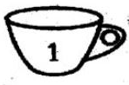
Cup or Bowl?
Right hand – Cup
Left hand – bowl

Slide 8
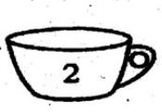
Cup or Bowl?
Right hand – Cup
Left hand – bowl

Slide 9
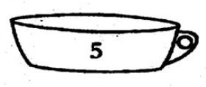
Cup or Bowl?
Right hand – Cup
Left hand – bowl

Slide 10
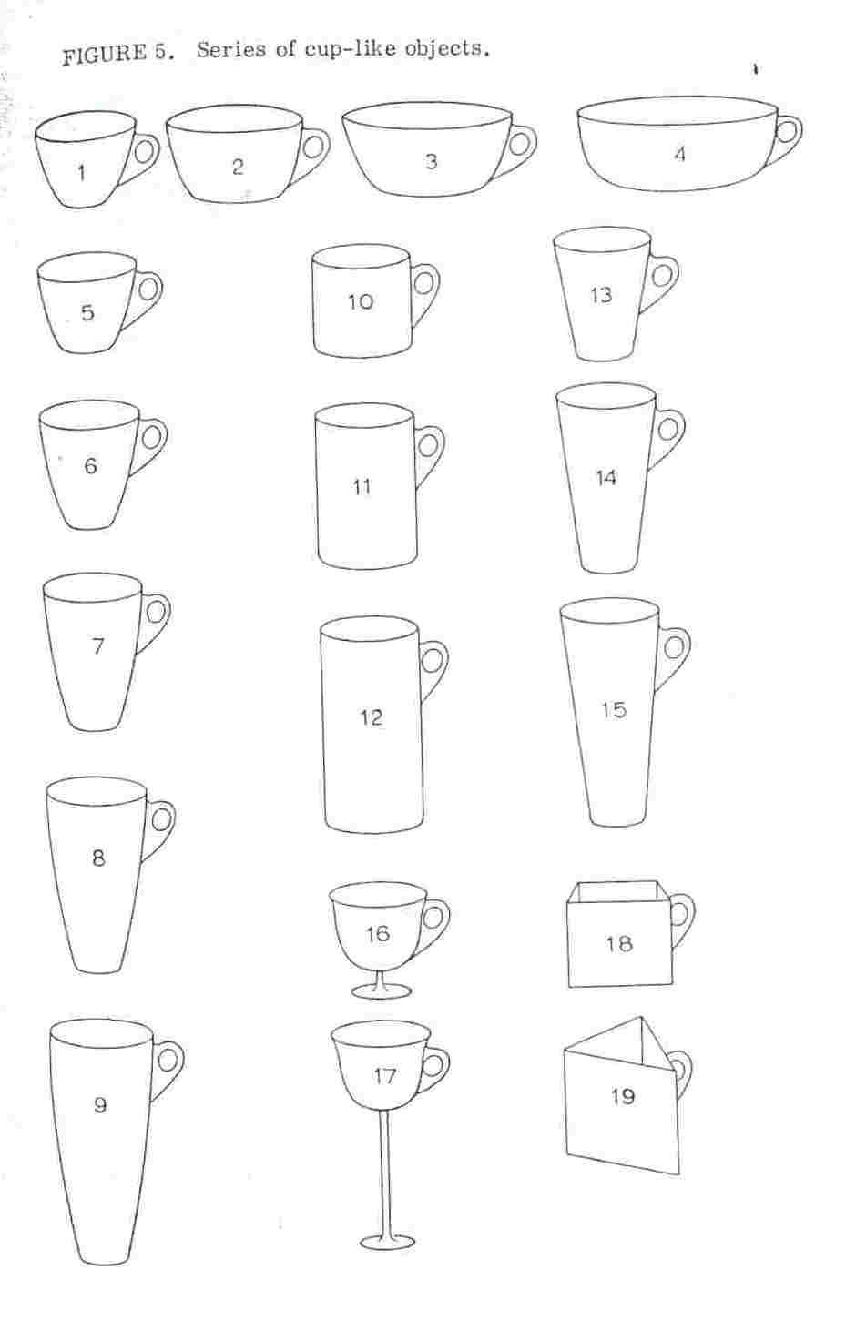
1:1,5
54%
1:>1,9
25%
1:1,2
10%
The object is filled with mashed potatos!
1:1,2
10%
³ Lablov, W. 1973.

Slide 11
1:1,5
54%
1:>1,9
25%
All the objects are “real“!
1:1,2
10%
BUT
The object is filled with mashed potatos!
The concepts aren‘t!
1:1,2
10%

Slide 12
1:1,5
54%
1:>1,9
25%
All the objects are “real“!
1:1,2
10%
BUT
mashed potatos
tea or coffee
eating
drinking
The concepts aren‘t!
1:1,2
10%

Slide 13
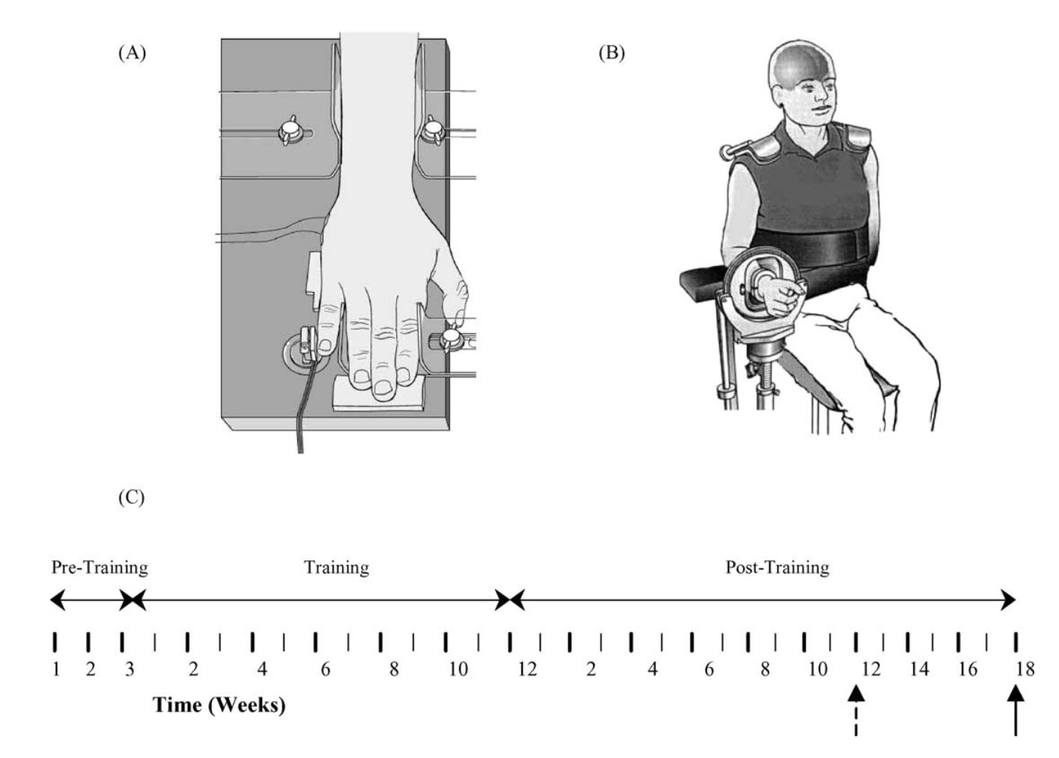
ABD ELB
(little finger ABDUCTION) (contraction of ELLBOW)
⁴ Ranganathan, Siemionow, Liu, Sahgal, & Yue 2004.

Slide 14
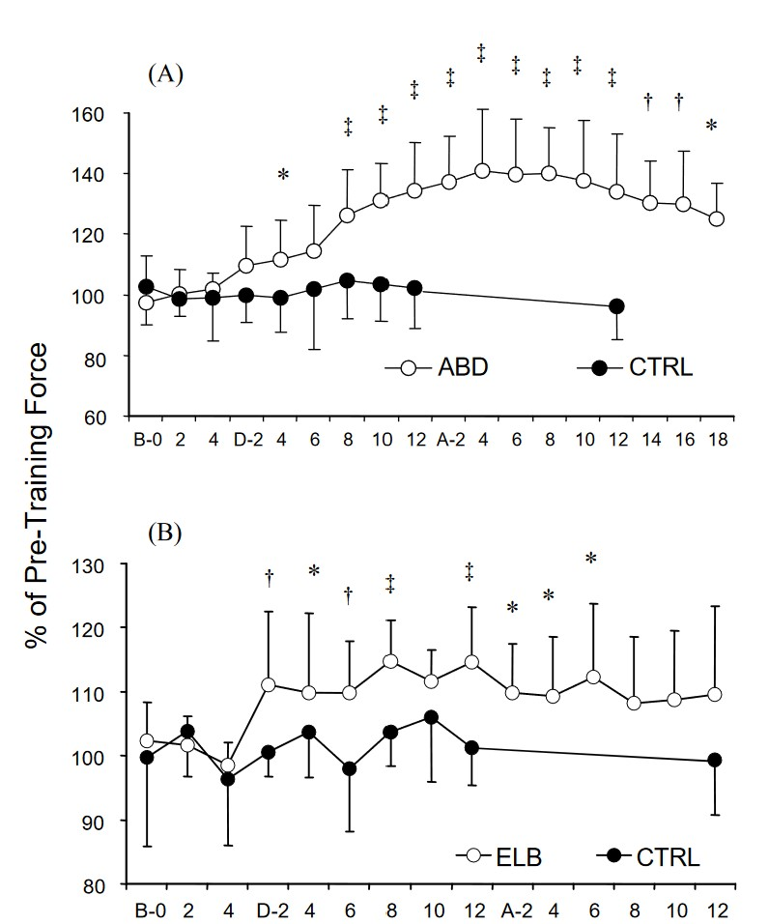
only MENTAL training!¹
B: before training
D: during training
A: after training
The significance levels were with respect to the baseline force:
  ∗P < 0.05
  †P < 0.01
  ‡P < 0.005).
⁴ Ranganathan, Siemionow, Liu, Sahgal, & Yue 2004.

Slide 15
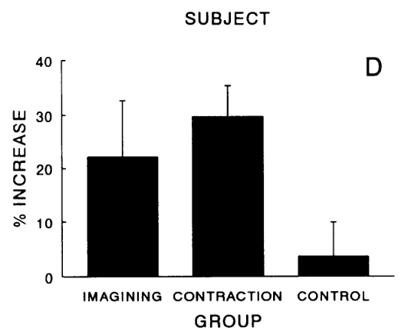
little finger ABDUCTION²
⁵ Yue & Cole 1992.

Slide 16
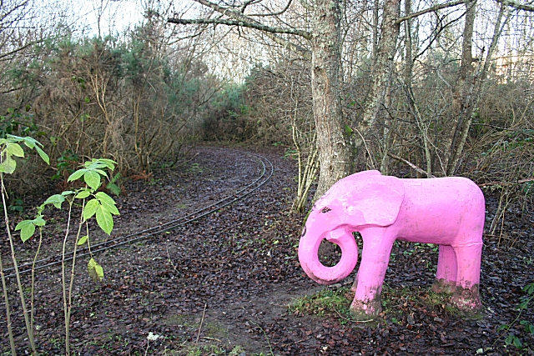
Don‘t think of…
a pink elephant

Slide 17
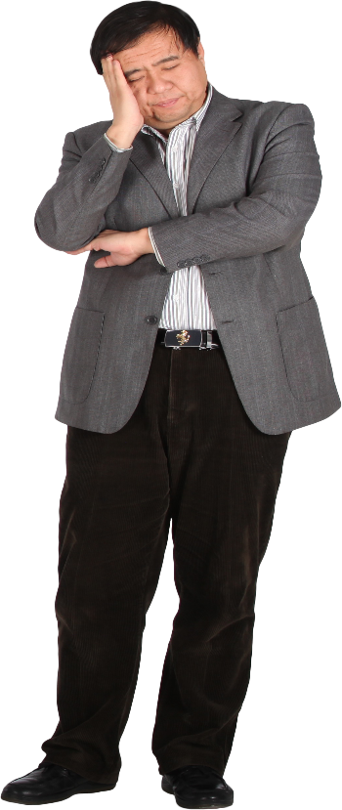
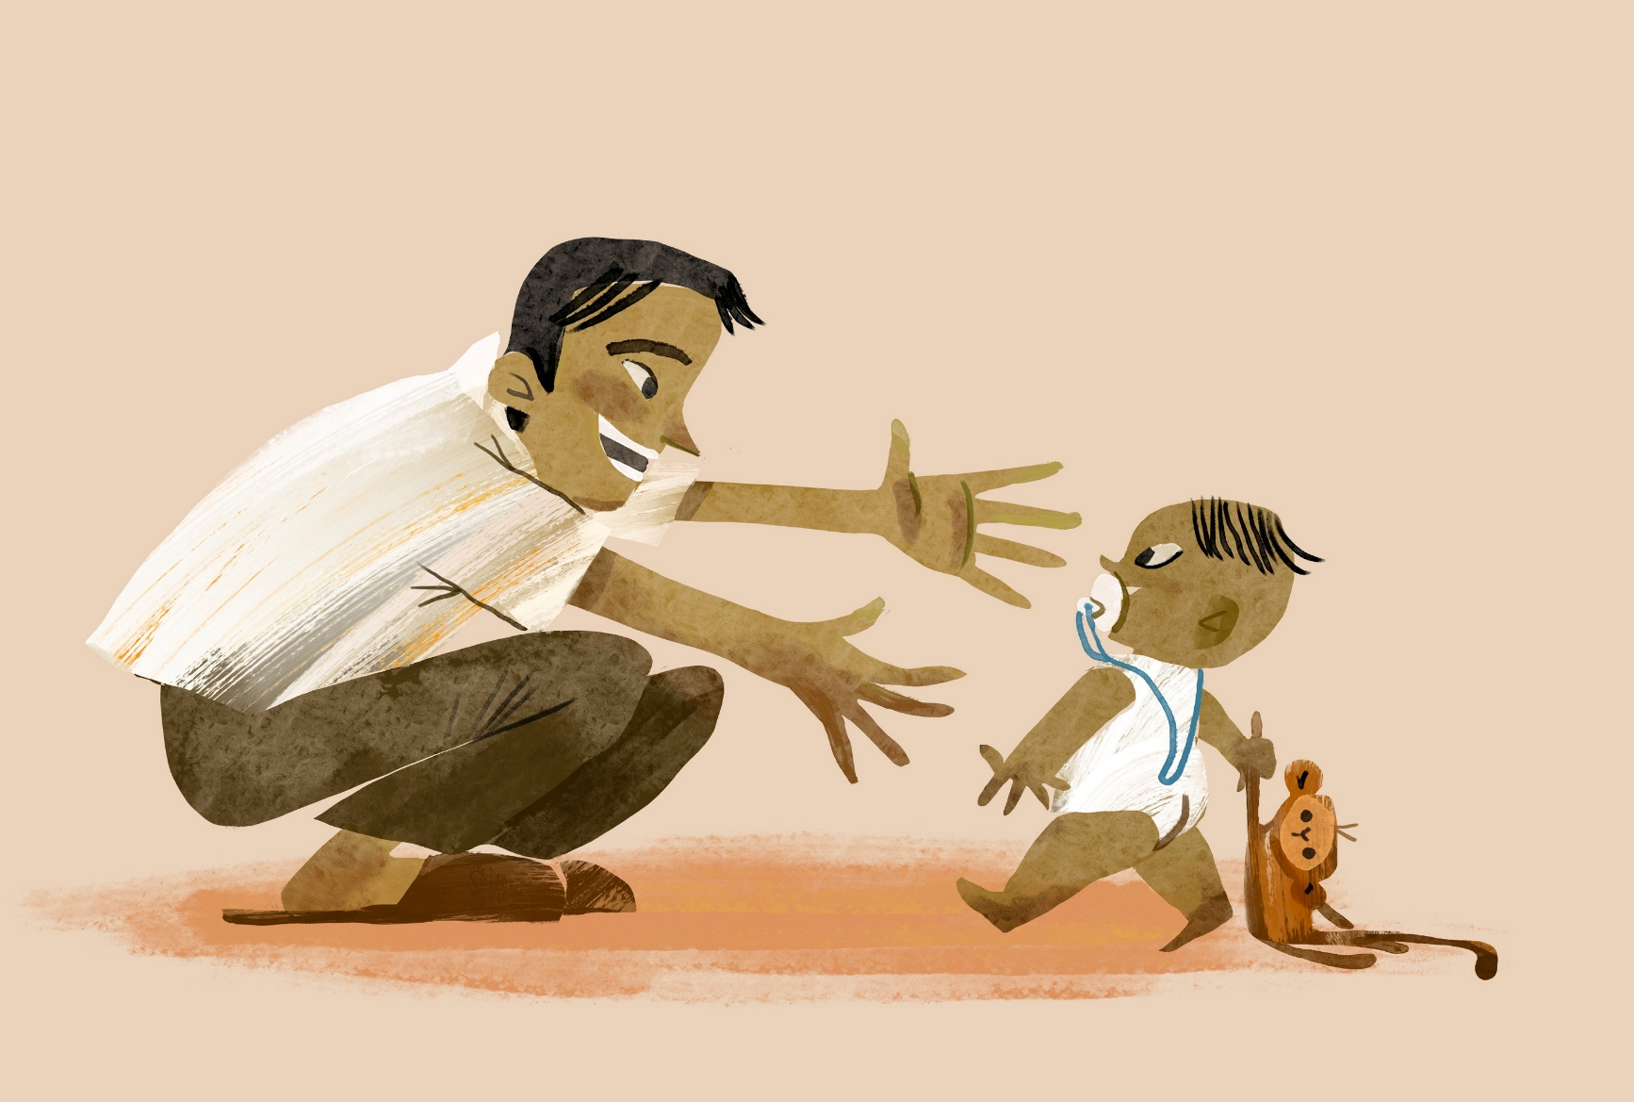
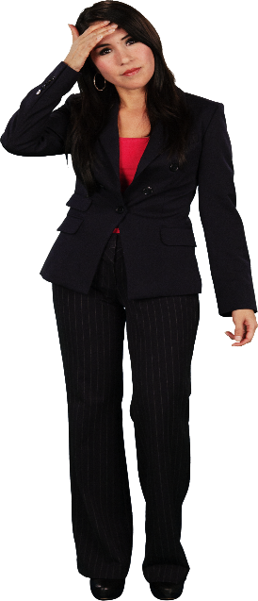

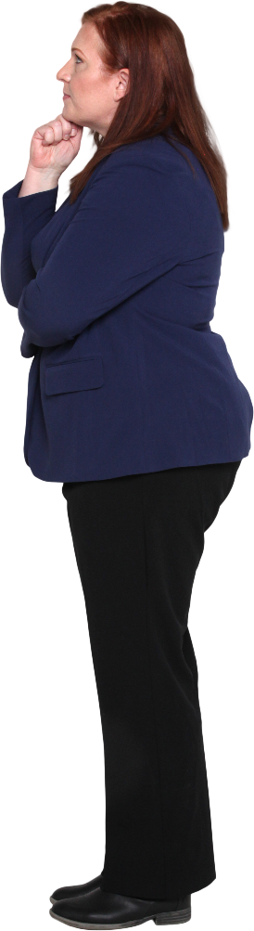
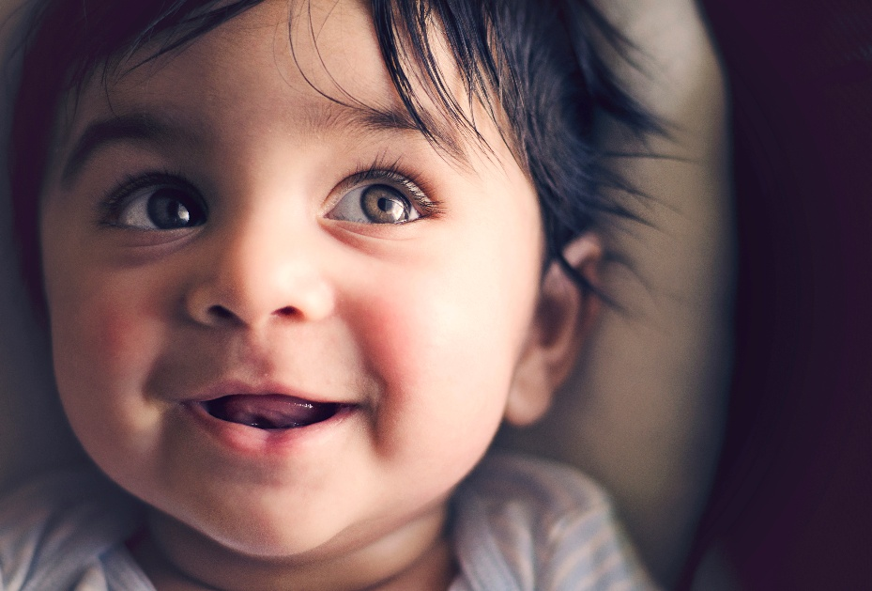

Slide 18
Last year I showed you
How we seem to learn, if something is good to eat…

Slide 19
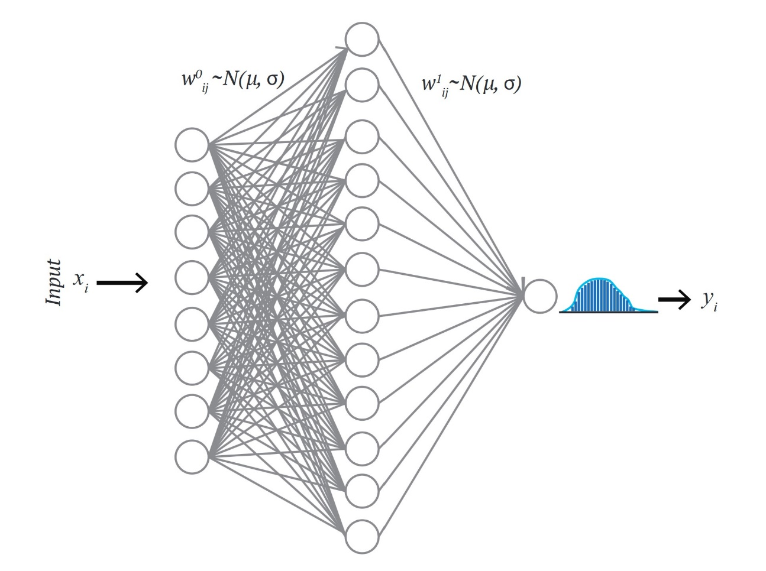
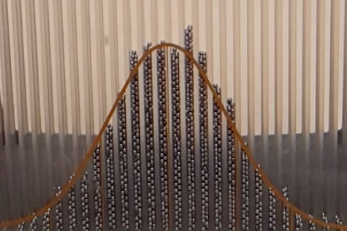
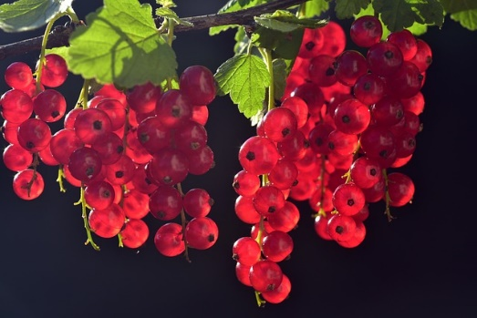
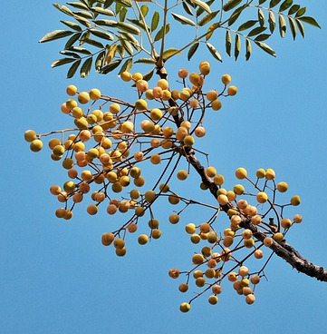
Amyg.
eyes
Starving
FFF
Poisoning
tongue
pfC
colon
…
…
Survival
⁶ Testor 2025.

Slide 20

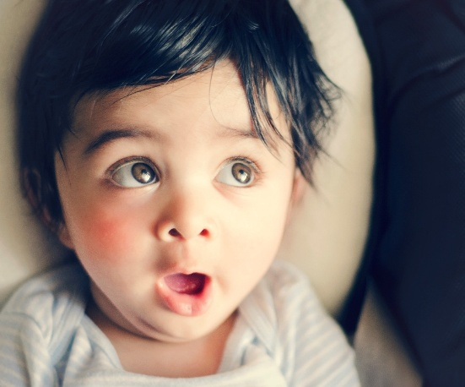

Slide 21
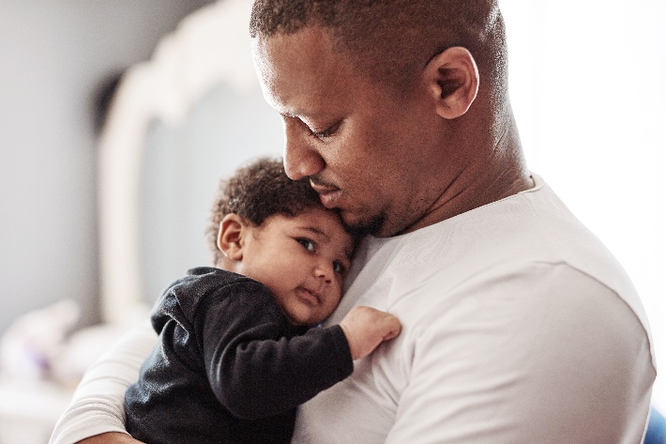
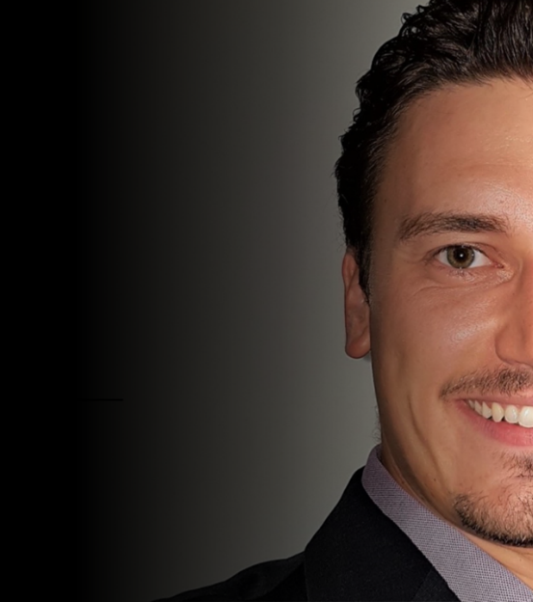
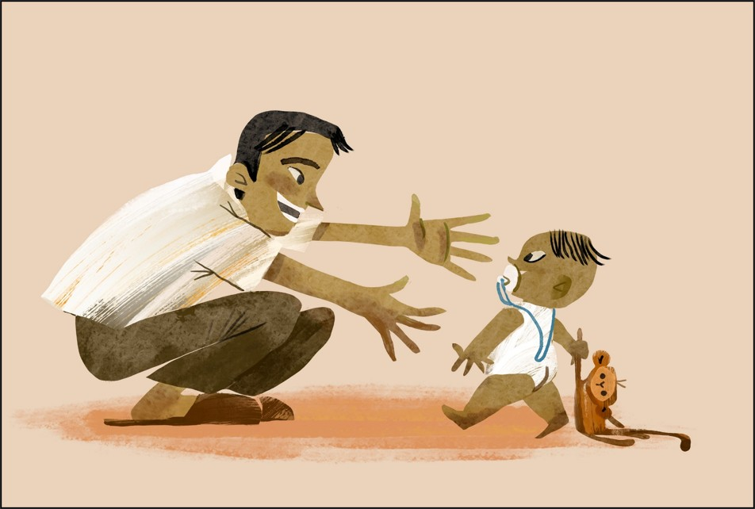
average man
Daddy
friend “Tom”

Slide 22
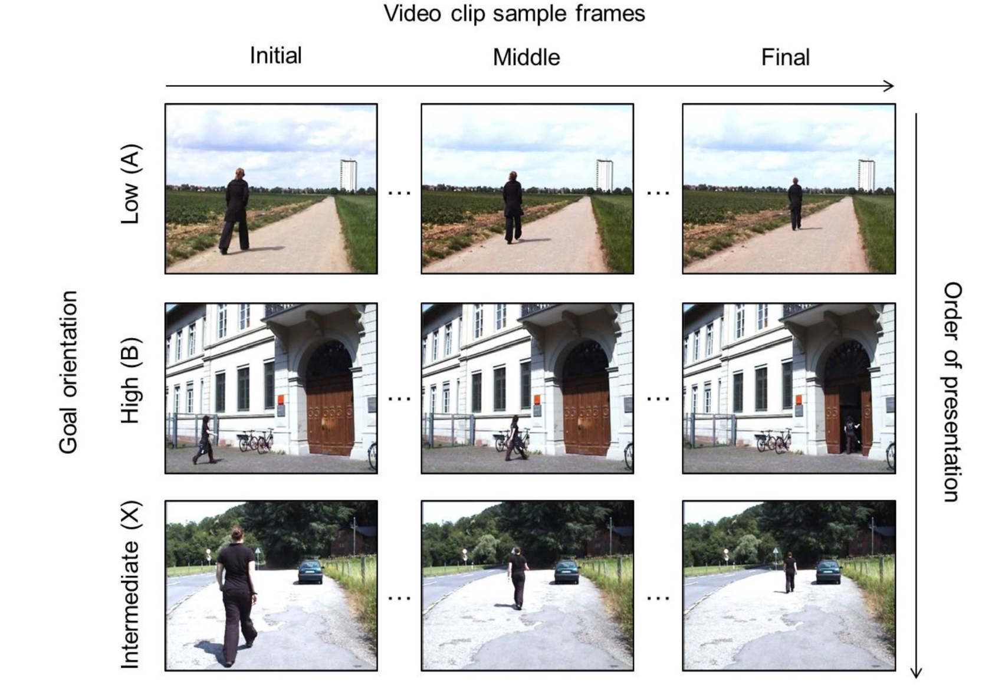
What do you see?
Is “X“ more like “A“ or “B“?

Slide 23
What do you see?¹⁰
Is “X“ more like “A“ or “B“?
¹⁰ Athanasopoulos, P. et.al. 2015.

Slide 24
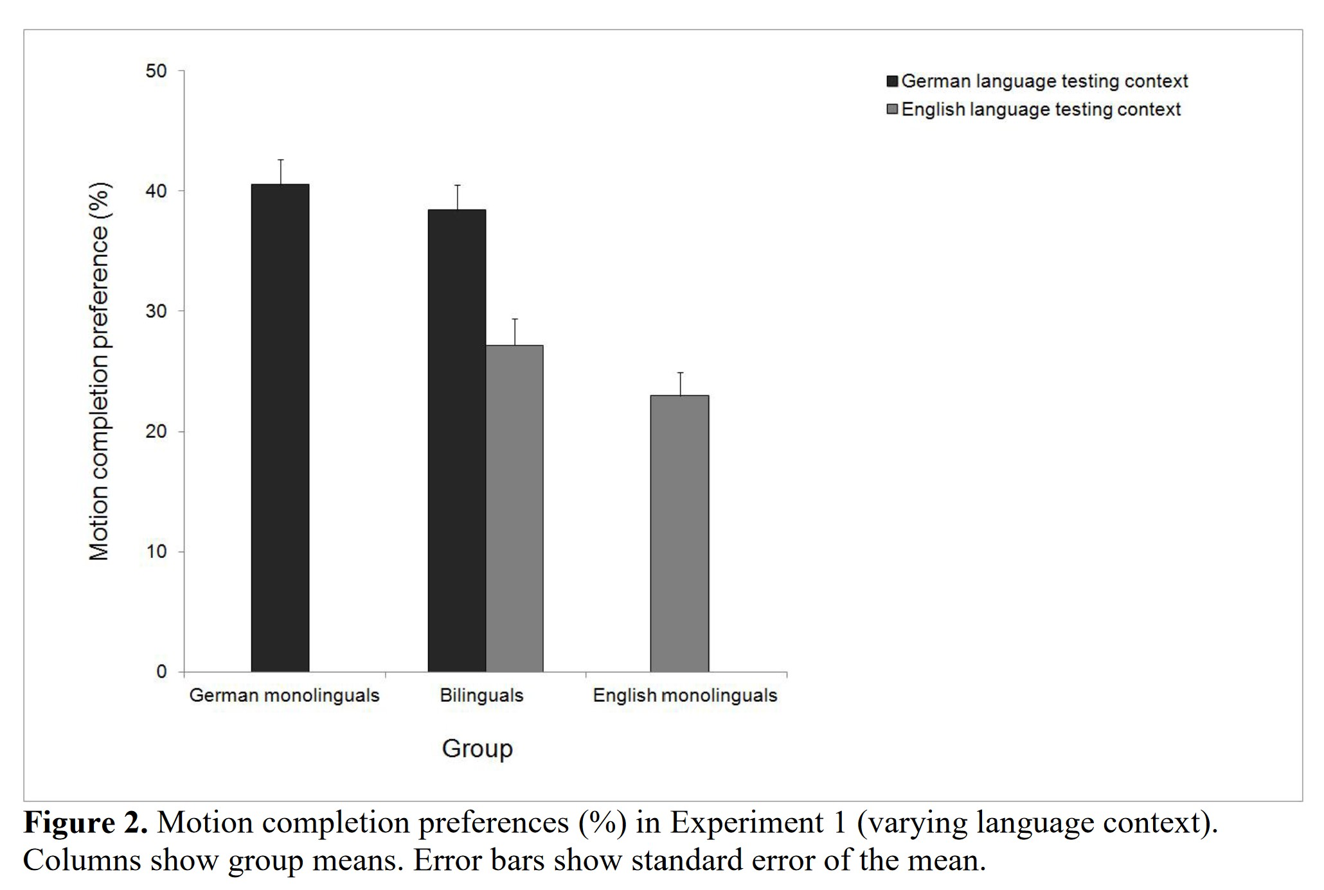
¹⁰ Athanasopoulos, P. et.al. 2015.

Slide 25
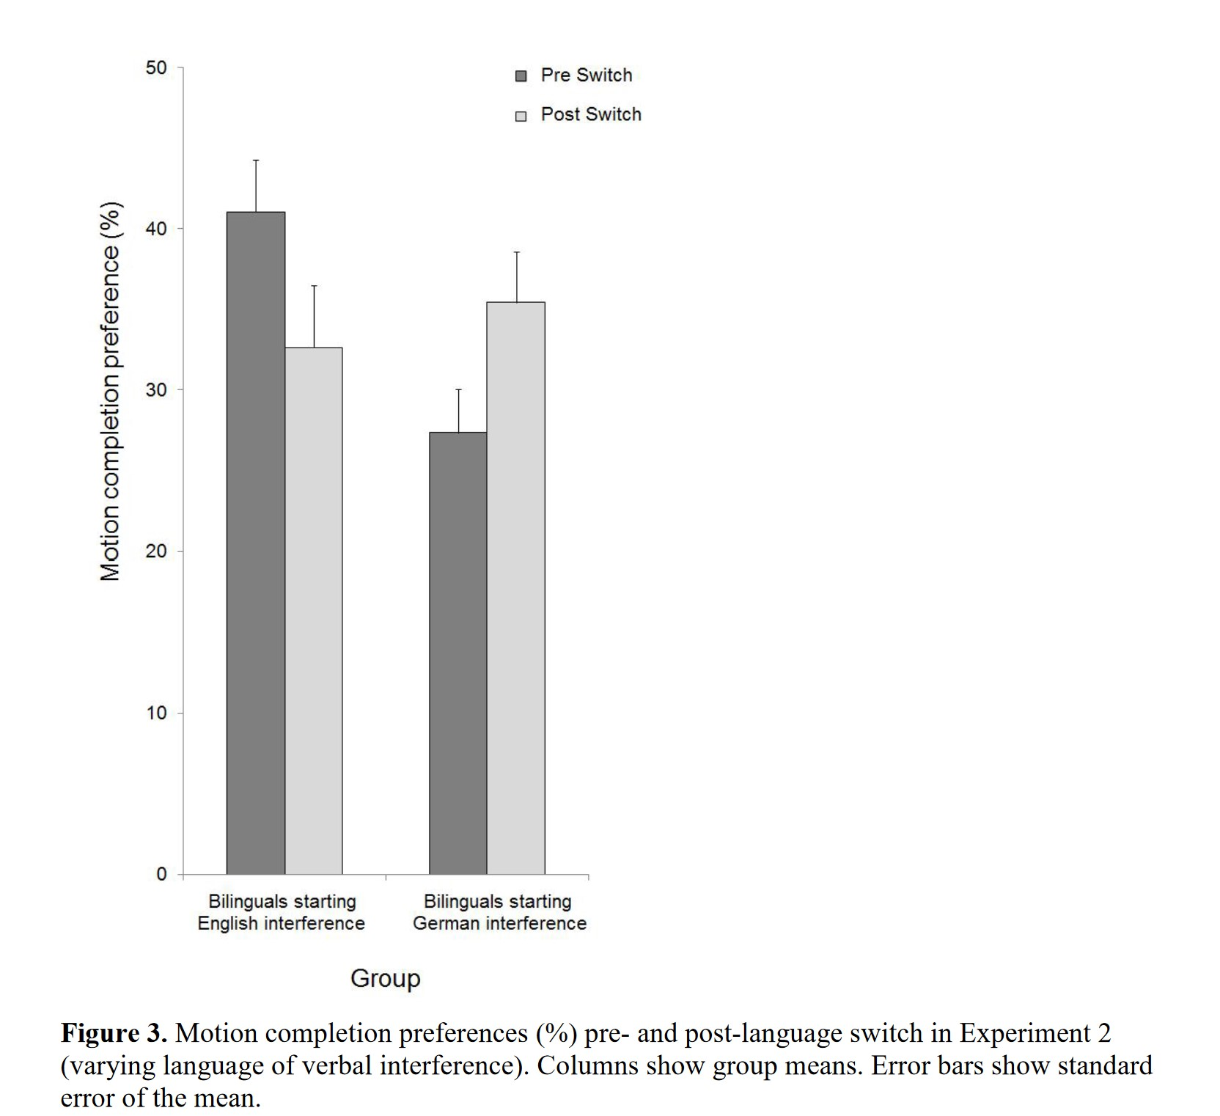
¹⁰ Athanasopoulos, P. et.al. 2015.

Slide 26
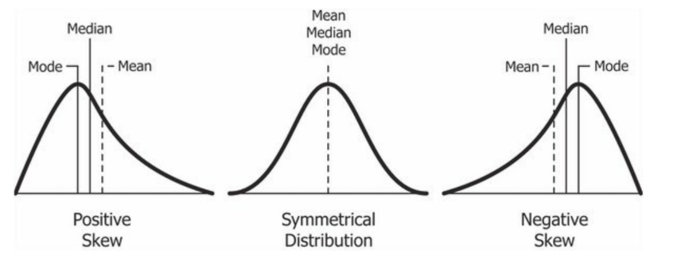
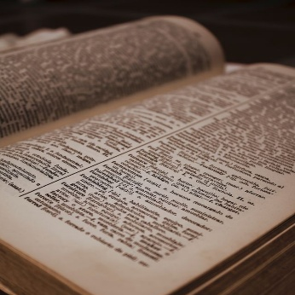
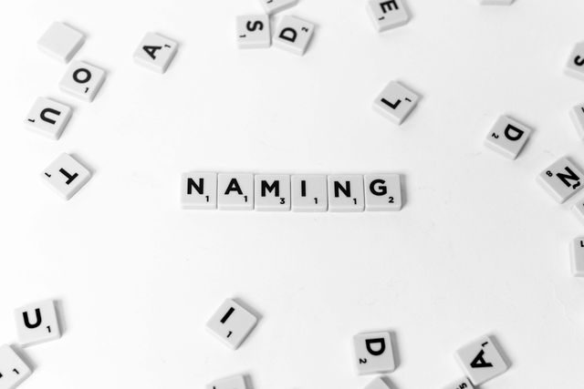

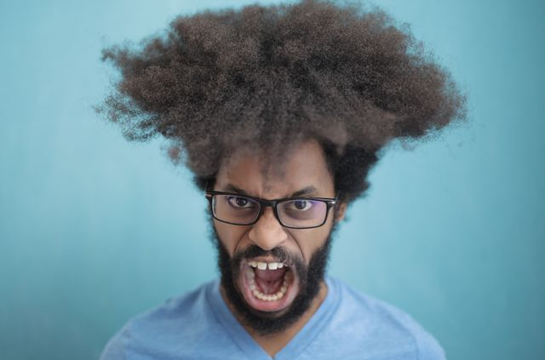
What does this “mean“?
Mean – statistically
Mean – verb
Mean – adjective

Slide 27
What does this “mean“?
Mean – statistically
Mean – verb
Mean – adjective
Listening is/we are biased
Experience
Language used
Concepts (scripts, schemata)
Socio-emotional perspective
…

Slide 28
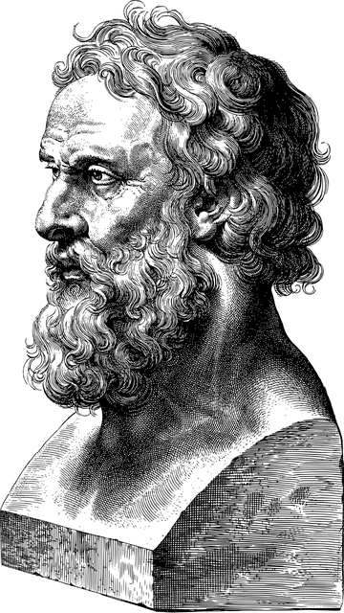
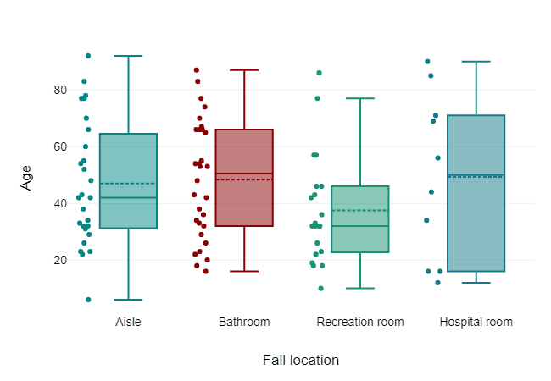
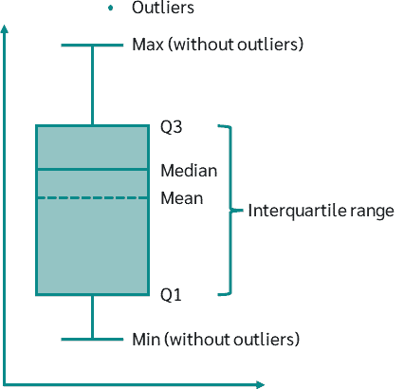
What does this “mean“?
Mean – statistically
Mean – verb
Mean – adjective
Listening is/we are biased
Experience
Language used
Concepts (scripts, schemata)
Socio-emotional perspective
…

Slide 29
What does this “mean“?
Where does “experience“/socialisation bias us?
  Test creation
  Testing of testees
  …
  Implementing new policies in our system
  Integrating others‘ views and positions
  → negotiations/ conflict management/ …
Mean – statistically
Mean – verb
Mean – adjective
Listening is/we are biased
Experience
Language used
Concepts (scripts, schemata)
Socio-emotional perspective
…

Slide 30
What does this “mean“?
Mean – statistically
Mean – verb
Mean – adjective
Challenge yourself and your team
Using different Languages
Experience stakeholders‘ reality
Take advantage of intercultural
change of perspective
…

Slide 31

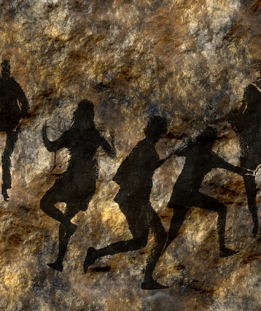
Allegory of the cave
¹¹ Plato & Jowett 1991

Slide 32

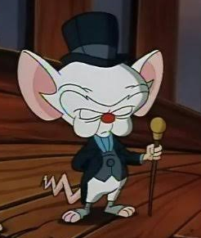

Thank you for your attention!
More languages - More security!

Slide 33
Literature
Athanasopoulos, P. et.al. (2015): Two languages, two minds: Flexible cognitive processing driven by language of operation. Psychological Science.26(4) S.518-526.
Labov, W. (1973): The boundaries of words and their meanings. In: Bailey, C.-J.N. & Shuy, R.W. (Hg.): New ways of analyzing variation in English. Washington DC. Georgetown University Press. pp. 340-73.
Plato P., & Jowett B. (1991). The republic: the complete and unabridged Jowett translation (Vintage classics). Vintage Books.
Ranganathan, V. K., Siemionow, V., Liu, J. Z., Sahgal, V., & Yue, G. H. (2004). From mental power to muscle power—gaining strength by using the mind. Neuropsychologia, 42(7), 944-956.
Testor, K. (2020): Cognitive Theoretical Foundations of Creativity: How Creativity Evolves in the Mind. Zürich. Springer International Publishing.
Wallner, F. (2002). Die Verwandlung der Wissenschaft. Jandl, M.J. (Ed.). Hamburg: Dr. Kovač.
Wittgenstein, L. (1922): Tractatus Logico-Philosophicus. London.
Yue, G., & Cole, K. J. (1992). Strength increases from the motor program: comparison of training with maximal voluntary and imagined muscle contractions. Journal of neurophysiology, 67(5), 1114-1123.

