Slide 1
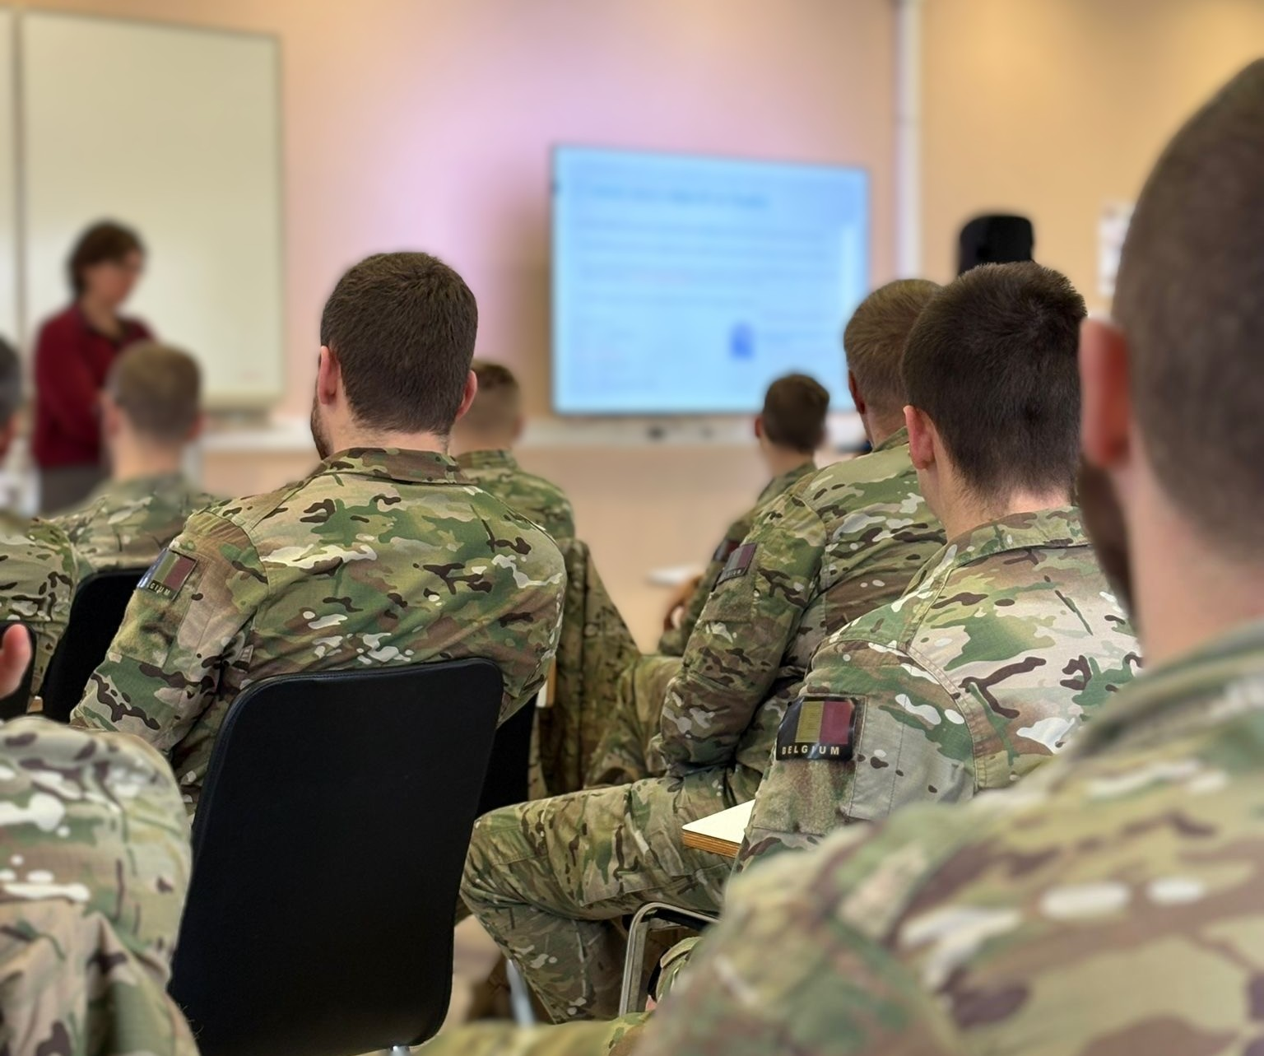

Going once… going twice… sold?
Exploring Repeated Listening in Military Language Testing
Kris Brams
Belgian Defence Language Centre
Royal NCO School Belgium

Slide 2
STANAG 6001 Listening Assessment:
Different approaches
One listening vs two
Audio-only vs audio-visual

Slide 3
STANAG 6001
Listening Assessment: different approaches
ROYAL MILITARY ACADEMY
ROYAL NCO SCHOOL
Enlisted personnel
NCO’s
Levels 1&2
Students (BAMA)
Officers
Level 2&3
Shared objective: STANAG 6001 Level 2
Need to have vs Nice to have
Financial incentive
Volunteer
2222
NCO
3232
Officer
3333

Slide 4
Same construct – same assessment?
Shared objective: STANAG 6001 Level 2 listening assessment
Royal NCO School Royal Military Academy
L2 -
L3 2

Slide 5
Different Administration Procedures
Same construct – same assessment?
Royal NCO School Royal Military Academy

Slide 6
Different Administration Procedures
Royal NCO School
Royal Military Academy
Shared Item Bank Listening October ‘25
Performance in accordance with their level

Slide 7


Two exploratory analyses
Test functioning single listening
Repeated listening
Reflect on meaning of
listening proficiency

Slide 8


Challenges

Slide 9
Listening Level 2
Test Try-out
72 candidates
level 2
level 1
26-item listening test
Listening once

Slide 10
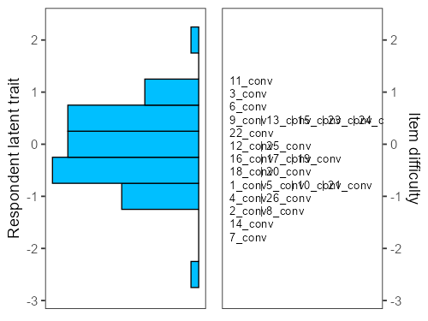
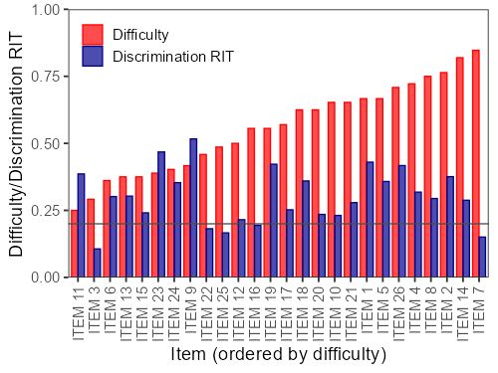
LISTENING LEVEL 2 BATCH 4 – 2CDO – ACAS – SLP2 - VDKMS

Slide 11
Preliminary findings
Appropriate targeting
Acceptable item functioning
Differentiation across proficiency levels
Can a longer listening test administered with single listening function effectively?

Slide 12

Repeated Listening
Study Design
N= 20
Same candidates
Same test - 15 items

Slide 13
Results & main findings
Mean scores

Slide 14
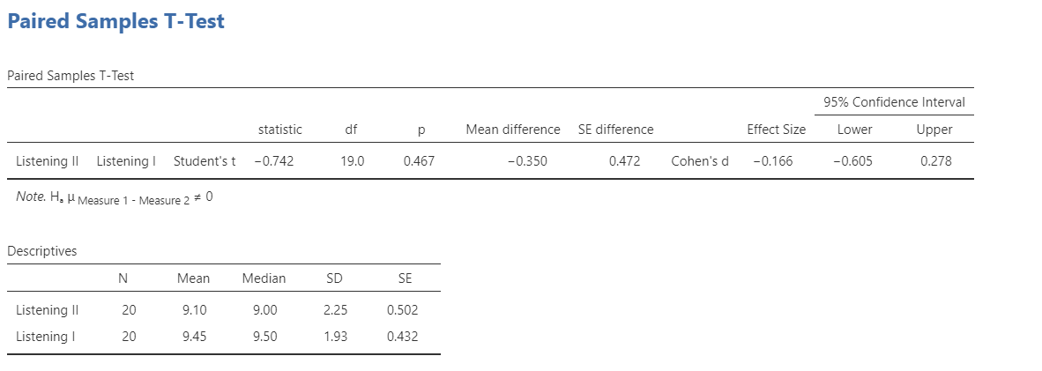
Difference very small
Individual behaviour
CONTEXT

Slide 15
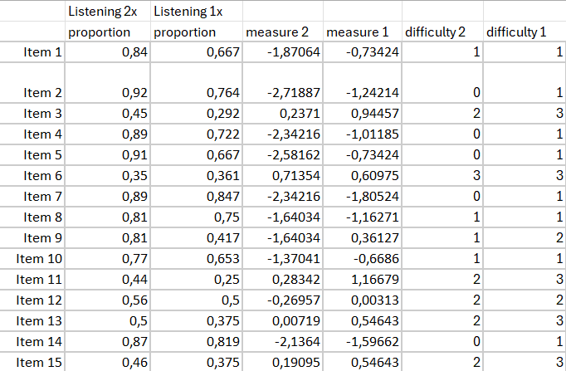
Observation
Administration condition may influence
location of item on proficiency continuum

Slide 16

Why allow a second listening?
Benefits
Drawbacks
Reduced anxiety
Support weaker listeners
Confirmation of information
Lower cognitive load
Administration issues
Less authentic
Longer administration
Distraction strong listeners
Measures reprocessing
Less operational realism

Slide 17
Beyond Repeated Listening
Audio vs video
Belgium vs other NATO nations
Should visual information be part of listening assessment?

Slide 18
Our experience
Some weaker video-based items converted to audio only
Satisfactory without visual support, better discrimination
Not without consequences

Slide 19
Reflection
Visual support may contribute to meaning
by helping listeners:
Identify speakers
Interpret interaction between speakers
Follow references to people, objects or events
Understand the broader communicative context

Slide 20
Fundamental reflections
When does visual information support the construct,
and when does it interfere with it?
Is identifying speakers, following gestures,
interpreting visual references, and using contextual clues part of listening proficiency?

Slide 21
Construct matters
Testing decision
Construct Question
Listening once vs twice
Immediate processing or eventual comprehension
Administration procedures should support the intended construct
Audio vs video
Listening or communication
Testing choices influence what we interpret as L2 proficiency
Task design
Operational performance or general proficiency
Listening tasks should reflect operational communication

Slide 22

Listening assessment in a military context
Listening assessment in a military context requires decisions about what aspects of communication we consider part of the construct
Going once?
Going twice?
We are truly listening

