Slide 1

TRAINING AND DOCTRINE COMMAND
PROFESSIONAL DEVELOPMENT CENTER
DEPARTMENT OF FOREIGN LANGUAGES

Slide 2
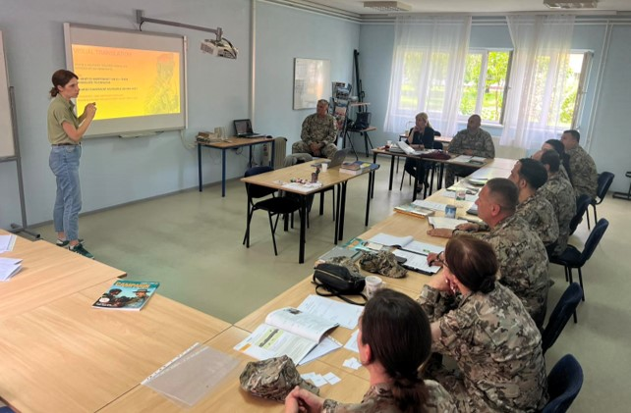
Department of Foreign Languages
INFO BRIEFING
OF-4 Ishak Ahmetović
Department of Foreign Languages, Head

Slide 3
Agenda
Mission and Organisational Overview of the Department of Foreign Languages (DFL)
Current Educational Programmes and Capabilities
Courses and testing in 2025

Slide 4
Mission Statement
The Department of Foreign Languages, through the implementation of individual and institutional training in the Armed Forces of BIH, provides foreign language training to members of the Ministry of Defence and the Armed Forces of BiH, as well as to other ministries and agencies in BiH, intending to develop and improve their language skills.

Slide 5
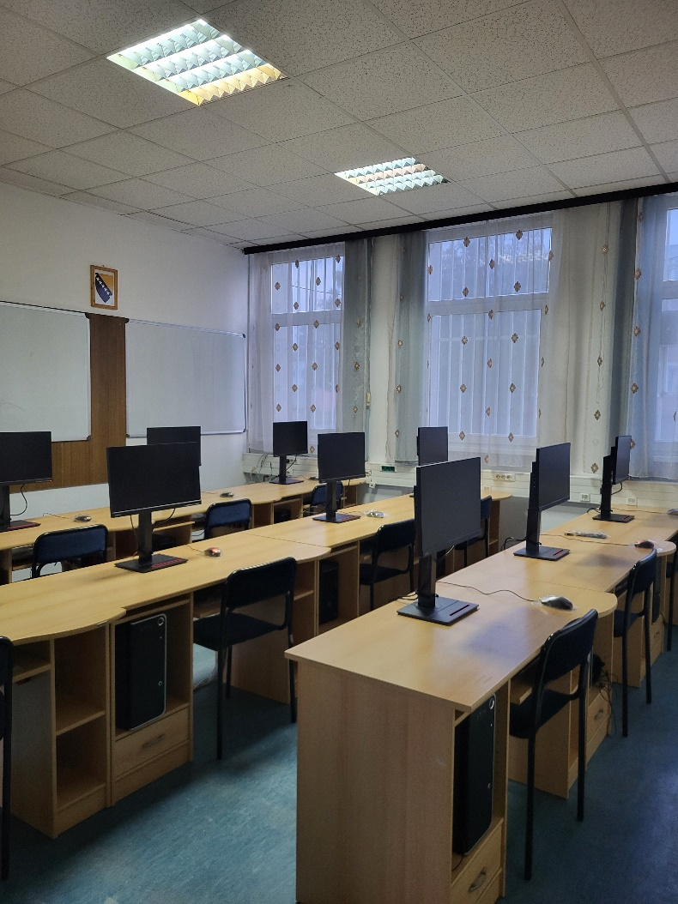
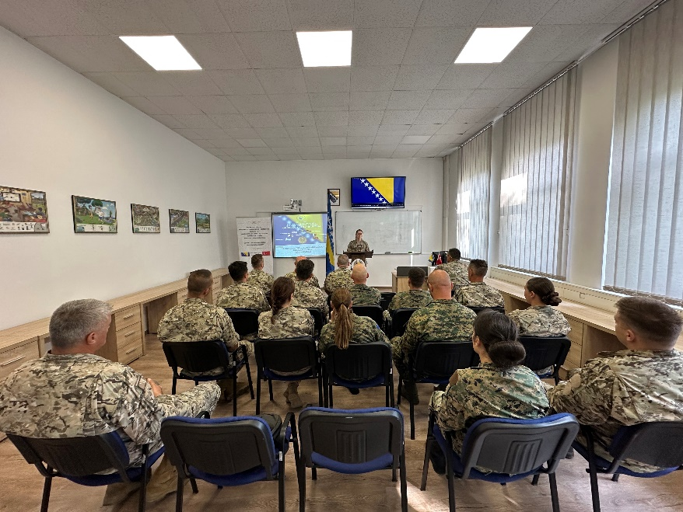
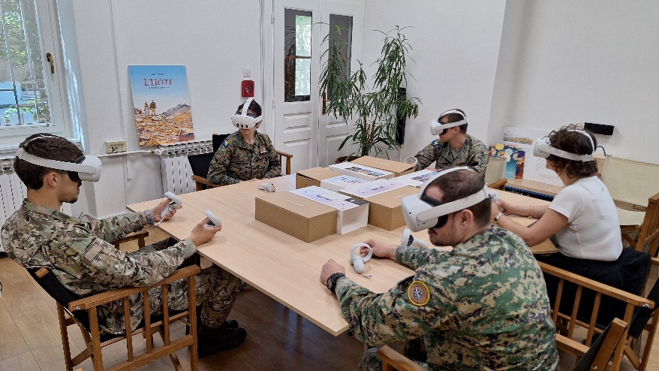
DFL within BiH MoD and AF BiH
BiH MoD
JS AFBiH
SC AFBiH
TRADOC
CPD
DFL
Sarajevo, September 2026

Slide 6
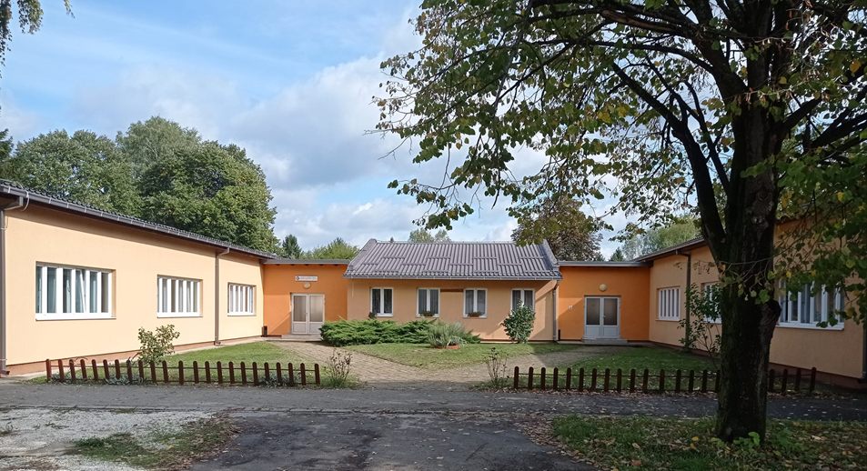
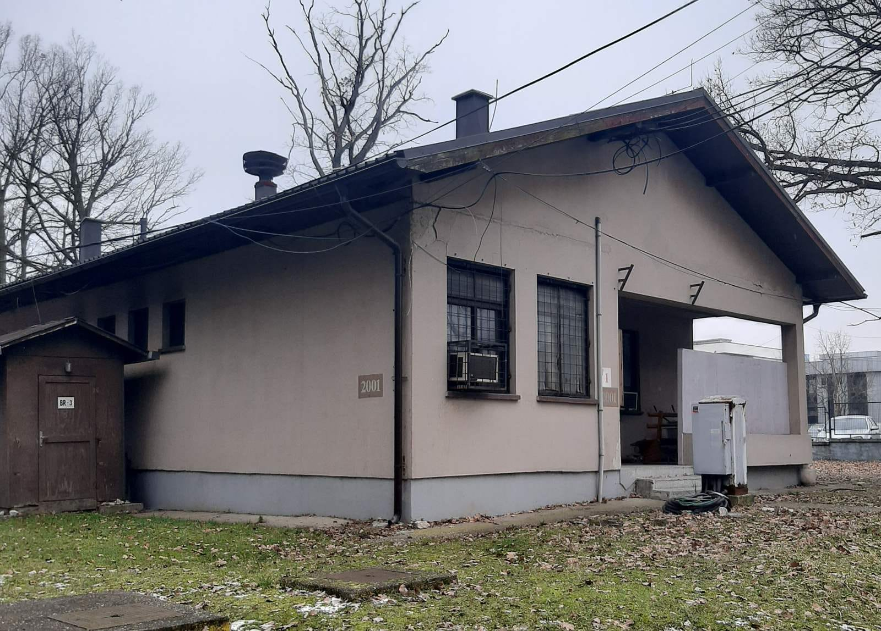
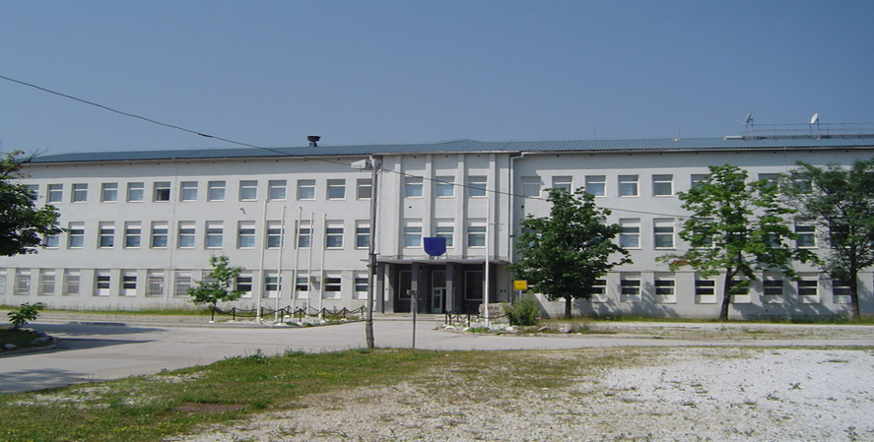
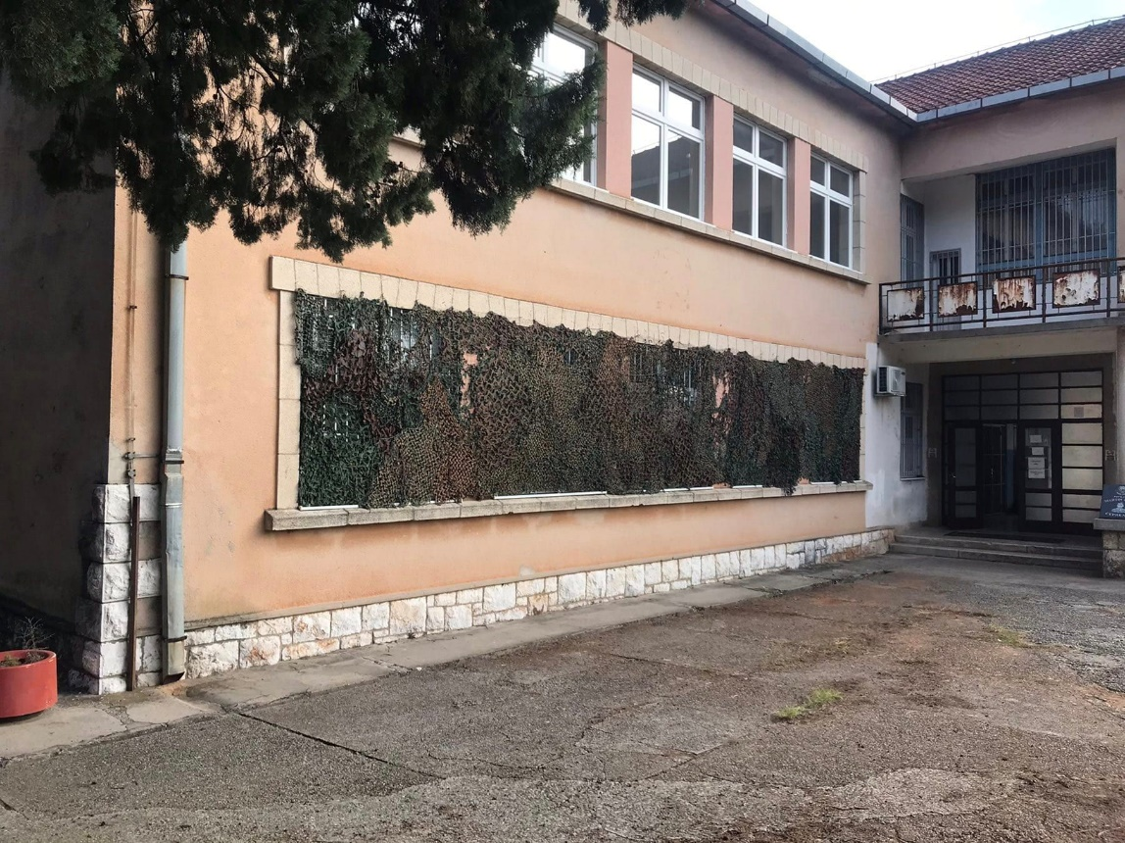
DFL Deployment (Lg Centres)
English Language Courses
(4 levels)
Greek Language Courses
(3 levels)
English Language Courses (3 levels)
Tuzla
Banja Luka
English Language Courses
(5 levels)
Sarajevo
Turkish Language Courses
(3 levels)
Turkish Language Courses
(3 levels)
French Language Courses
(3 levels)
Čapljina
German Language Courses
(3 levels)
Offical Languages in BiH
(2 levels)
English Language Courses (3 levels)

Slide 7
DFL Organisational Overview
DFL
English
Language
German
Language
French
Language
Turkish
Language
Greek
Language
Official Languages in BiH
30 INSTRUCTORS
5 LEVELS
REFRESHMENT
MIL. TERMINOLOGY
3 LEVELS
REFRESHMENT COURSES
2 LEVELS
INTENSIVE
INTENSIVE
INTENSIVE
NON-INTENSIVE

Slide 8
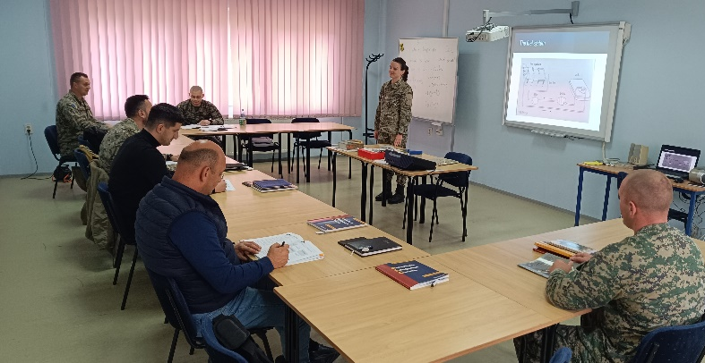
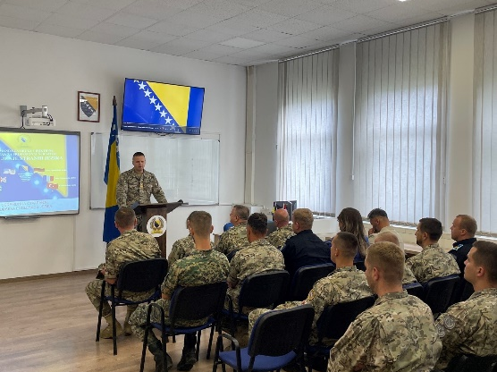
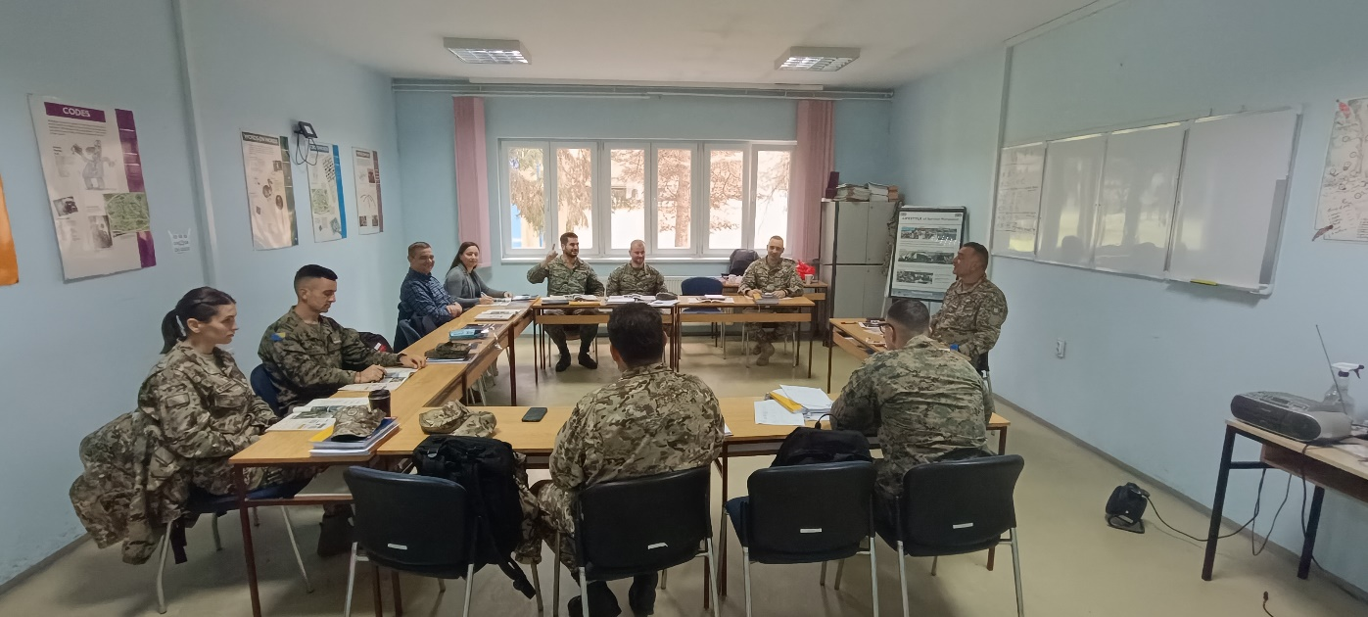
Capacities
400 Ss per year:
English Language
54 %
Turkish Language
14 %
German Language
9 %
Greek Language
9 %
French Language
9 %
BiH Official Languages
5 %

Slide 9
NATO BILC, DEEP for BiH
Basic Methodology Course
Advanced Methodology Course
Shadowing Intensive and Non-intensive Lg Programs
English Teaching Faculty Development
Language Standards and Assessment Seminar
Language Testing Seminar
Applied Consecutive Interpretation Techniques
EL Proficiency Building Course

Slide 10
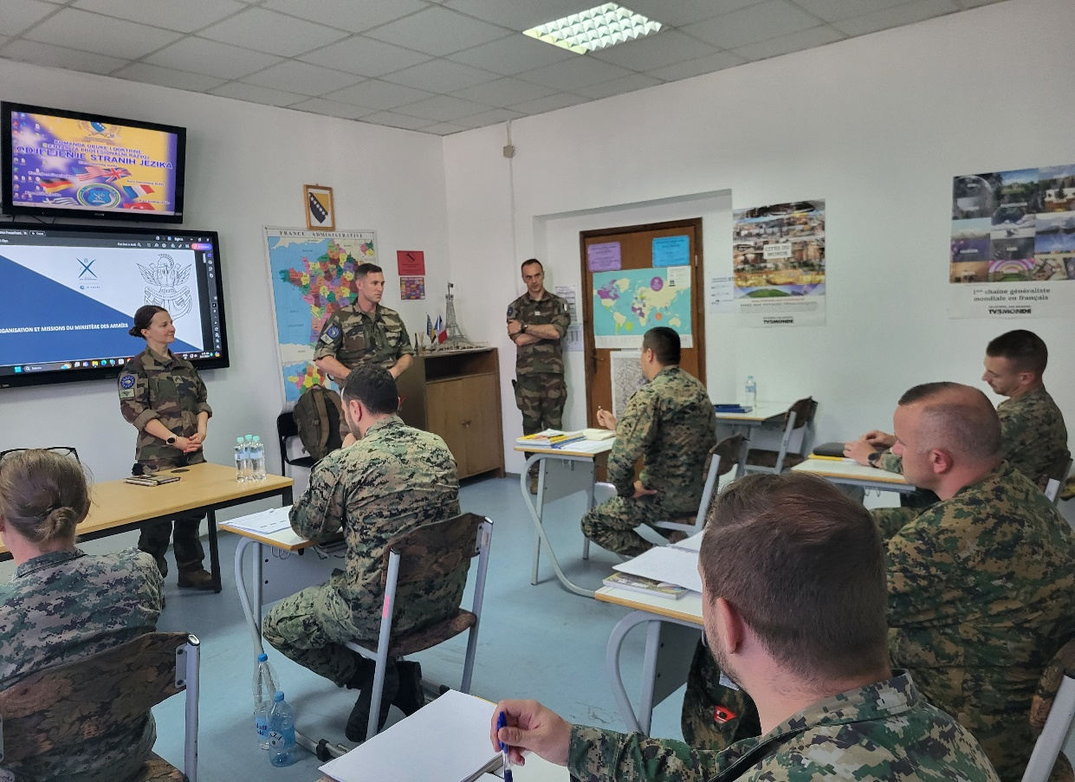
Courses and Testing in 2025
LANGUAGE COURSES | No of COURSES
ENGLISH | 18
TURKISH | 5
GREEK | 3
GERMAN | 2
FRENCH | 2
BiH OFFICIAL LANGUAGES | 2
TOTAL | 32
TESTING | No of Sessions | No of Candidates
TOTAL | 27 | 1200

Slide 11
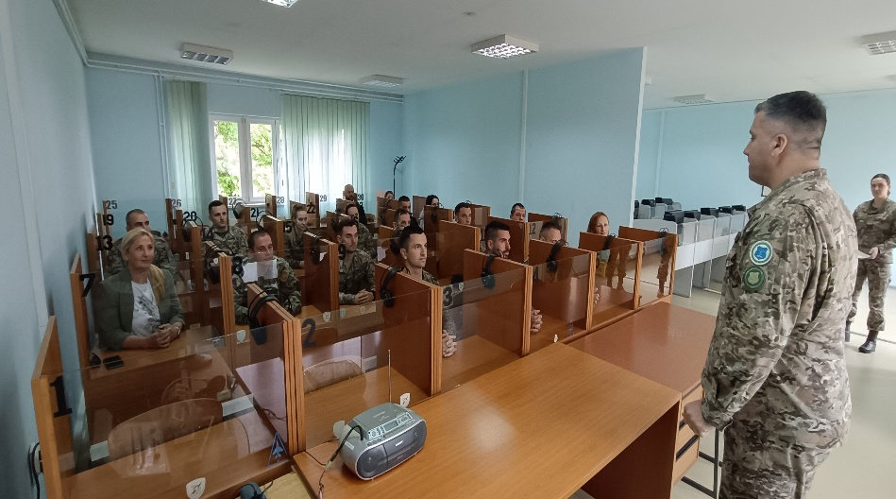
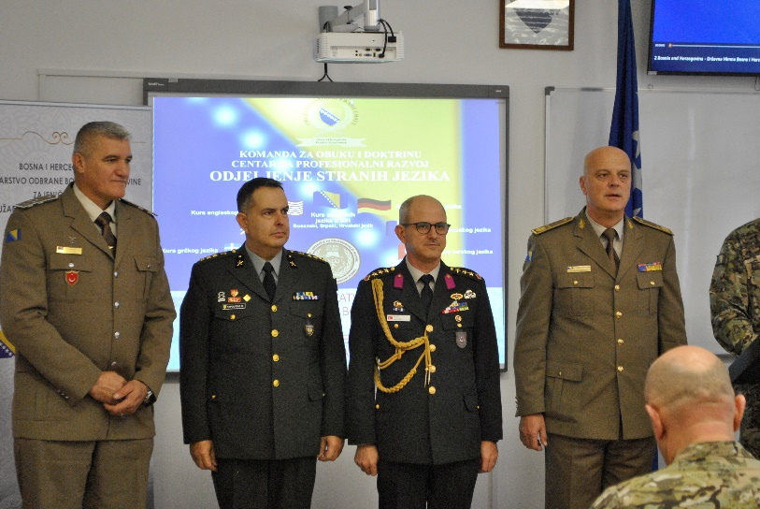
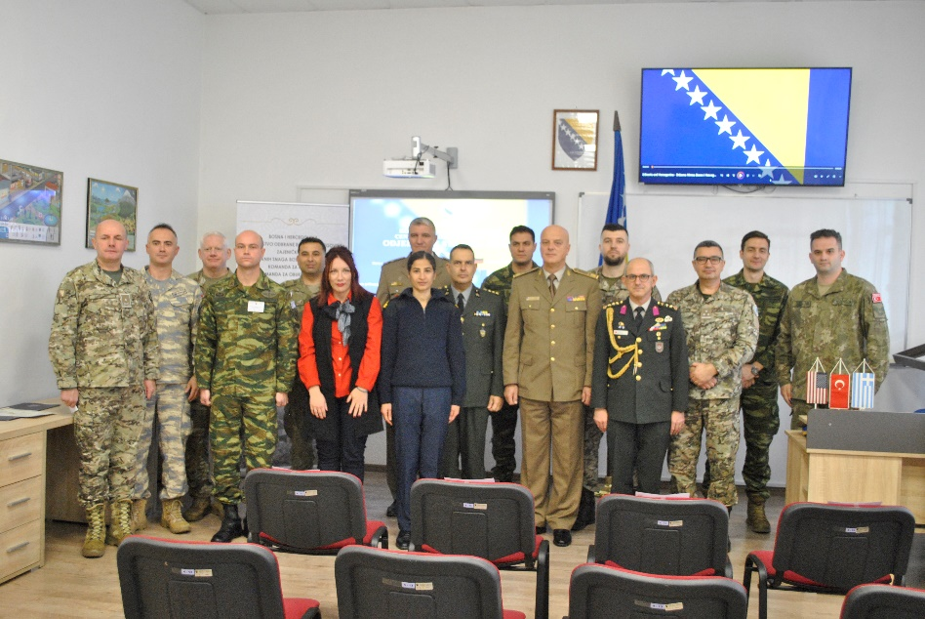
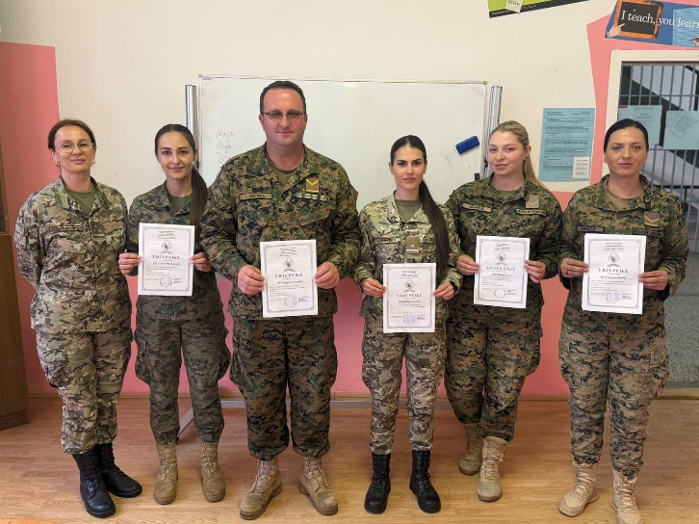
Questions
?

