Slide 1
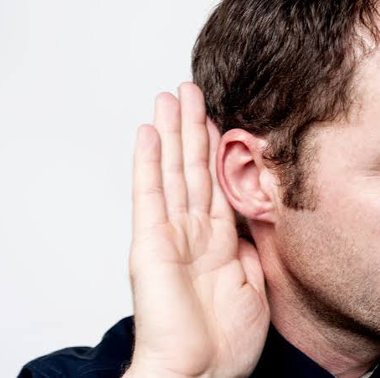

Panel A
Level 1 listening texts and items: challenges and solutions
Moderator: Tom Labidi

Slide 2





Panel Members:
Stefka Ganeva, BGR
Fabio Carnevali, ITA
Rodica Moșneguțu, MDA
Joanna Studzinska, POL
Dmytro Demydko, UKR

Slide 3
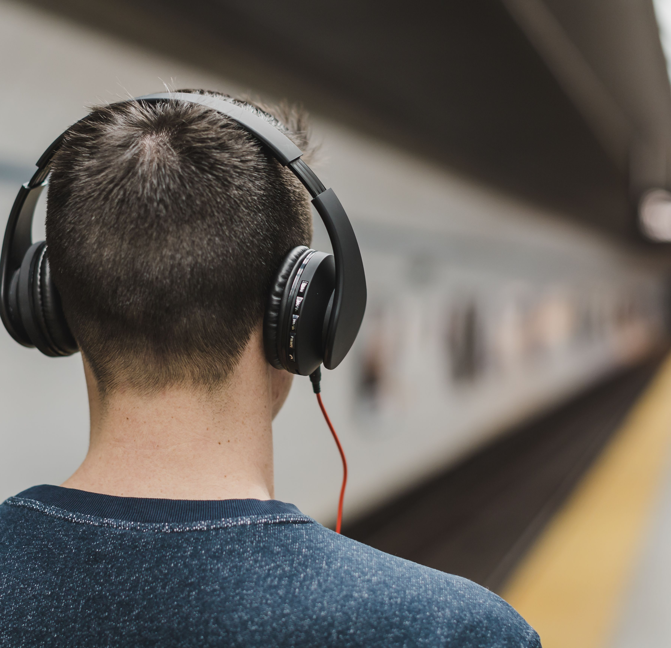
How does your team define authenticity in Level 1 listening?
How does your team develop Level 1 listening items? Do you use AI or other tools?
What challenges does your team face in Level 1 listening assessment?
How well do your tests balance real-world authenticity and practicality?

Slide 4

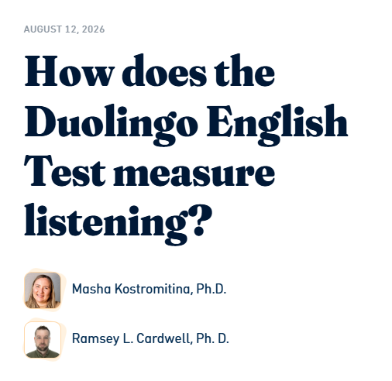

Resource:
Duolingo research page with links to additional research topics:
https://blog.englishtest.duolingo.com/

