Slide 1
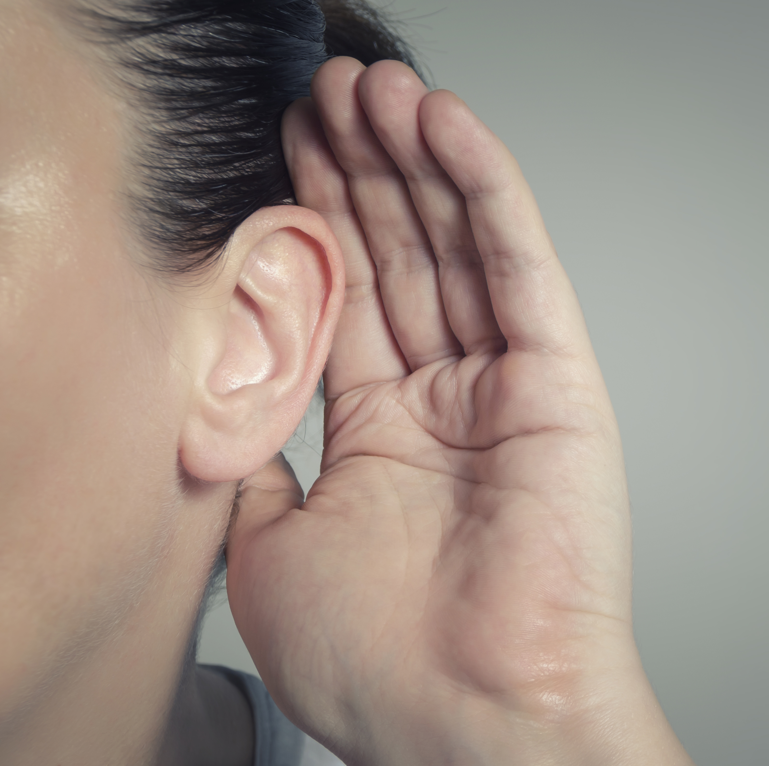

Panel B
Authentic language and English as a Lingua Franca (ELF) considerations
Moderator: Peggy Garza

Slide 2






Panel Members:
Karl Testor, AUT
Dorte Fensteen Nielsen, DNK
Maria Luisa Alía Alberca, ESP
Tamar Shavlakadze, GEO
Daniel Neto, PRT
Maria Celusnakova, SVK

Slide 3
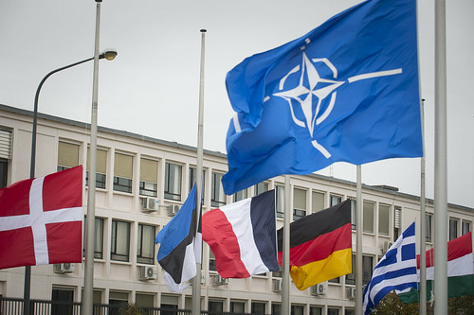
How does your nation interpret best practices guidance on authenticity and NATO English?
How does your nation incorporate native and non-native speakers?
How does your nation use AI-generated listening materials?
What role should AI play in creating and modifying listening tests?

Slide 4
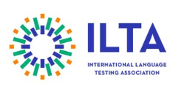
Resource:
International Language Testing Association (ILTA)
Webinar: Exploring the use of AI-generated voices to represent global Englishes in listening tests: Expert and test-taker perspectives
18 September, 9:00–10:00 a.m. US Eastern time/14:00–15:00 UK time
https://www.iltaonline.com/events/EventDetails.aspx?id=2080036
Leyla Karatay, Cambridge University Press & Assessment, will present research comparing AI-generated and human voices across different English varieties, examining perceptions of intelligibility, authenticity, fairness, and the potential use of AI-generated voices in operational listening assessments.
All webinars: https://www.iltaonline.com/page/ILTAWebinarSeries

