Slide 1


Panel C:
From national practices to best practices in listening assessment
Moderator: Andrea Gjorevski

Slide 2






Panel Members:
Kris Brams, BEL
Annie Bordeleau, CAN
Anika Dähn, DEU
Marju Laurits, EST
Viktorija Miciunaite, LTU
Ancuta Solomon, ROU

Slide 3

What listening item types do you use, and why?
What is your approach to repetition, and why?
Do you use visuals (e.g., video) in listening tests, and why?
Are test takers allowed to take notes?
What lessons have you learned, and what would you change?

Slide 4


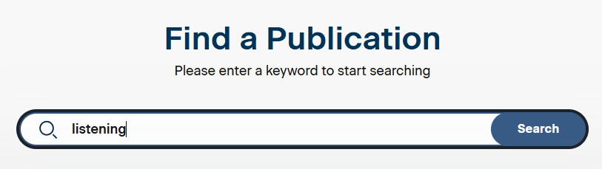
Resource:
Educational Testing Service
https://www.ets.org/research.html

