Slide 1
History of the STANAG 6001 Testing Workshops
Peggy Garza
Associate BILC Secretariat

Slide 2


STANAG 6001 Testing Workshops
2010 Sarajevo, BiH Testing speaking
2011 Stockholm, SWE Testing writing
2012 Copenhagen, DNK Testing listening
2013 SHAPE, Mons, BEL Integrating test development stages
2014 Reichenau, AUT Item development
2015 Vilnius, LTU Text editing, authenticity, L4
2016 Brno, CZE Validity & the validity argument
2017 Skopje, MKD Successful teams and Testing Best Practices
2018 Kranska Gora, SVN Trialling
2019 Tours, FRA Standardizing testing –lessons learned
2020 Online, ROU– PLTCE BBB Testing reading
2021 Hybrid, PLTCE Digital technologies & STANAG 6001 testing
2022 Bonn, DEU Testing in the Digital Age
2023 Riga, LVA New Technology & Maintaining Validity/Norming
2024 Bergen, NOR Sustaining Validity Through Multinational Collaboration
2025 The Hague, NLD Assessing Writing Proficiency in an AI Era

Slide 3
Workshop Goals
Norm with colleagues from other nations
Share successful practices and concerns
Learn from academia
Report on current research
Explore new trends (AI)
Provide updates to the LTS and ALTS and the BILC Website

Slide 4
Ideas for the Workshop Themes
Suggestions from the Host Nation
Recommendations from the STANAG 6001 Testing Community

Slide 5
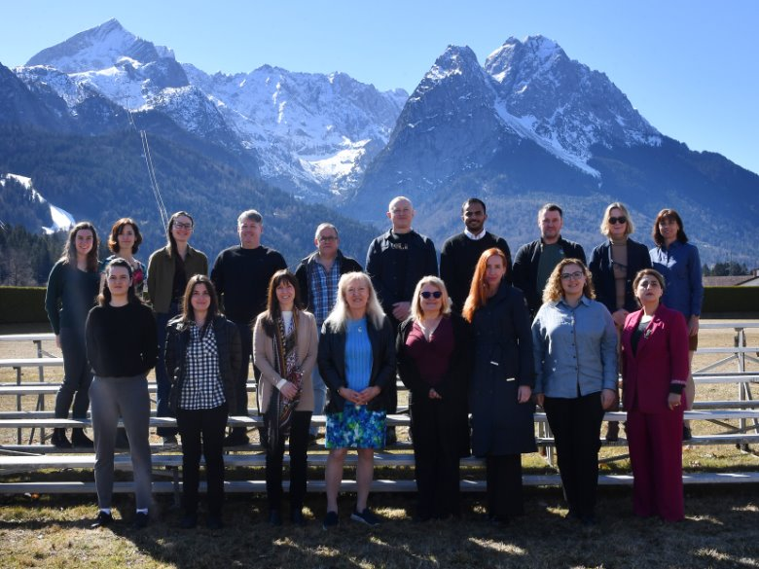
What about the 2026 theme?
We can thank the 2026 Advanced Language Testing Seminar (ALTS) participants!

