Slide 1



BILC SHARED ITEM BANK
Progress Update
NATO BILC Testing Workshop
Sarajevo 2026
Merit Kompus
Shared Item Bank WG

Slide 2
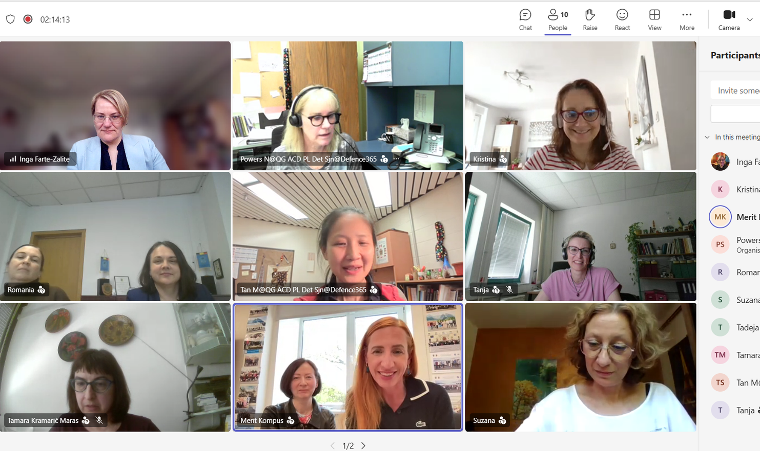
This is Us
Canada
Croatia
Estonia
Latvia
Romania
Slovenia

Slide 3
Project Overview
  Project launched in 2020 with seven nations
  Online collaboration,development and moderation
  2020–2021: Foundations and test specifications
  2024: Reading phase completed
  2026: Listening phase completed

Slide 4
Project Goals
  Develop reading & listening anchor items for STANAG 6001 Levels 1–3
  Support a common interpretation and application of the STANAG 6001 scale
  Promote best testing practices
  Strengthen NATO linguistic interoperability

Slide 5
Reading Phase
  42 items pretested with 1,000 candidates from 16 countries
  14 reading anchor items released in 2024
  Guidelines on the Use of Anchor Items
  Development report distributed
  6 sample items published on the BILC website
  18 countries requested and received access
  Feedback collected from participating countries
  Other interested countries can still request access

Slide 6
Listening Phase
  Two-year development cycle
  18 online moderation sessions
  82 items developed → 59 retained
  Items piloted on 40 teachers → 57 retained
  Items pretested (Oct 2025 – Feb 2026)
  920 candidates from 18 countries
  Statistical analysis completed
  13 anchor items: L1 - 4, L2 - 3, L3 - 6

Slide 7
Following the TW
  Release of listening anchor items: September 15
  Distribution of the item development report
  Guidelines on the Use of Anchor Items
  Sample listening items on the BILC website

Slide 8
Contact Information
sibanchoritems@gmail.com
Suzana Horvat, Merit Kompus, Marju Laurits

Slide 9
Next Steps
Revising Best Practices in STANAG 6001 Testing by
        building on the SIB experience
        gathering input from the BILC community
        keeping up with developments in language testing

