Slide 1
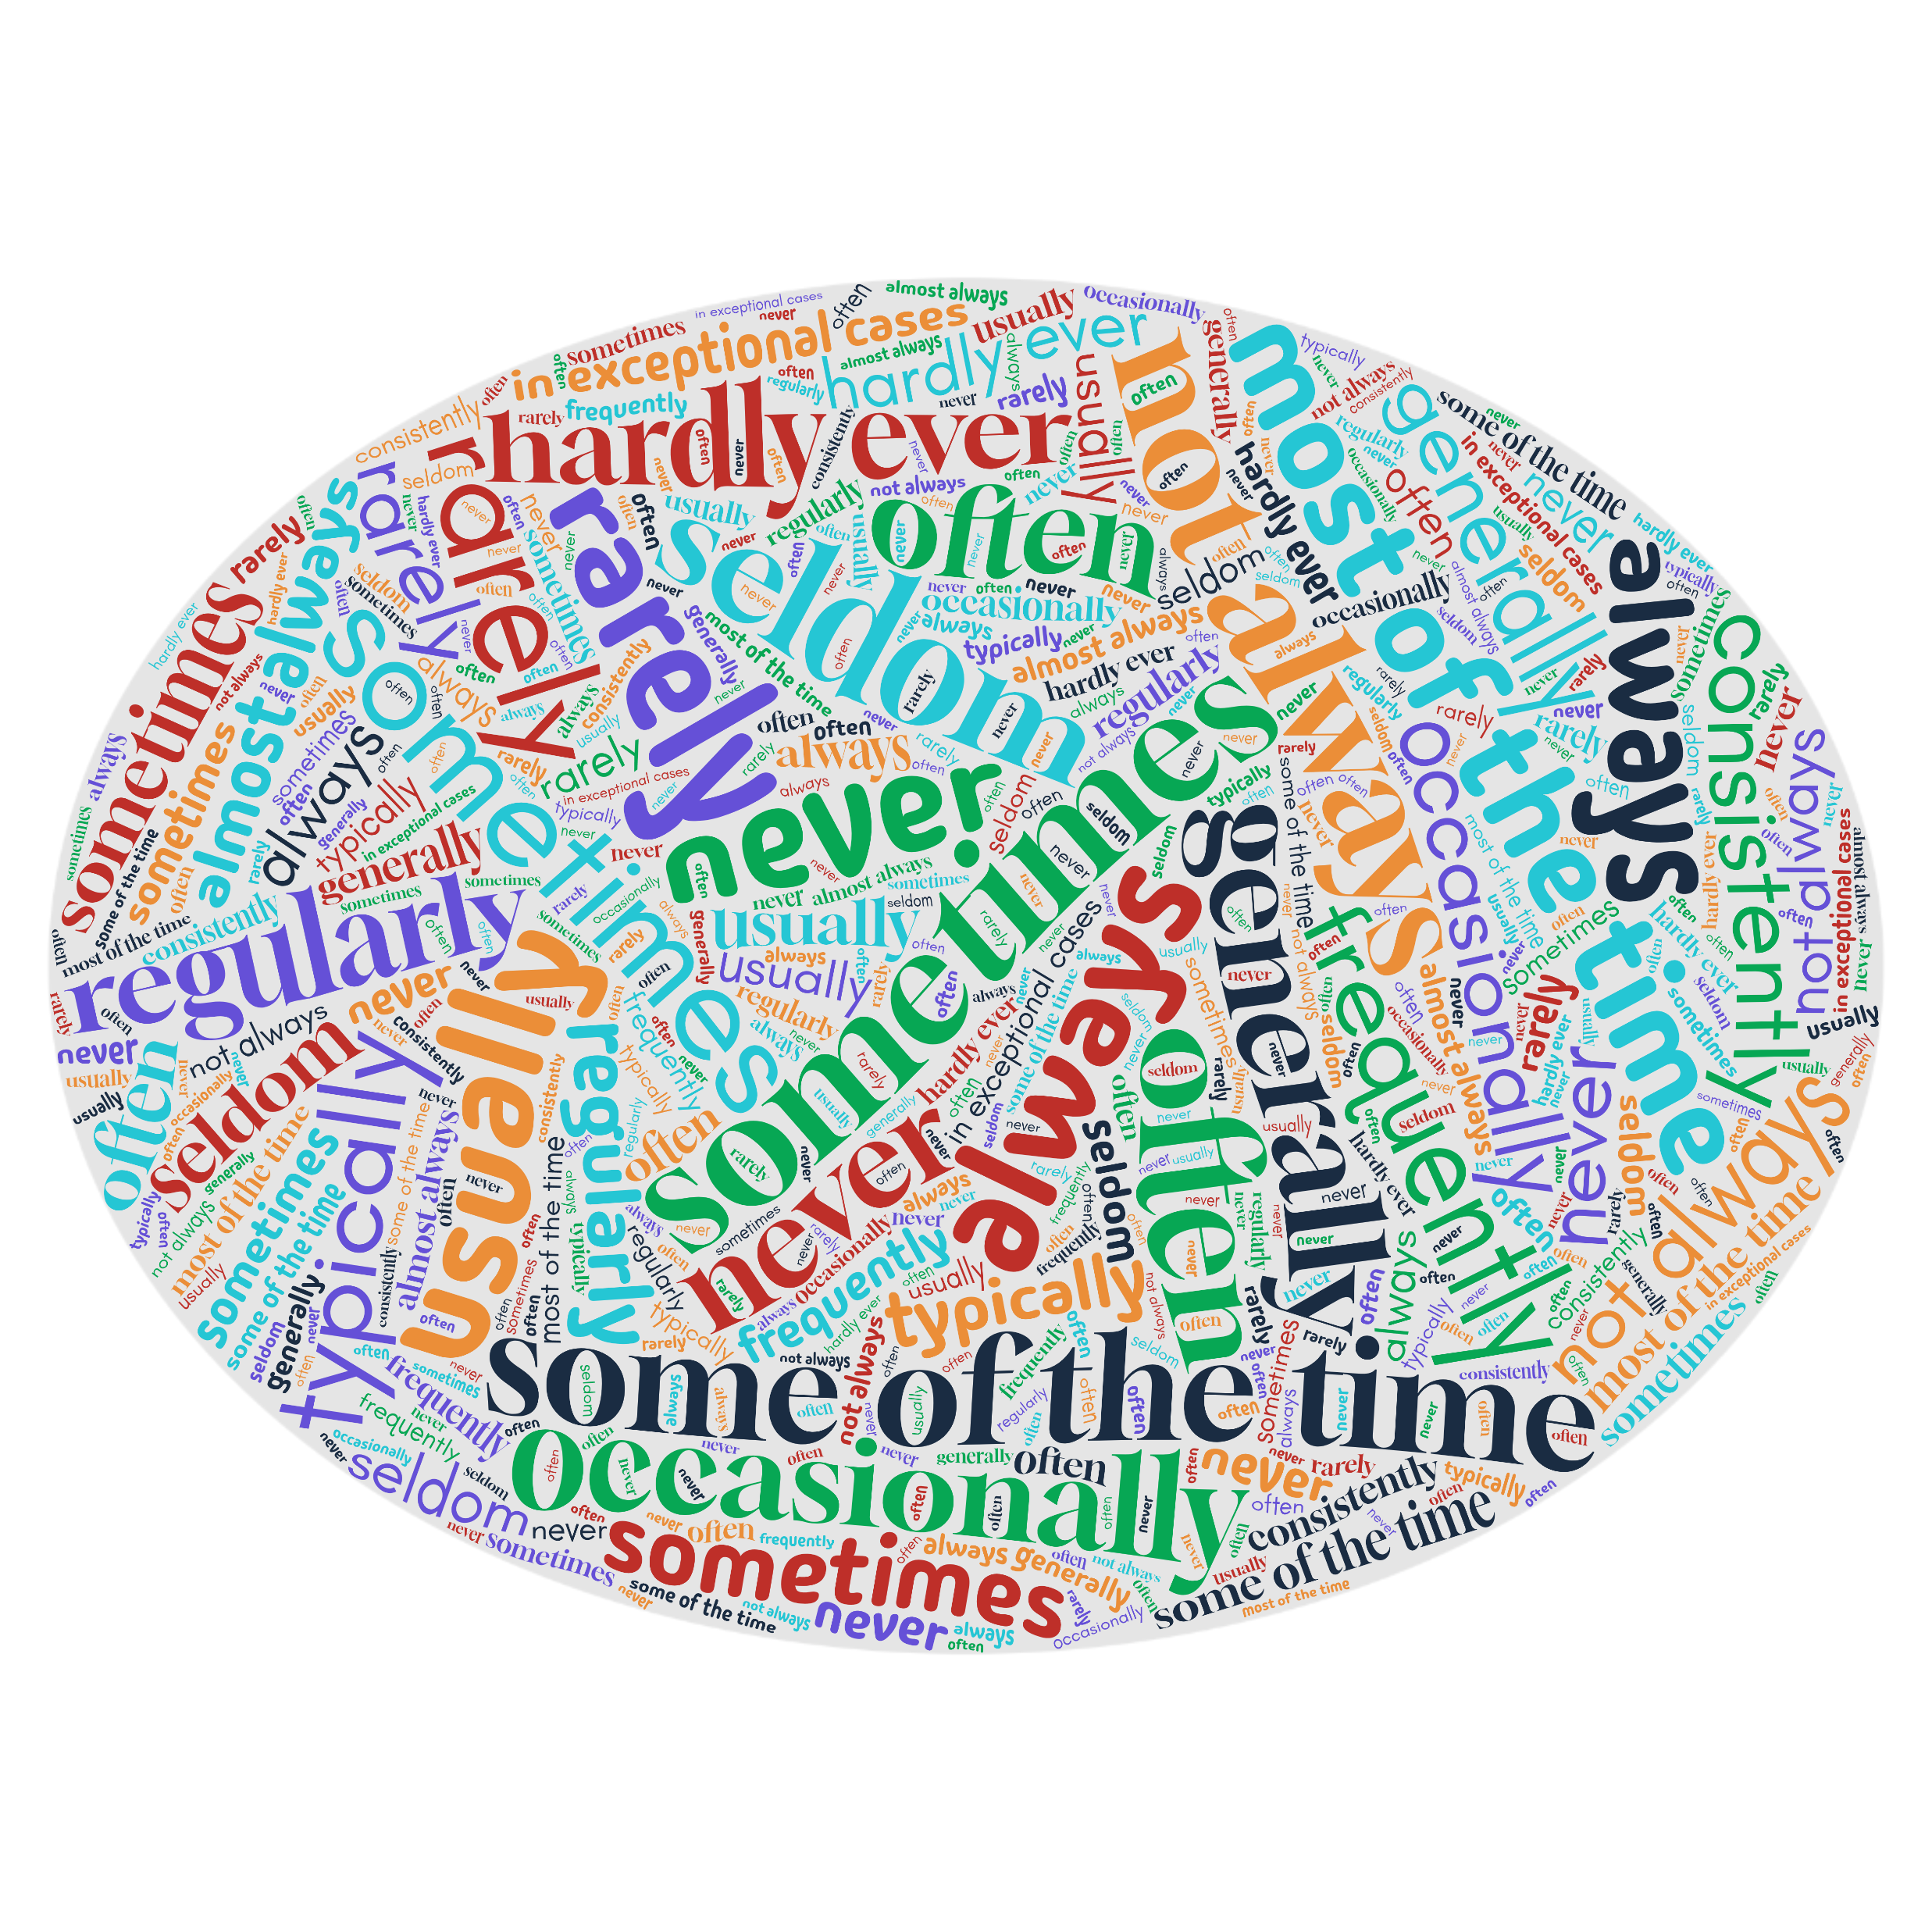
How often is “sometimes”?
Interpreting frequency expressions in language proficiency descriptors
Gerard Seinhorst
Netherlands Defence Language Centre
BILC STANAG 6001 Testing Workshop 2026 - Sarajevo

Slide 2
The motivation
What do language professionals actually understand by “usually”, “often” and “occasionally”?
  Are the expressions interpreted approximately in the same way?
The concern
The alternative
The purpose of the study
If “usually” or “often” mean substantially different things to different users, descriptor interpretation and assessment could become less consistent
If users converge on broadly similar interpretations, this would support continued use of frequency expressions in language proficiency descriptors
Measure the degree of shared interpretation

Slide 3
The survey
The questionnaire combined quantitative and qualitative elements
1
Professional background and familiarity using language descriptors
Assigning a numerical value to 20 frequency expressions, using a common carrier phrase: “The language user can ________________ complete the task”.
2
3
Identify expressions that were found difficult to interpret and explain why

Slide 4
The study
What did the study investigate?
1
How do respondents interpret 20 frequency expressions on a common 0-100 scale? *
2
Which expressions show the greatest and least agreement among respondents?
3
Do professional background and experience with descriptors matter?
4
Which expressions are difficult to interpret – and does that correspond to observed variation?
* The 0–100 scale was a common measurement tool for comparing interpretations –
not an attempt to define the expressions numerically

Slide 5
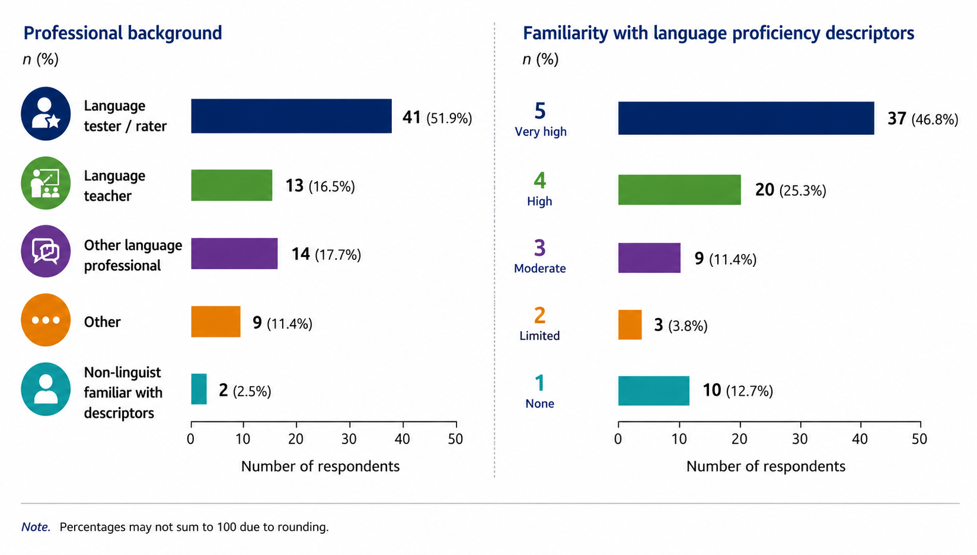
79 Respondents
The comparison of particular interest: experienced testers/raters versus teachers and other language professionals

Slide 6
Disclaimer
The study investigated interpretation of frequency expressions;
it did not investigate whether differences in those interpretations produce differences in rating decisions.

Slide 7
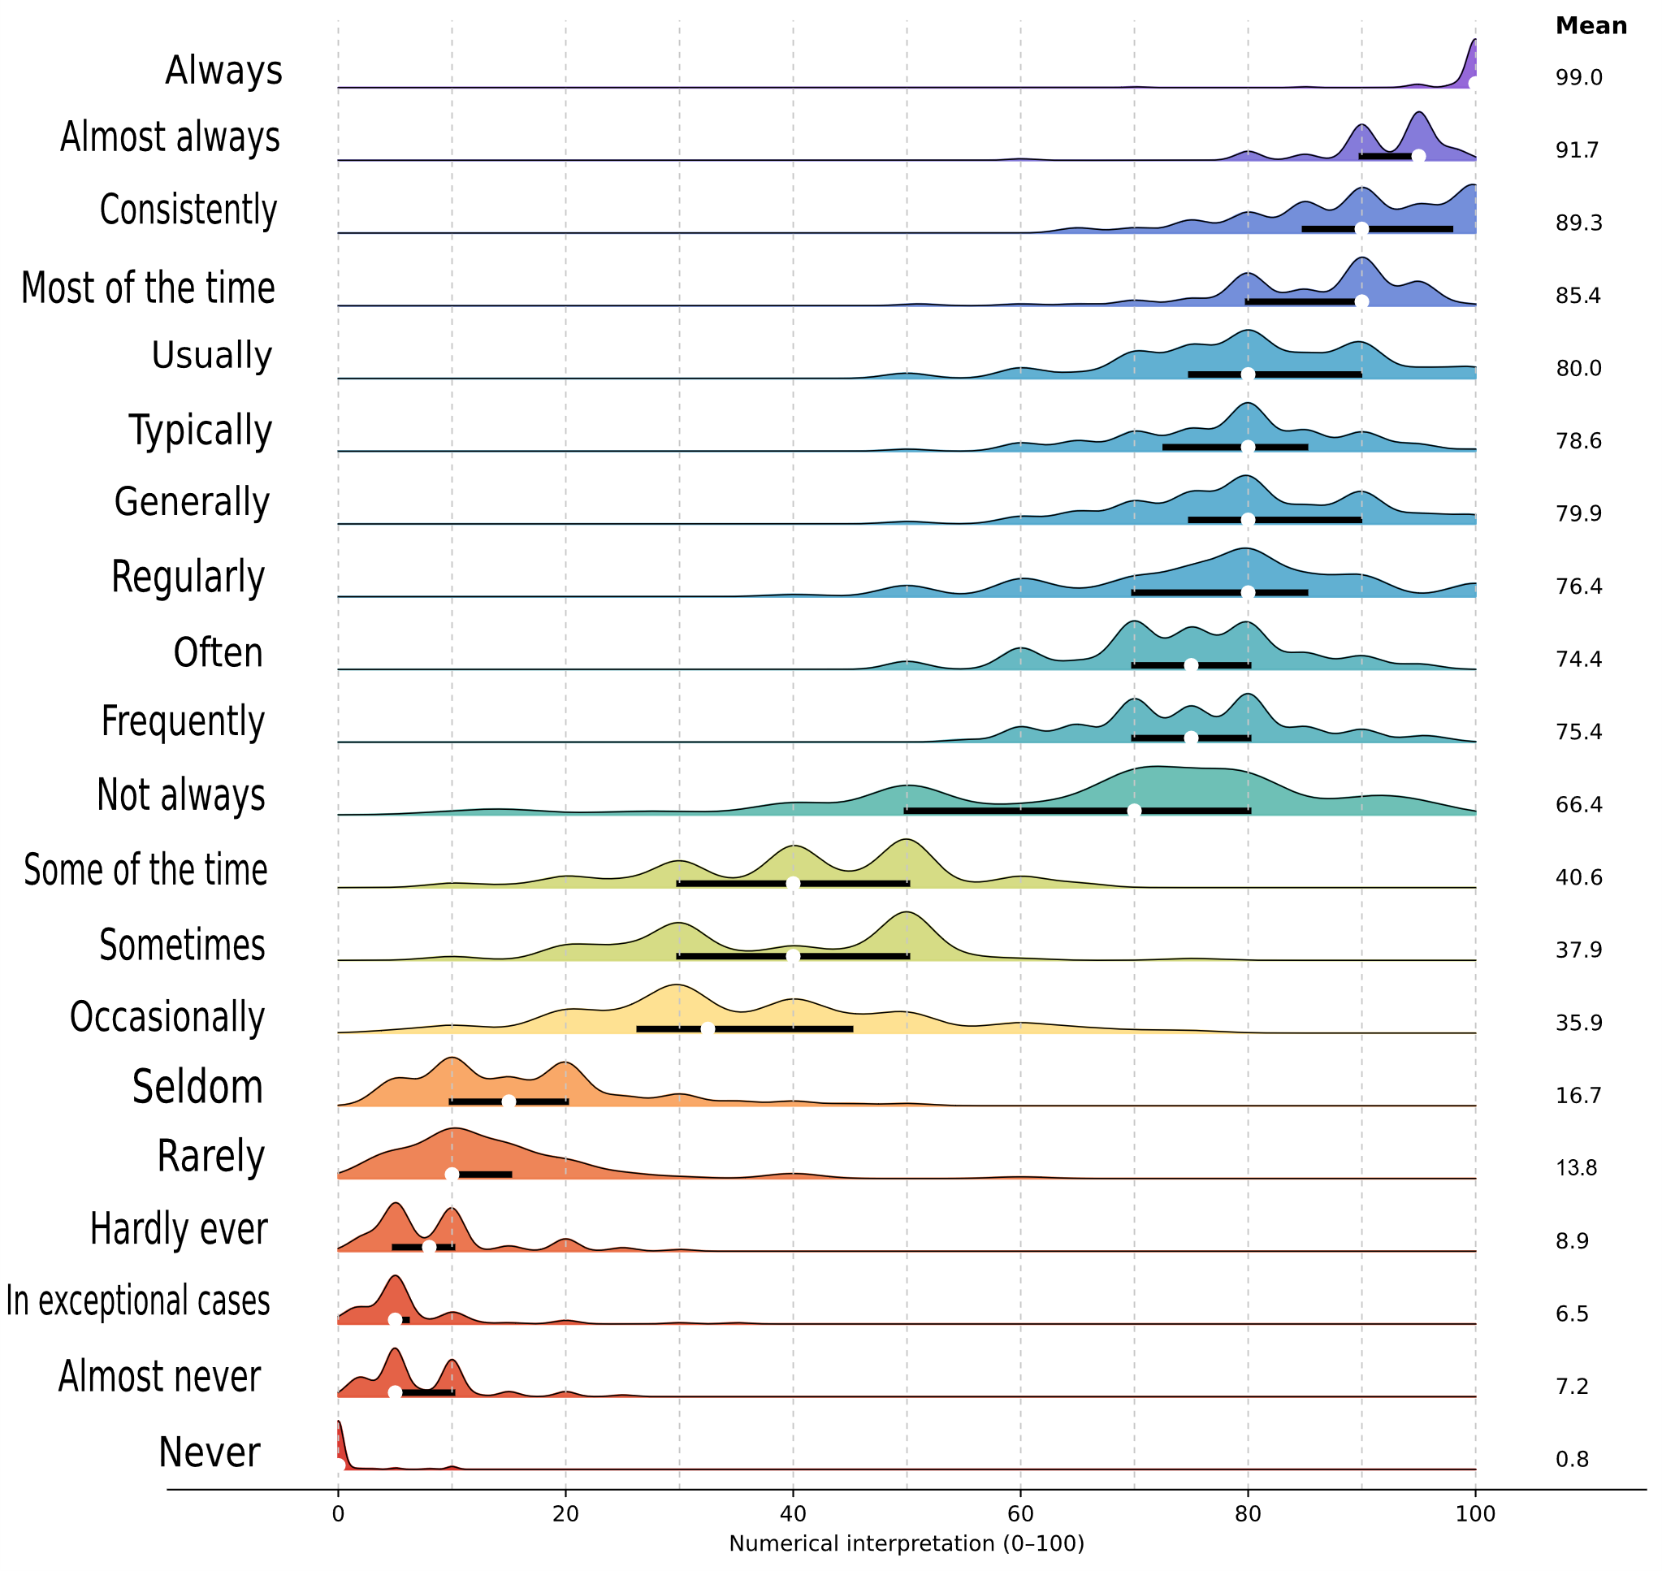
The results
The white dot represents the median, the black horizontal bar the Interquartile Range (the range containing the middle 50% of responses)
Narrow ridges indicate relatively strong agreement; broader distributions indicate greater variation in interpretation

Slide 8
Interpretation differences
Low agreement
High agreement
IQR: the range containing the middle 50% of responses

Slide 9
Emerging patterns - 1
Many expressions form overlapping semantic clusters
VERY LOW FREQUENCY
LOW-MEDIUM FREQUENCY
HIGH FREQUENCY
often (75)
almost never (5)
frequently (75)
in exceptional cases (5)
occasionally (30)
regularly (80)
hardly ever (8)
sometimes (40)
generally (80)
rarely (10)
some of the time (40)
typically (80)
seldom (15)
usually (80)
Near-synonymy may create overlap without undermining shared understanding

Slide 10
Emerging patterns - 2
Not all expressions function alike
Not always (70)
– a logical exception
Consistently (90)
– a conceptual exception
It does not directly specify how often something occurs. It merely excludes one possibility: 100%
That allows a very broad range of interpretations, reflected in the largest IQR (30)
It refers primarily to stability or reliability across repeated performances rather than simply to the frequency of an event
Assigning a single percentage therefore feels less intuitive
  Expressions can occupy similar numerical regions
  while being conceptualised in fundamentally different ways

Slide 11
Emerging patterns - 3
Difficulty to interpret does not necessarily mean disagreement on meaning

Slide 12
Difficult to interpret, but showing high agreement
Difficult to interpret, and showing low agreement
Respondents reporting the expression as difficult to interpret (%) - (N=79)
Not difficult to interpret, and showing high agreement
Not difficult to interpret, but showing low agreement
Observed variability in interpretation
Interquartile range (0-100 scale)

Slide 13
Do testers/raters interpret the expressions differently?
Differences between the two main professional groups were modest
Experienced testers / raters
Teachers and other language professionals
showed somewhat greater agreement with one another, particularly for expressions in the middle of the frequency continuum
showed broadly similar patterns of interpretation
No fundamentally different interpretation system emerged
The data do not suggest two fundamentally different understandings of the expressions

Slide 14
Main findings
The expressions are interpreted approximately - as could be expected
The variation is not random: clear patterns emerge in how expressions are positioned along the frequency continuum
Many expressions occupy recognisable and overlapping semantic regions
Some expressions show considerable agreement despite being difficult to quantify
Some apparently problematic expressions are problematic for quite specific linguistic reasons (e.g. not always and consistently)
Testers/raters do not appear to operate with a fundamentally different interpretation system from teachers and other language professionals.

Slide 15
Key take-away
Language professionals appear to share a considerably greater degree of common understanding of frequency expressions than they themselves often assume

Slide 16
What does it mean for BILC?
1
Retain frequency expressions
Do not replace them systematically with fixed numerical definitions or percentage ranges
2
Use the findings to guide descriptor writing
Pay particular attention to overlapping expressions, broader variation and structurally unusual expressions such as “not always”
3
Strengthen shared interpretive practice
Continue calibration, moderation, standardisation and professional dialogue
Examine how these expressions function in complete descriptors and authentic assessment contexts; investigate any causal relationship between difference in interpretation and difference in rating decisions
4
Continue research

Slide 17
A final thought…
Frequency expressions do not specify an exact numerical boundary because the language performance they describe does not have an exact numerical boundary
A descriptor saying “can usually perform this language task” describes a pattern of performance, not an exact number of cases in which someone can perform the task
Performance naturally varies across tasks, contexts, occasions and levels of complexity

Slide 18
“FUNCTIONAL VAGUENESS”

Slide 19
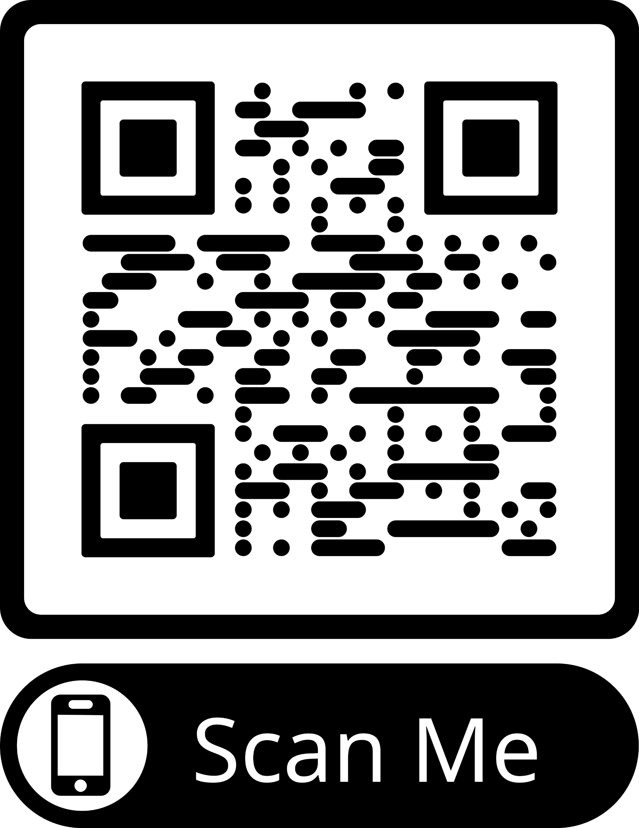
Full report
0r click here: Interpreting Frequency Expressions
Thank you for your attention!

