Slide 1
Sharing AI tools in Language Testing
Mary Jo & Inga
Sarajevo 2026

Slide 2
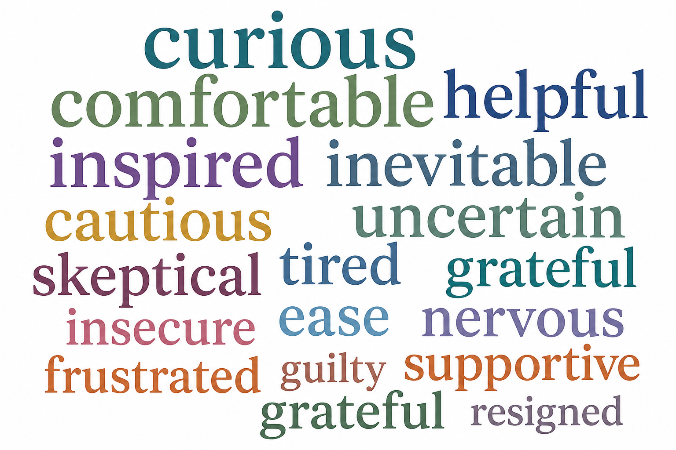
Sharing AI tools in Language Testing
Concerns
Bias
Hallucinations/ lies
AI-generated feedback/ rating → legal issues
Privacy and ethics
(Potential) loss of jobs – only AI/ both humans & AI in testing?
Cognitive decline of AI users
Loss of skills
Potential test compromise

Slide 3
Sharing AI tools in Language Testing
Discussion questions
Where could AI genuinely improve language test development?
What ethical concerns matter most in language testing?
What are the areas where human judgment should prevail?
AI Marketplace
Chat GPT/ Google AI/ Copilot/ Gemini/ Notebook LM/ Elevenlabs
item/ distractor development & inspiration
proofreading & paraphrasing
editing texts to fit level & length requirements
analysing faulty items
rating written performances
links to sources
creating podcasts

