Slide 1
Listening Assessment from the Perspective of
Computer-Assisted Language Testing:
Opportunities, Challenges and Best Practices
NATO BILC STANAG 6001 Testing Workshop
1-4 September 2026 Sarajevo, Bosnia - Herzegovina
Tamar Shavlakadze / Foreign Language Testing Division
Training and Military Education Command, Ministry of Defence of Georgia

Slide 2
Our CALT Story
From rationale to ongoing validation
• Why we moved to CALT
• How we developed and piloted the programme
• What worked — and what did not
• Listening assessment in the new environment
• What comes next
2

Slide 3
Why Move to CALT?
~900
candidates per year
• High-stakes testing for promotion, study abroad and international positions
• Traditional listening rooms can introduce variation: acoustics, noise and distraction
• Aim: a more efficient, standardised, fair and evidence-based STANAG 6001 testing system
3

Slide 4
From Paper to CALT
The goal was not simply to digitalise an existing test
How can we transfer STANAG 6001 testing to a digital environment
without changing the construct we intend to assess?
• Close cooperation between testers and software developers
• Test format, administration, scoring and required system functions defined together
4

Slide 5
CALT Development Roadmap
Nine stages — but not a completely linear process
1. Needs
Analysis
2. Conceptualisation
& Planning
3. Programme
Development
4. Internal
Testing
5. Piloting
6. Feedback &
Evidence
7. Revision &
Improvement
8. Implementation
9. Ongoing
Monitoring &Development
5

Slide 6
Piloting: Where We Learned Most
“We did not expect the process to be flawless — and it was not!”
• Large-scale piloting under realistic testing conditions
• Technical and usability issues became visible
• Test-taker feedback provided evidence for revision
• Piloting became part of the development cycle — not the final confirmation
6

Slide 7
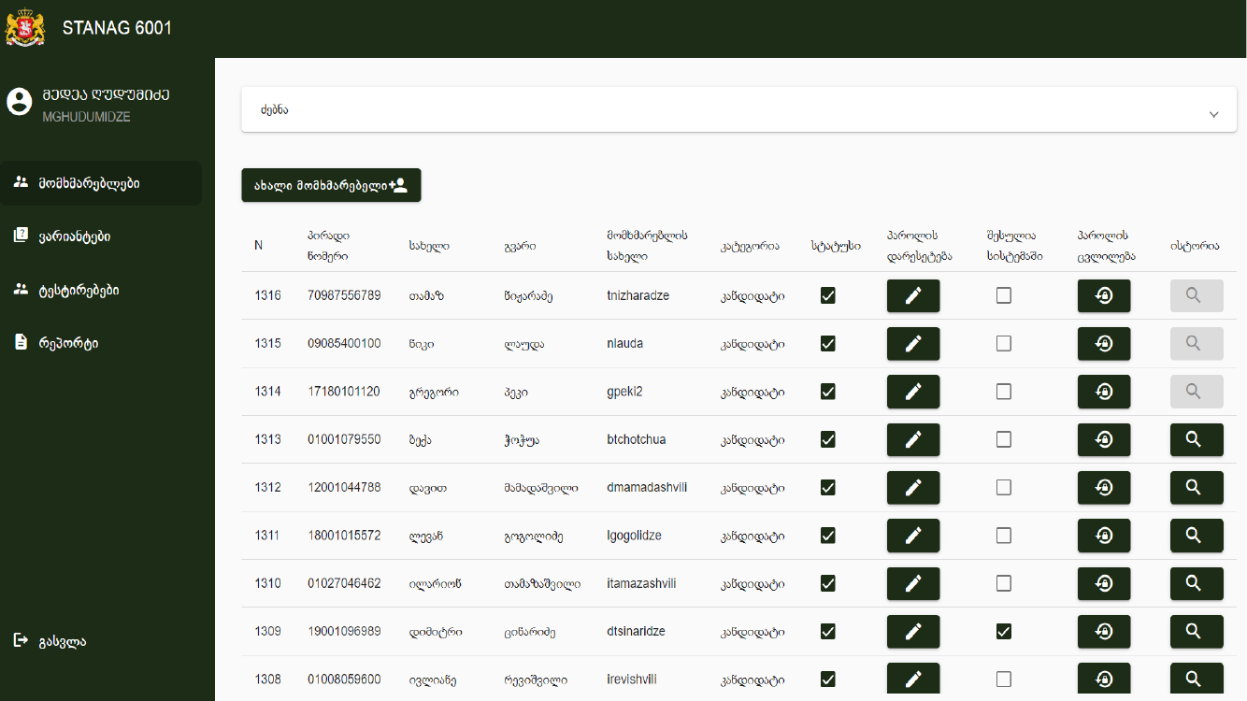
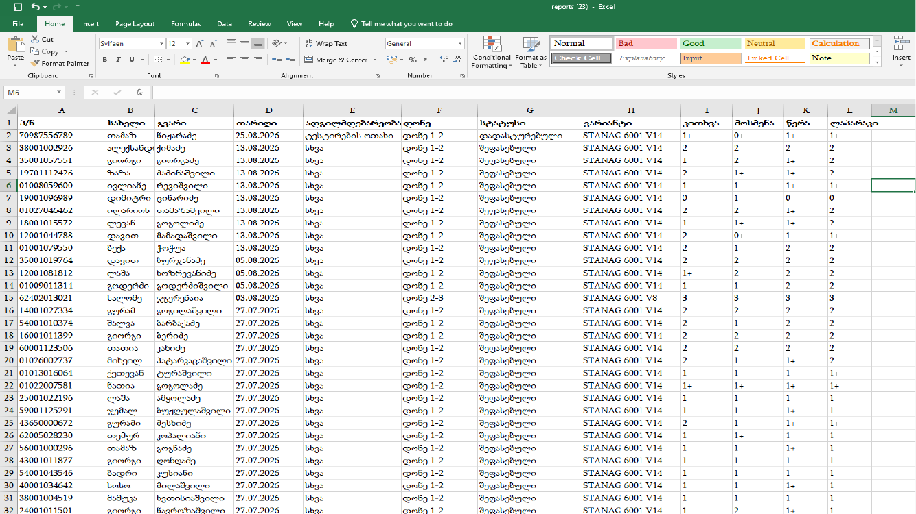
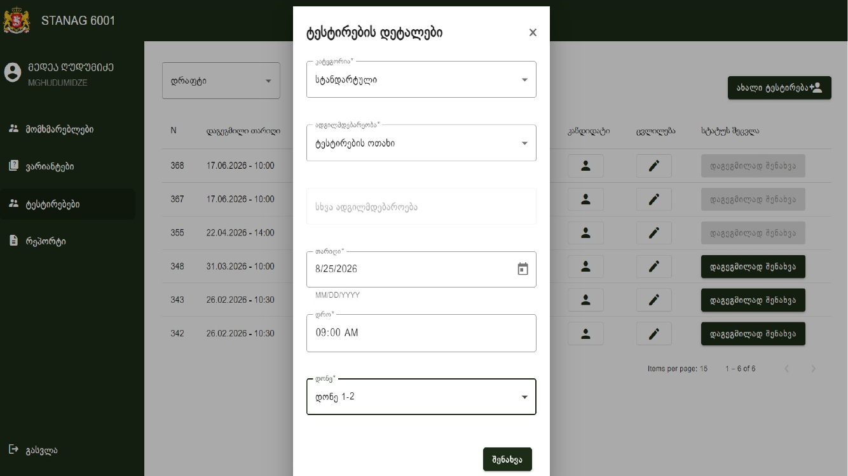
Test Administration Workflow
From administrator access to scheduling the session
• Capacity: up to 40 candidates at a time.
• Reports can be downloaded for record keeping.
• If testing is interrupted, candidate work is automatically saved so the test can resume from the point where it was interrupted.
10

Slide 8
Listening Assessment in Practice
Each format involves trade-offs: our priority is to balance practicality, construct representation and authenticity.
Bi-level 1 & 2
Bi-level 2 & 3
15 Level 1 items / 15 Level 2 items
Approx. 45 minutes
MCQ Items (3 options)
Authentic Level 2 recordings
15 Level 2 items / 15 Level 3 items
Approx. 90 minutes
MCQ Items (3 options)
Authentic level 3 recordings
12

Slide 9
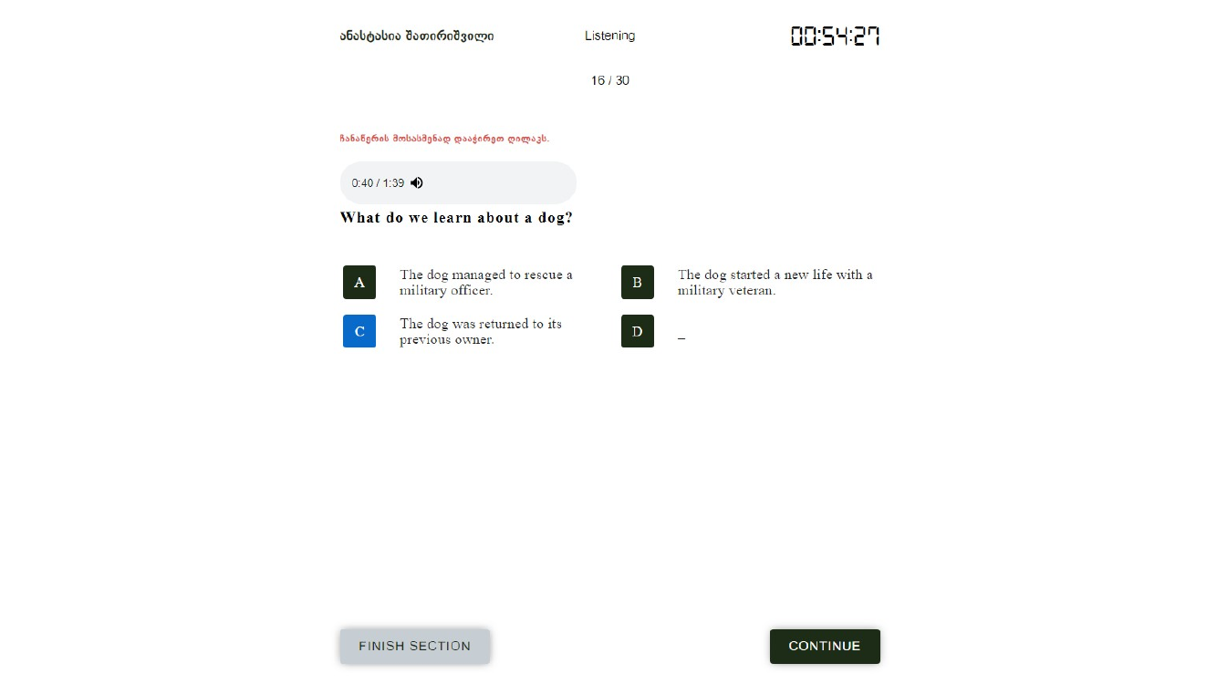
Candidate Listening Interface
A controlled individual listening environment
• Candidates can review the answer options before listening.
• At present, they can choose to listen once or replay the recording.
13

Slide 10
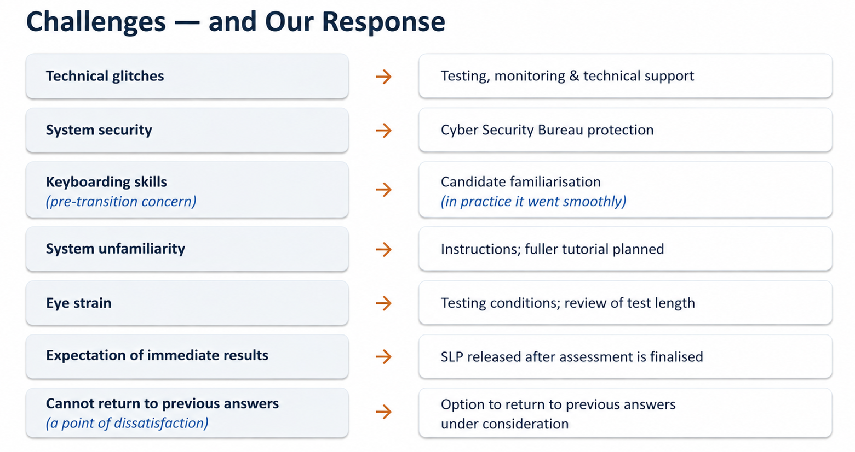

Slide 11
What CALT Offers
Candidate perspective
Testing perspective
The transition to CALT has particular significance for listening assessment
Individual headphones reduce acoustic interference and provide more consistent listening conditions.
Easy editing and revision; Visible word count
Better control of time and progress
More consistent delivery conditions
Reduced scoring error in objectively scored components
Greater standardisation of administration
Items are mixed within each level to reduce test compromise
8

Slide 12
A Key Question: One Listening or Two?
Current practice
Issue under review
LEVEL 1&2: Candidates choose whether to listen once or twice (candidate-friendly solution; reciprocal)
LEVEL 2&3: Replay policy still under review (Level 3 nonreciprocal)
• Moving to one listening is being considered
• It would also reduce the length of the bi-level 2&3 test
15

Slide 13
Activate Spell-Check or Not?
A technology choice that becomes a construct decision
✓
ENABLE
×
DISABLE
Authenticity / TLU alignment
Independent language control
Reflects the modern workplace
Preserves evidence of unaided writing control
Commonly available in the TLU domain
Spelling may help differentiate Levels 2 and 3
Supports authentic writing conditions
Avoids masking spelling or lexical weaknesses
KEY QUESTION
Does spell-check increase authenticity — or alter the construct being assessed?
Technology choice → Construct decision

Slide 14
The Way Ahead
CALT is an ongoing process of development, monitoring and validation
• Develop a fuller computer-based tutorial and FAQ.
• Review and update testing policy.
• Revisit listening replay policy and overall test length (Levels 2&3)
• Continue collecting candidate feedback, technical evidence and test data.
• Continue evaluating whether digital features support — rather than alter — the intended construct.
17

Slide 15
Validation does not end when a test/testing system becomes operational
Going digital was not the final destination.
It was the beginning of another stage in the development and validation
of the national STANAG 6001 testing system.
Thank you for your attention!

